Slide 1
Distributed and Cloud Computing
K. Hwang, G. Fox and J. Dongarra
Lecture Note 1: Enabling Technologies and Distributed System Models
Copyright © Elsevier Inc. All rights reserved.

Slide 2
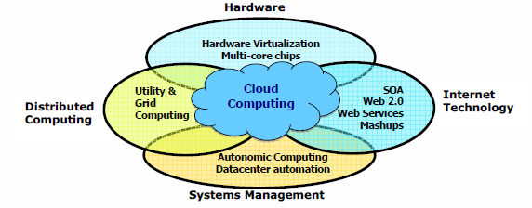
Data Deluge Enabling New Challenges
(Courtesy of Judy Qiu, Indiana University, 2011)

Slide 3
From Desktop/HPC/Grids to Internet Clouds in 30 Years
HPC moving from centralized supercomputers
to geographically distributed desktops, desksides,
clusters, and grids to clouds over last 30 years
R/D efforts on HPC, clusters, Grids, P2P, and virtual
machines has laid the foundation of cloud computing
that has been greatly advocated since 2007
Location of computing infrastructure in areas with
lower costs in hardware, software, datasets,
space, and power requirements – moving from
desktop computing to datacenter-based clouds

Slide 4
Interactions among 4 technical challenges:
Data Deluge, Cloud Technology, eScience,
and Multicore/Pareallel Computing
(Courtesy of Judy Qiu, Indiana University, 2011)
Notes:
E-Science or eScience is computationally intensive science that is carried out in highly distributed network environments, or science that uses immense data sets that require grid computing; the term sometimes includes technologies that enable distributed collaboration, such as the Access Grid.

Slide 5
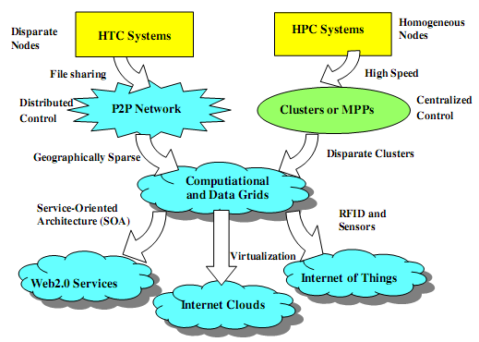
Evolutionary Trend toward Clouds and Internet of Things
HPC: High-Performance Computing
HTC: High-Throughput Computing
P2P:
Peer to Peer
MPP:
Massively Parallel Processors
Source: K. Hwang, G. Fox, and J. Dongarra,
Distributed and Cloud Computing,
Morgan Kaufmann, 2012.

Slide 6
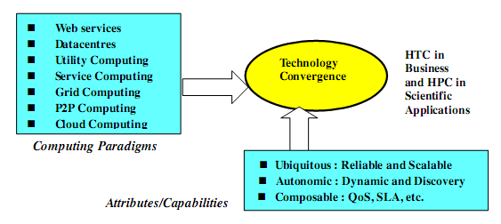
Technology Convergence toward HPC for Science and HTC for Business
(Courtesy of Raj Buyya, University of Melbourne, 2011)
Notes:
Computing Paradigms
Some common characteristics: design objectives
Major technological challenges
(to build distributed system that explore massive parallelism at all processing levels.)
New network-efficient processors
Scalable memory and storage schemes
Distributed OSes
Middleware for machine virtualization
New programming models
Efficient resource management
Application program development

Slide 7
Major technological challenges to build distributed system
New network-efficient processors
Scalable memory and storage schemes
Distributed OSes
Middleware for machine virtualization
New programming models
Efficient resource management
Application program development

Slide 8
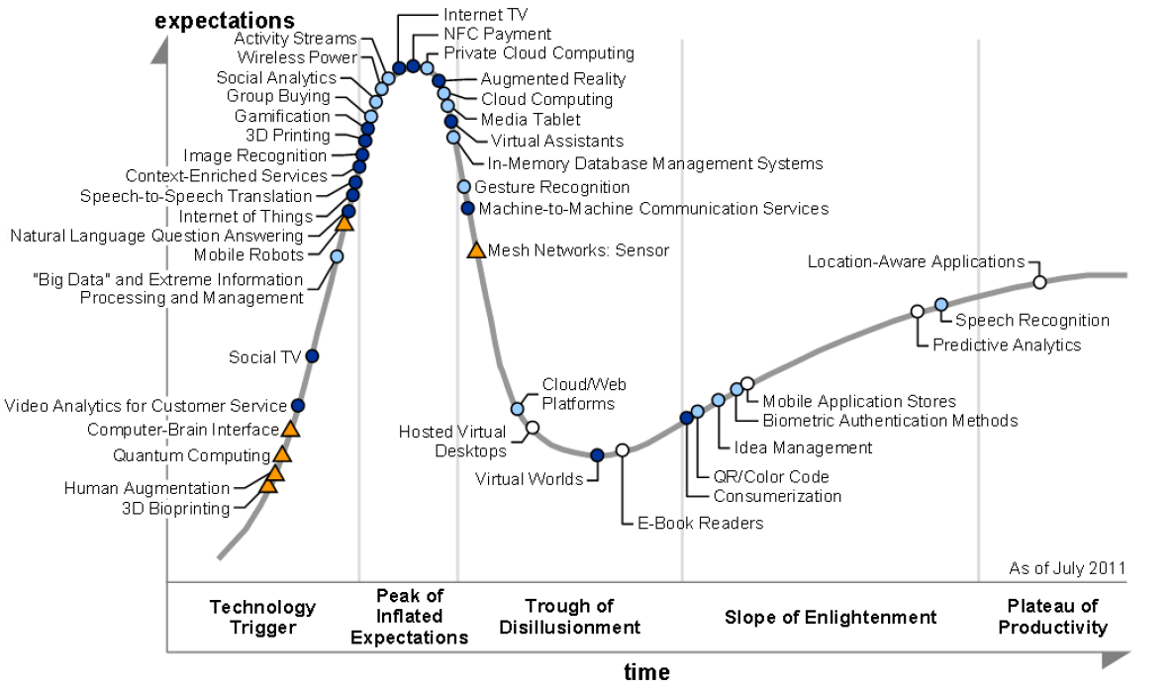
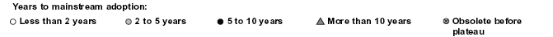
2011 Gartner “IT Hype Cycle” for Emerging Technologies
2010
2009
2011
2008
2007
What is Gartner Hype cycle? https://en.wikipedia.org/wiki/Gartner_hype_cycle

Slide 9
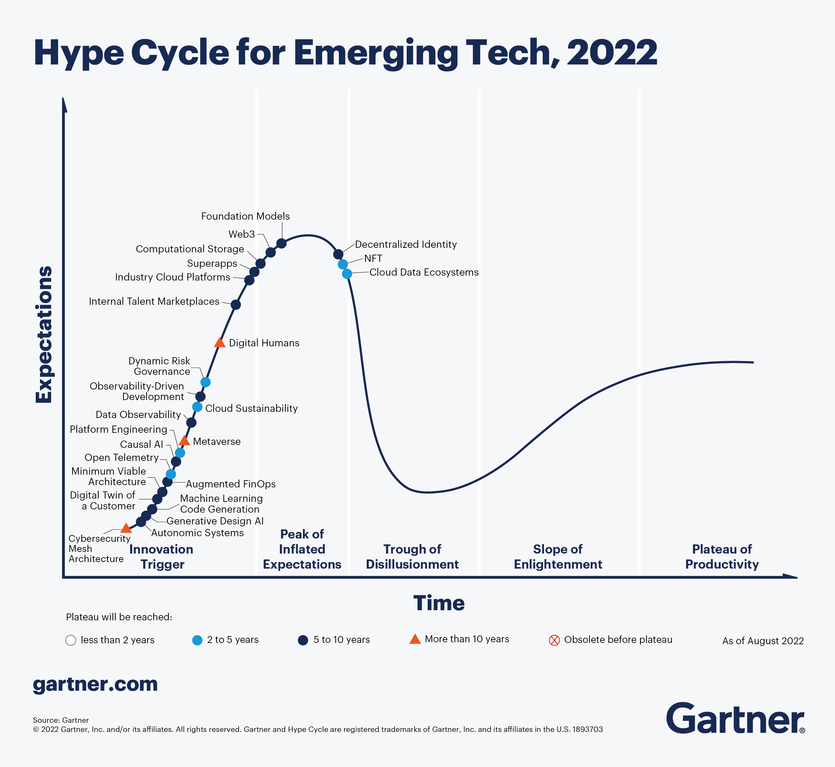
Notes:
https://www.gartner.com/en/newsroom/press-releases/2021-08-23-gartner-identifies-key-emerging-technologies-spurring-innovation-through-trust-growth-and-change
https://en.wikipedia.org/wiki/Gartner_hype_cycle

Slide 10
Internet of Things (IoT)
Introduced in 1999 at MIT
What is IoT?
  The networked interconnection of everyday objects, tools, devices, software, processing ability, sensors, computers, and other technologies.
  A wireless network of sensors that interconnect all things in our daily life.

Slide 11
Internet of Things (IoT)
Idea of IoT
  To tag every object using RFID or a related sensor or electronic technology such as GPS.
  With IPv6 protocol, 2¹²⁸ IP addresses are available to distinguish all the objects on Earth, including all computers and pervasive devices
Let’s review Computer Network Fundamental.
  Lecture Notes 1-1, 1-2, 1-3

Slide 12
Internet of Things (IoT)
Requirements
  Track 100 trillion static or moving object simultaneously.
  Need universal addressability of all of the objects or things.
  To reduce the complexity of identification, search, and storage, one can set the threshold to filter out fine-grain objects.
  Now, we also have IoT which is not connected to the public Internet and just connected to a private network.
All the objects and devices:
  Instrumented, interconnected, and interacted with each other intelligently.

Slide 13
Internet of Things (IoT)
Communication Patterns
  H2H (human-to-human)
  H2T (human-to-thing)
  T2T (thing-to-thing)
What to achieve: a smart Earth
  Intelligent cities
  Clean water
  Efficient power
  Convenient transportation
  Good food supplies
  Responsible banks
  Fast telecommunications
  Green IT
  Better schools
  Good health care
  Abundant resource
  and so on

Slide 14
Four Reference Books:
K. Hwang, G. Fox, and J. Dongarra, Distributed and Cloud Computing: from Parallel Processing to the Internet of Things Morgan Kauffmann Publishers, 2011
R. Buyya, J. Broberg, and A. Goscinski (eds), Cloud Computing: Principles and Paradigms, ISBN-13: 978-0470887998, Wiley Press, USA, February 2011.
T. Chou, Introduction to Cloud Computing: Business and Technology, Lecture Notes at Stanford University and at Tsinghua University, Active Book Press, 2010.
T. Hey, Tansley and Tolle (Editors), The Fourth Paradigm : Data-Intensive Scientific Discovery, Microsoft Research, 2009.

