Slide 1


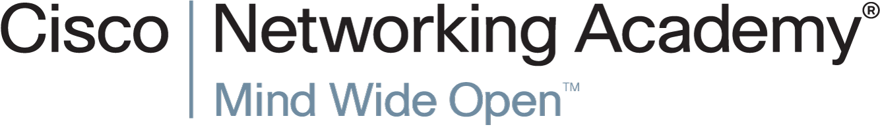
Lecture Note 1-2
IPv6 Network Addresses

Slide 2
Introduction to Networks
8.2 IPv6 Network Addresses
Notes:
8.2 IPv6 Network Addresses

Slide 3
IPv4 Issues
The Need for IPv6
IPv6 is designed to be the successor to IPv4.
Depletion of IPv4 address space has been the motivating factor for moving to IPv6.
Projections show that all five RIRs will run out of IPv4 addresses between 2015 and 2020.
With an increasing Internet population, a limited IPv4 address space, issues with NAT and an Internet of things, the time has come to begin the transition to IPv6!
IPv4 has a theoretical maximum of 4.3 billion addresses, plus private addresses in combination with NAT.
IPv6 larger 128-bit address space provides for 340 undecillion addresses.
IPv6 fixes the limitations of IPv4 and includes additional enhancements, such as ICMPv6.
Notes:
8.2.1.1 The Need for IPv6
<<Five RIRs>> (Regional internet Registry) System
http://www.cisco.com/web/about/ac123/ac147/archived_issues/ipj_4-4/regional_internet_registries.html
RIPE NCC
Réseaux IP Européens (RIPE)
RIPE Network Coordination Centre (NCC)
While in the United States the Government continued to support and fund registry functions, this was not the case in other parts of the world. In Europe, IP network operators cooperating in Réseaux IP Européens (RIPE) realized the need for professional coordination and registration functions. Establishment of the RIPE Network Coordination Centre (NCC) was proposed in the same month that RFC 1174 was published. The RIPE NCC was to "function as a 'Delegated Registry' for IP numbers in Europe, as anticipated and defined in RFC 1174" (RIPE-19).
2. APNIC
(Asia Pacific Network Information Centre), now Asia Pacific Networking Group [APNG]
Asia Pacific Network Information Centre (APNIC), the second RIR, was established in Tokyo in 1993, as a pilot project of APCCIRN (Asia Pacific Coordination Committee for Intercontinental Research Networks, now Asia Pacific Networking Group [APNG]).
3. ARIN
(American Registry for Internet Numbers )
In 1991, the contract to perform the IR function was awarded to Network Solutions, Inc. in Herndon, Virginia. This included the transition of services including IP address registration, domain name registration and support, Autonomous System Number (AS) registration, user registration, online information services, help-desk operations, and RFC and Internet-Draft archive and distribution services (RFC 1261).
…
As a result, ARIN (American Registry for Internet Numbers ) was established in December 1997, as an independent, nonprofit corporation, with a membership structure open to all interested entities or individuals.
<Two Emerging RIRs>
4. AfriNIC (for the Africa region)
5. LACNIC (for Latin America and the Caribbean)

Slide 4
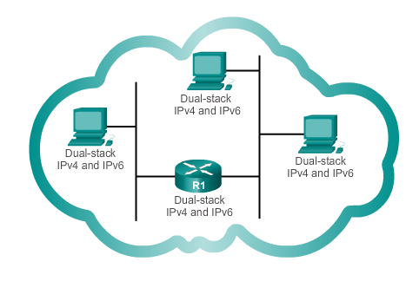
IPv4 Issues
IPv4 and IPv6 Coexistence
The migration techniques can be divided into three categories:
Dual-stack, Tunnelling, and Translation.
Dual-stack
Dual-stack: Allows IPv4 and IPv6 to coexist on the same network. Devices run both IPv4 and IPv6 protocol stacks simultaneously.
Notes:
8.2.1.2 IPv4 and IPv6 Coexistence

Slide 5
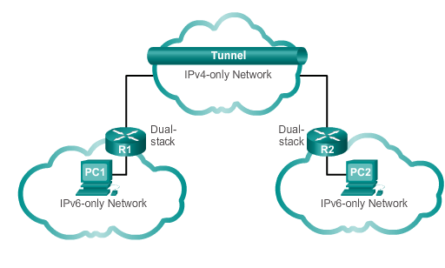
IPv4 Issues
IPv4 and IPv6 Coexistence (cont.)
Tunnelling
Tunnelling: A method of transporting an IPv6 packet over an IPv4 network. The IPv6 packet is encapsulated inside an IPv4 packet.
Notes:
8.2.1.2 IPv4 and IPv6 Coexistence

Slide 6
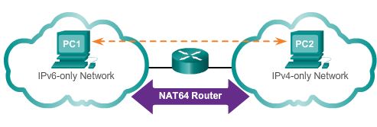
IPv4 Issues
IPv4 and IPv6 Coexistence (cont.)
Translation
Translation: The Network Address Translation 64 (NAT64) allows IPv6-enabled devices to communicate with IPv4-enabled devices using a translation technique similar to NAT for IPv4. An IPv6 packet is translated to an IPv4 packet, and vice versa.
Notes:
8.2.1.2 IPv4 and IPV6 Coexistence (cont.)

Slide 7
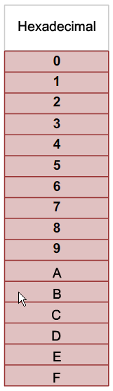
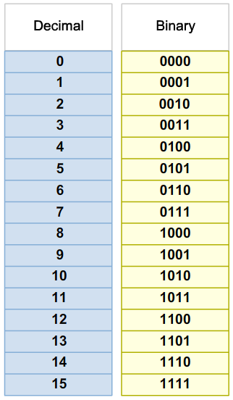
IPv6 Addressing
Hexadecimal Number System
Hexadecimal is a base sixteen system.
Base 16 numbering system uses the numbers 0 to 9 and the letters A to F.
Four bits (half of a byte) can be represented with a single hexadecimal value.
Notes:
8.2.2.1 Hexadecimal Number System

Slide 8
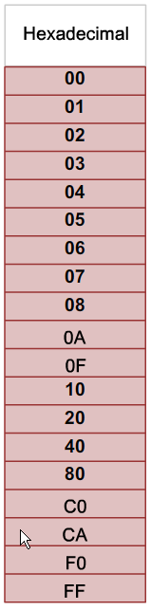
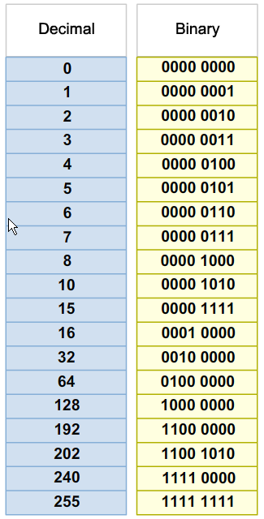
IPv6 Addressing
Hexadecimal Number System (cont.)
Look at the binary bit patterns that match the decimal and hexadecimal values
Notes:
8.2.2.1 Hexadecimal Number System (cont.)

Slide 9
IPv6 Addressing
IPv6 Address Representation
128 bits in length and written as a string of hexadecimal values
In IPv6, 4 bits represents a single hexadecimal digit, 32 hexadecimal value = IPv6 address
  2001:0DB8:0000:1111:0000:0000:0000:0200
  FE80:0000:0000:0000:0123:4567:89AB:CDEF
Hextet used to refer to a segment of 16 bits or four hexadecimals
Can be written in either lowercase or uppercase
Notes:
8.2.2.2 IPv6 Address Representation

Slide 10
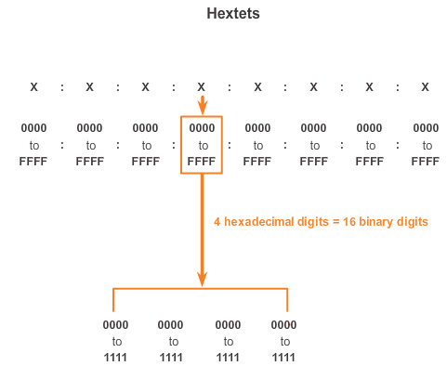
IPv6 Addressing
IPv6 Address Representation (cont.)
Notes:
8.2.2.2 IPv6 Address Representation (cont.)

Slide 11

IPv6 Addressing
Rule 1- Omitting Leading 0s
The first rule to help reduce the notation of IPv6 addresses is any leading 0s (zeros) in any 16-bit section or hextet can be omitted.
01AB can be represented as 1AB.
09F0 can be represented as 9F0.
0A00 can be represented as A00.
00AB can be represented as AB.
Notes:
8.2.2.3 Rule 1 – Omitting Leading 0s

Slide 12
IPv6 Addressing
Rule 2 - Omitting All 0 Segments
A double colon (::) can replace any single, contiguous string of one or more 16-bit segments (hextets) consisting of all 0’s.
Double colon (::) can only be used once within an address otherwise the address will be ambiguous.
Known as the compressed format.
Incorrect address - 2001:0DB8::ABCD::1234.
Notes:
8.2.2.4 Rule 2 – Omitting All 0 Segments

Slide 13
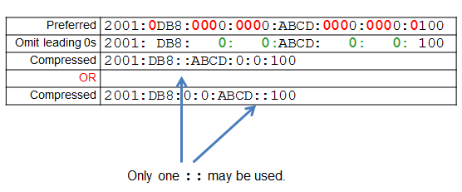
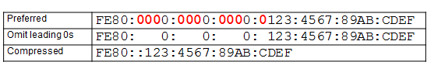
IPv6 Addressing
Rule 2 - Omitting All 0 Segments (cont.)
Example #1
Example #2
Notes:
8.2.2.4 Rule 2 – Omitting All 0 Segments (cont.)

Slide 14
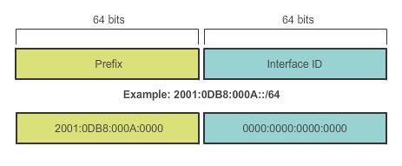
Types of IPv6 Addresses
IPv6 Prefix Length
IPv6 does not use the dotted-decimal subnet mask notation
Prefix length indicates the network portion of an IPv6 address using the following format:
  IPv6 address/prefix length
  Prefix length can range from 0 to 128
  Typical prefix length is /64
Notes:
8.2.3.2 IPv6 Prefix Length

Slide 15
Types of IPv6 Addresses
IPv6 Address Types
There are three types of IPv6 addresses:
Unicast
Multicast
Anycast.
Note: IPv6 does not have broadcast addresses.
Notes:
8.2.3.1 IPv6 Address Types

Slide 16
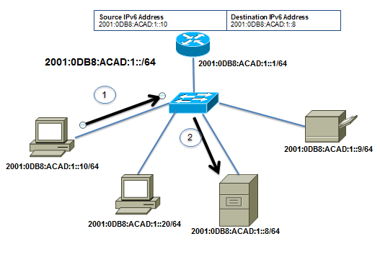
Types of IPv6 Addresses
IPv6 Unicast Addresses
Unicast
  Uniquely identifies an interface on an IPv6-enabled device.
  A packet sent to a unicast address is received by the interface that is assigned that address.
Notes:
8.2.3.1/8.2.3.3 IPv6 Unicast Addresses

Slide 17
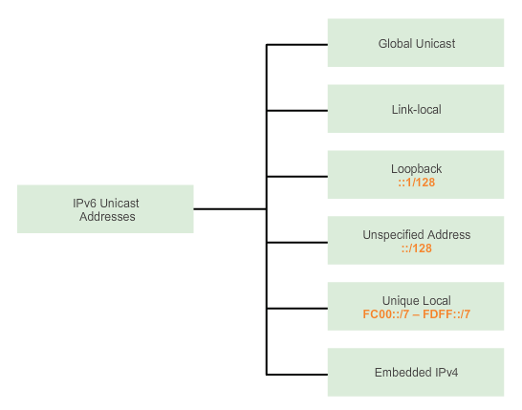
Types of IPv6 Addresses
IPv6 Unicast Addresses (cont.)
Notes:
8.2.3.3 IPv6 Unicast Addresses (cont.)

Slide 18
Types of IPv6 Addresses
IPv6 Unicast Addresses (cont.)
Global Unicast
  Similar to a public IPv4 address
  Globally unique
  Internet routable addresses
  Can be configured statically or assigned dynamically
Link-local
  Used to communicate with other devices on the same local link
  Confined to a single link; not routable beyond the link
Notes:
8.2.3.3 IPv6 Unicast Addresses (cont.)

Slide 19
Types of IPv6 Addresses
IPv6 Unicast Addresses (cont.)
Loopback
  Used by a host to send a packet to itself and cannot be assigned to a physical interface.
  Ping an IPv6 loopback address to test the configuration of TCP/IP on the local host.
  All-0s except for the last bit, represented as ::1/128 or just ::1.
Unspecified Address
  All-0’s address represented as ::/128 or just ::
  Cannot be assigned to an interface and is only used as a source address.
  An unspecified address is used as a source address when the device does not yet have a permanent IPv6 address or when the source of the packet is irrelevant to the destination.
Notes:
8.2.3.3 IPv6 Unicast Addresses (cont.)

Slide 20
Types of IPv6 Addresses
IPv6 Unicast Addresses (cont.)
Unique Local
  Similar to private addresses for IPv4.
  Used for local addressing within a site or between a limited number of sites.
  In the range of FC00::/7 to FDFF::/7.
IPv4 Embedded (not covered in this course)
  Used to help transition from IPv4 to IPv6.
Notes:
8.2.3.3 IPv6 Unicast Addresses (cont.)

Slide 21
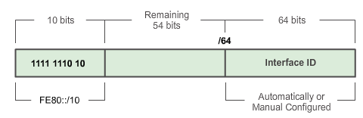
Types of IPv6 Addresses
IPv6 Link-Local Unicast Addresses
Add a header
Every IPv6-enabled network interface is REQUIRED to have a link-local address
Enables a device to communicate with other IPv6-enabled devices on the same link and only on that link (subnet)
FE80::/10 range, first 10 bits are 1111 1110 10xx xxxx
1111 1110 1000 0000 (FE80) - 1111 1110 1011 1111 (FEBF)
Notes:
8.2.3.4 IPv6 Link-Local Unicast Addresses

Slide 22
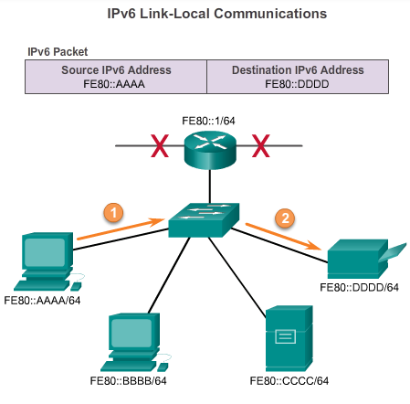
Types of IPv6 Addresses
IPv6 Link-Local Unicast Addresses (cont.)
Packets with a source or destination link-local address cannot be routed beyond the link from where the packet originated.
Notes:
8.2.3.4 IPv6 Link-Local Unicast Addresses

Slide 23
IPv6 Unicast Addresses
Structure of an IPv6 Global Unicast Address
IPv6 global unicast addresses are globally unique and routable on the IPv6 Internet
Equivalent to public IPv4 addresses
ICANN allocates IPv6 address blocks to the five RIRs
Notes:
8.2.4.1 Structure of an IPv6 Global Unicast Address

Slide 24
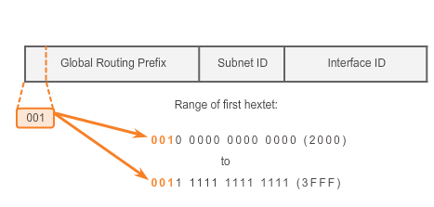
IPv6 Unicast Addresses
Structure of an IPv6 Global Unicast Address (cont.)
Currently, only global unicast addresses with the first three bits of 001 or 2000::/3 are being assigned
Notes:
8.2.4.1 Structure of an IPv6 Global Unicast Address (cont.)

Slide 25
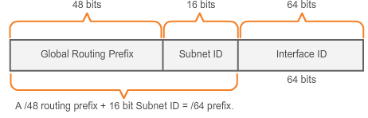
IPv6 Unicast Addresses
Structure of an IPv6 Global Unicast Address (cont.)
A global unicast address has three parts: Global Routing Prefix, Subnet ID, and Interface ID.
Global Routing Prefix is the prefix or network portion of the address assigned by the provider, such as an ISP, to a customer or site, currently, RIR’s assign a /48 global routing prefix to customers.
2001:0DB8:ACAD::/48 has a prefix that indicates that the first 48 bits (2001:0DB8:ACAD) is the prefix or network portion.
Notes:
regional Internet registry (RIR)
8.2.4.1 Structure of an IPv6 Global Unicast Address (cont.)

Slide 26
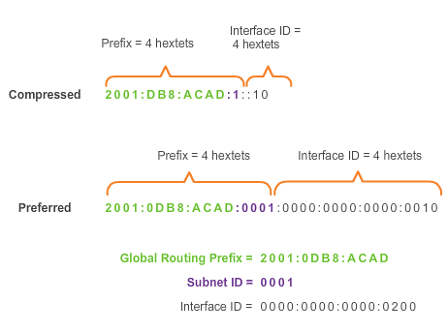
IPv6 Unicast Addresses
Structure of an IPv6 Global Unicast Address (cont.)
Subnet ID is used by an organization to identify subnets within its site
Interface ID
  Equivalent to the host portion of an IPv4 address.
  Used because a single host may have multiple interfaces, each having one or more IPv6 addresses.
Notes:
8.2.4.1 Structure of an IPv6 Global Unicast Address

Slide 27
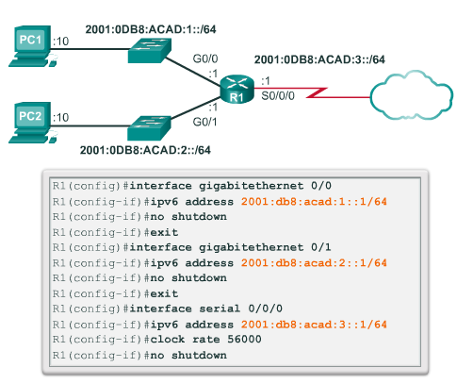
IPv6 Unicast Addresses
Static Configuration of a Global Unicast Address
Notes:
<<Undoing a Command or Feature>>
If you want to undo a command you entered or disable a feature, enter the keyword no before most commands; for example, no ip routing.
8.2.4.2 Static Configuration of a Global Unicast Address

Slide 28
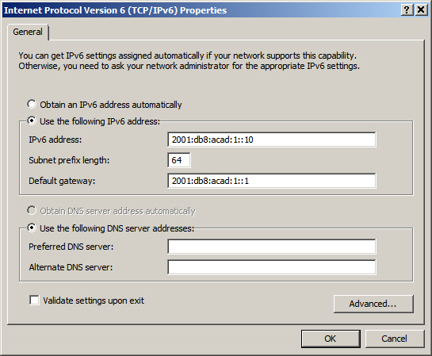
IPv6 Unicast Addresses
Static Configuration of an IPv6 Global Unicast Address (cont.)
Windows IPv6 Setup
Notes:
8.2.4.2 Static Configuration of an IPv6 Global Unicast Address (cont.)

Slide 29
IPv6 Unicast Addresses
Dynamic Configuration of a Global Unicast Address using SLAAC
Stateless Address Autoconfiguraton (SLAAC)
A method that allows a device to obtain its prefix, prefix length and default gateway from an IPv6 router
No DHCPv6 server needed
Rely on ICMPv6 Router Advertisement (RA) messages
IPv6 routers
Forwards IPv6 packets between networks
Can be configured with static routes or a dynamic IPv6 routing protocol
Sends ICMPv6 RA messages
Notes:
8.2.4.3 Dynamic Configuration of a Global Unicast Address using SLAAC

Slide 30
IPv6 Unicast Addresses
Dynamic Configuration of a Global Unicast Address using SLAAC (cont.)
The IPv6 unicast-routing command enables IPv6 routing.
RA message can contain one of the following three options:
  SLAAC Only – Uses the information contained in the RA message.
  SLAAC and DHCPv6 – Uses the information contained in the RA message and get other information from the DHCPv6 server, stateless DHCPv6 (for example, DNS).
  DHCPv6 only – The device should not use the information in the RA, stateful DHCPv6.
Routers send ICMPv6 RA messages using the link-local address as the source IPv6 address
Notes:
8.2.4.3 Dynamic Configuration of a Global Unicast Address using SLAAC (cont.)

Slide 31
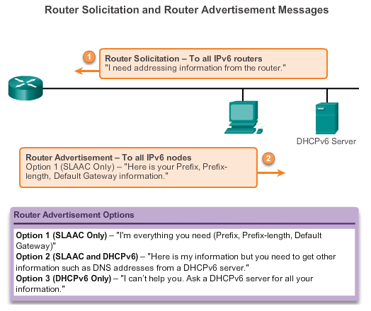
IPv6 Unicast Addresses
Dynamic Configuration of a Global Unicast Address using SLAAC (cont.)
Notes:
8.2.4.3 Dynamic Configuration of a Global Unicast Address using SLAAC (cont.)

Slide 32
IPv6 Unicast Addresses
Dynamic Configuration of a Global Unicast Address using DHCPv6 (cont.)
Dynamic Host Configuration Protocol for IPv6 (DHCPv6)
Similar to IPv4
Automatically receives addressing information, including a global unicast address, prefix length, default gateway address and the addresses of DNS servers using the services of a DHCPv6 server.
Device may receive all or some of its IPv6 addressing information from a DHCPv6 server depending upon whether option 2 (SLAAC and DHCPv6) or option 3 (DHCPv6 only) is specified in the ICMPv6 RA message.
Host may choose to ignore whatever is in the router’s RA message and obtain its IPv6 address and other information directly from a DHCPv6 server.
Notes:
8.2.4.4 Dynamic Configuration of a Global Unicast Address using DHCPv6 (cont.)

Slide 33
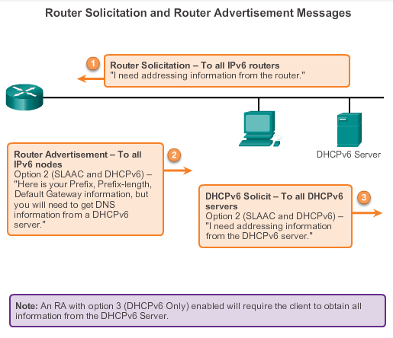
IPv6 Unicast Addresses
Dynamic Configuration of a Global Unicast Address using DHCPv6 (cont.)
Notes:
8.2.4.4 Dynamic Configuration of a Global Unicast Address using DHCPv6 (cont.)

Slide 34
IPv6 Unicast Addresses
EUI-64 Process or Randomly Generated
EUI-64 Process (Extended Unique Identifier)
Uses a client’s 48-bit Ethernet MAC address and inserts another 16 bits in the middle of the 46-bit MAC address to create a 64-bit Interface ID.
Advantage is that the Ethernet MAC address can be used to determine the interface; is easily tracked.
EUI-64 Interface ID is represented in binary and comprises three parts:
24-bit OUI from the client MAC address, but the 7th bit (the Universally/Locally bit) is reversed (0 becomes a 1).
Inserted as a 16-bit value FFFE.
24-bit device identifier from the client MAC address.
Notes:
organization unique identifier (OUI)
https://community.cisco.com/t5/networking-documents/understanding-ipv6-eui-64-bit-address/ta-p/3116953
Extended Unique Identifier (EUI), as per RFC2373, allows a host to assign iteslf a unique 64-Bit IP Version 6 interface identifier (EUI-64). This feature is a key benefit over IPv4 as it eliminates the need of manual configuration or DHCP as in the world of IPv4. The IPv6 EUI-64 format address is obtained through the 48-bit MAC address. The MAC address is first separated into two 24-bits, with one being OUI (Organizationally Unique Identifier) and the other being NIC specific. The 16-bit 0xFFFE is then inserted between these two 24-bits for the 64-bit EUI address. IEEE has chosen FFFE as a reserved value which can only appear in EUI-64 generated from the an EUI-48 MAC address.
8.2.4.5 EUI-64 Process or Randomly Generated
EUI (Extended Unique identifier)
When the Universal/Local bit (U/L) is 1 it means that the address was manually configured, it’s not the one that was actually the burned in address on the card. If you manually change the MAC address of the router’s interface you “must” (per RFC) set the U/L to 1 to indicate that it’s a locally administered address.
Brian McGahan, CCIE #8593 (R&S/SP/Security)
bmcgahan@INE.com
Internetwork Expert, Inc.
http://www.INE.com
Online Community: http://www.IEOC.com
CCIE Blog: http://blog.INE.com

Slide 35
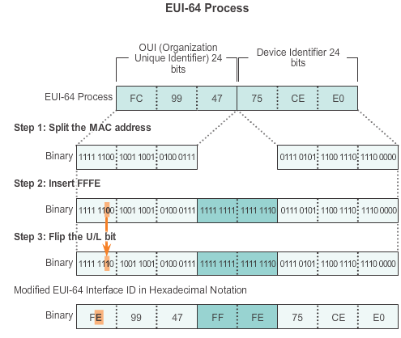
IPv6 Unicast Addresses
EUI-64 Process or Randomly Generated (cont.)
Notes:
8.2.4.5 EUI-64 Process or Randomly Generated

Slide 36
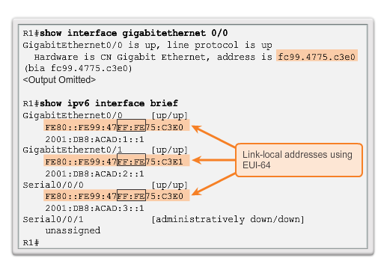
IPv6 Unicast Addresses
EUI-64 Process or Randomly Generated (cont.)
Notes:
8.2.4.5 EUI-64 Process or Randomly Generated (cont.)

Slide 37
IPv6 Unicast Addresses
EUI-64 Process or Randomly Generated (cont.)
Randomly Generated Interface IDs
Depending upon the operating system, a device can use a randomly generated Interface ID instead of using the MAC address and the EUI-64 process.
Notes:
https://community.cisco.com/t5/networking-documents/understanding-ipv6-eui-64-bit-address/ta-p/3116953
Extended Unique Identifier (EUI), as per RFC2373, allows a host to assign iteslf a unique 64-Bit IP Version 6 interface identifier (EUI-64). This feature is a key benefit over IPv4 as it eliminates the need of manual configuration or DHCP as in the world of IPv4. The IPv6 EUI-64 format address is obtained through the 48-bit MAC address. The MAC address is first separated into two 24-bits, with one being OUI (Organizationally Unique Identifier) and the other being NIC specific. The 16-bit 0xFFFE is then inserted between these two 24-bits for the 64-bit EUI address. IEEE has chosen FFFE as a reserved value which can only appear in EUI-64 generated from the an EUI-48 MAC address.
8.2.4.5 EUI-64 Process or Randomly Generated (cont.)

Slide 38
IPv6 Unicast Addresses
EUI-64 Process or Randomly Generated (cont.)
Randomly Generated Interface IDs
Depending upon the operating system, a device can use a randomly generated Interface ID instead of using the MAC address and the EUI-64 process.
Beginning with Windows Vista, Windows uses a randomly generated Interface ID instead of one created with EUI-64.
Windows XP (and previous Windows operating systems) used EUI-64.
Notes:
8.2.4.5 EUI-64 Process or Randomly Generated (cont.)

Slide 39
IPv6 Unicast Addresses
Dynamic Link-local Addresses
Link-Local Address
After a global unicast address is assigned to an interface, an IPv6-enabled device automatically generates its link-local address.
Must have a link-local address that enables a device to communicate with other IPv6-enabled devices on the same subnet.
Uses the link-local address of the local router for its default gateway IPv6 address.
Routers exchange dynamic routing protocol messages using link-local addresses.
Routers’ routing tables use the link-local address to identify the next-hop router when forwarding IPv6 packets.
Notes:
8.2.4.6 Dynamic Link-local Addresses

Slide 40
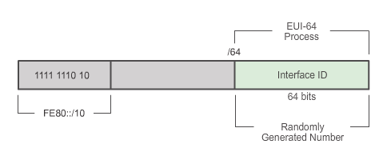
IPv6 Unicast Addresses
Dynamic Link-local Addresses (cont.)
Dynamically Assigned
The link-local address is dynamically created using the FE80::/10 prefix and the Interface ID.
Notes:
8.2.4.6 Dynamic Link-local Addresses (cont.)

Slide 41
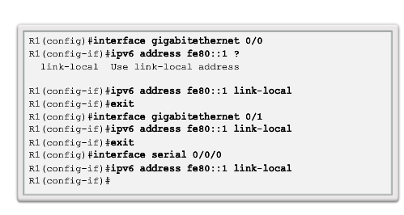
IPv6 Unicast Addresses
Static Link-local Addresses
Configuring Link-local
Notes:
8.2.4.7 Static Link-local Addresses

Slide 42
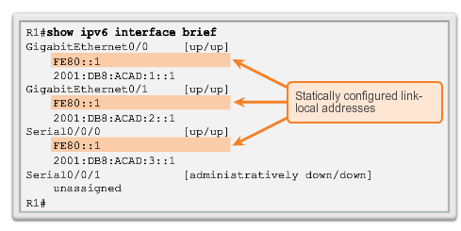
IPv6 Unicast Addresses
Static Link-local Addresses (cont.)
Configuring Link-local
Notes:
8.2.4.7 Static Link-local Addresses (cont.)

Slide 43
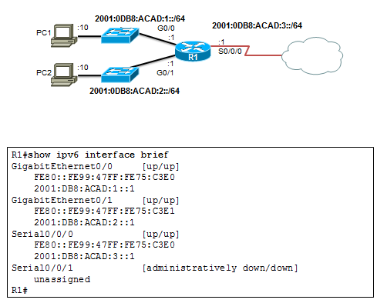
IPv6 Global Unicast Addresses
Verifying IPv6 Address Configuration
Each interface has two IPv6 addresses -
global unicast address that was configured
one that begins with FE80 is automatically added as a link-local unicast address
Notes:
8.2.4.8 Verifying IPv6 Address Configuration

Slide 44
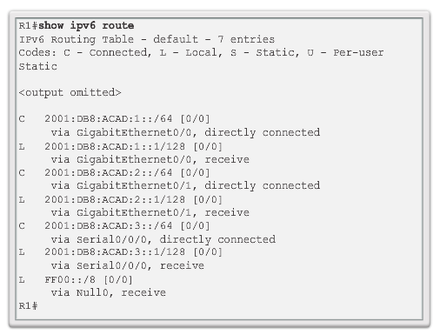
IPv6 Global Unicast Addresses
Verifying IPv6 Address Configuration (cont.)
Notes:
8.2.4.8 Verifying IPv6 Address Configuration (cont.)

Slide 45
IPv6 Multicast Addresses
Assigned IPv6 Multicast Addresses
IPv6 multicast addresses have the prefix FF00::/8
There are two types of IPv6 multicast addresses:
  Assigned multicast
  Solicited node multicast
Notes:
8.2.5.1 Assigned IPv6 Multicast Addresses

Slide 46
IPv6 Multicast Addresses
Assigned IPv6 Multicast Addresses (cont.)
Two common IPv6 assigned multicast groups include:
  FF02::1 All-nodes multicast group –
    All IPv6-enabled devices join
    Same effect as an IPv4 broadcast address
  FF02::2 All-routers multicast group
    All IPv6 routers join
    A router becomes a member of this group when it is enabled as an IPv6 router with the ipv6 unicast-routing global configuration mode command.
    A packet sent to this group is received and processed by all IPv6 routers on the link or network.
Notes:
8.2.5.1 Assigned IPv6 Multicast Addresses (cont.)

Slide 47
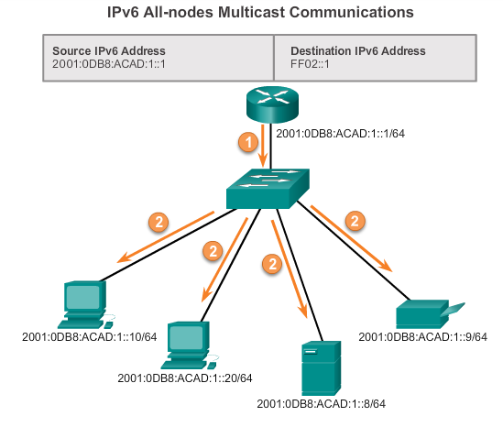
IPv6 Multicast Addresses
Assigned IPv6 Multicast Addresses (cont.)
Notes:
8.2.5.1 Assigned IPv6 Multicast Addresses (cont.)

Slide 48
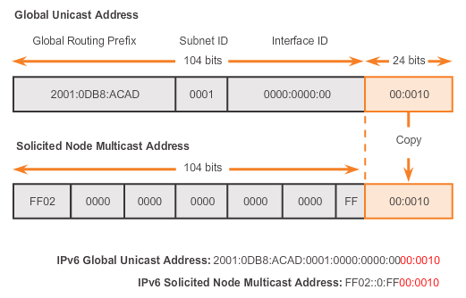
IPv6 Multicast Addresses
Solicited Node IPv6 Multicast Addresses
Similar to the all-nodes multicast address, matches only the last 24 bits of the IPv6 global unicast address of a device
Automatically created when the global unicast or link-local unicast addresses are assigned
Created by combining a special FF02:0:0:0:0:0:FF00::/104 prefix with the right-most 24 bits of its unicast address
Notes:
8.2.5.2 Solicited Node IPv6 Multicast Addresses

Slide 49
IPv6 Multicast Addresses
Solicited Node IPv6 Multicast Addresses (cont.)
The solicited node multicast address consists of two parts:
FF02:0:0:0:0:0:FF00::/104 multicast prefix – First 104 bits of the all solicited node multicast address
Least significant 24-bits – Copied from the right-most 24 bits of the global unicast or link-local unicast address of the device
Notes:
8.2.5.2 Solicited Node IPv6 Multicast Addresses (cont.)

Slide 50
8.3 Connectivity Verification
Notes:
8.3 Connectivity Verification

Slide 51
ICMP
ICMPv4 and ICMPv6 Messages
ICMP messages common to both ICMPv4 and ICMPv6 include:
  Host confirmation
  Destination or Service Unreachable
  Time exceeded
  Route redirection
Although IP is not a reliable protocol, the TCP/IP suite does provide for messages to be sent in the event of certain errors, sent using the services of ICMP.
Notes:
8.3.1.1 ICMPv4 and ICMPv6 Messages

Slide 52
ICMP
ICMPv6 Router Solicitation and Router Advertisement Messages
ICMPv6 includes four new protocols as part of the Neighbor Discovery Protocol (ND or NDP):
  Router Solicitation message
  Router Advertisement message
  Neighbor Solicitation message
  Neighbor Advertisement message
Router Solicitation and Router Advertisement Message – Sent between hosts and routers.
Router Solicitation (RS) message – RS messages are sent as an IPv6 all-routers multicast message.
Router Advertisement (RA) message – RA messages are sent by routers to provide addressing information.
Notes:
8.3.1.2 ICMPv6 Router Solicitation and Router Advertisement Messages

Slide 53
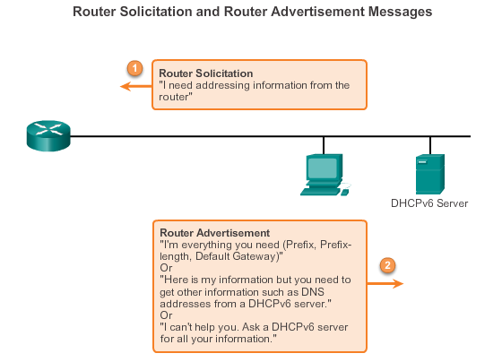
ICMP
ICMPv6 Router Solicitation and Router Advertisement Messages (cont.)
Notes:
8.3.1.2 ICMPv6 Router Solicitation and Router Advertisement Messages (cont.)

Slide 54
ICMP
ICMPv6 Neighbor Solicitation and Neighbor Advertisement Messages
  Two additional message types:
    Neighbor Solicitation (NS)
    Neighbor Advertisement (NA) messages
  Used for address resolution is used when a device on the LAN knows the IPv6 unicast address of a destination, but does not know its Ethernet MAC address.
  Also used for Duplicate Address Detection (DAD)
      Performed on the address to ensure that it is unique.
      The device sends an NS message with its own IPv6 address as the targeted IPv6 address.
Notes:
8.3.1.3 ICMPv6 Neighbor Solicitation and Neighbor Advertisement Messages

Slide 55
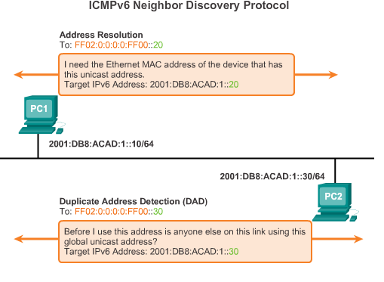
ICMP
ICMPv6 Neighbor Solicitation and Neighbor Advertisement Messages (cont.)
Notes:
8.3.1.3 ICMPv6 Neighbor Solicitation and Neighbor Advertisement Messages (cont.)

Slide 56
Routing and Switching Essentials
9.3 Design Considerations for IPv6
Notes:
9.3 Design Considerations for IPv6

Slide 57
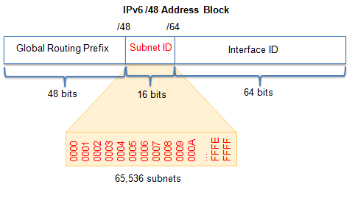
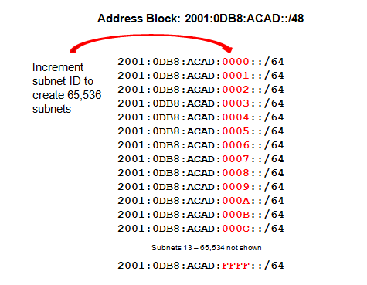
Subnetting an IPv6 Network
Subnetting Using the Subnet ID
An IPv6 Network Space is subnetted to support hierarchical, logical design of the network
Notes:
9.3.1.1 Subnetting Using the Subnet ID

Slide 58
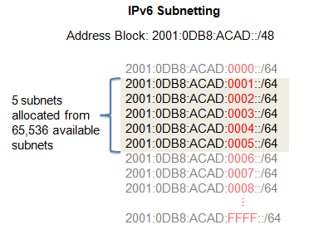
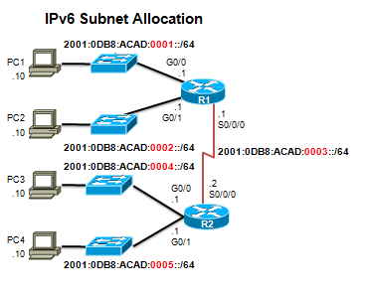
Subnetting an IPv6 Network
IPV6 Subnet Allocation
Notes:
9.3.1.2 IPv6 Subnet Allocation

Slide 59
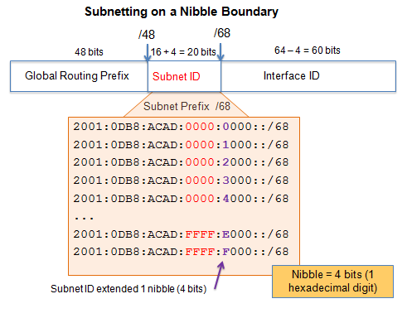
Subnetting an IPv6 Network
Subnetting into the Interface ID
IPv6 bits can be borrowed from the interface ID to create additional IPv6 subnets.
Notes:
9.3.1.3 Subnetting into the Interface ID

Slide 60
IP Addressing
Summary
Each IPv6 address has 128 bits verses the 32 bits in an IPv4 address.
The prefix length is used to indicate the network portion of an IPv6 address using the following format: IPv6 address/prefix length
There are three types of IPv6 addresses: unicast, multicast, and anycast.
An IPv6 link-local address enables a device to communicate with other IPv6-enabled devices on the same link and only on that link (subnet).
Packets with a source or destination link-local address cannot be routed beyond the link from where the packet originated.
IPv6 link-local addresses are in the FE80::/10 range.
ICMP is available for both IPv4 and IPv6.
Notes:
Summary

Slide 61
IP Addressing
Summary
Each IPv6 address has 128 bits verses the 32 bits in an IPv4 address.
The prefix length is used to indicate the network portion of an IPv6 address using the following format: IPv6 address/prefix length
There are three types of IPv6 addresses: unicast, multicast, and anycast.
An IPv6 link-local address enables a device to communicate with other IPv6-enabled devices on the same link and only on that link (subnet).
Packets with a source or destination link-local address cannot be routed beyond the link from where the packet originated.
IPv6 link-local addresses are in the FE80::/10 range.
Notes:
Summary

