Slide 1

Lecture Note 1-3
Internet Routing Protocols
Basic Routing
Routing Information Protocol (RIP)
Open Shortest Path First (OSPF)
Border Gateway Protocol (BGP)

Slide 2

Lecture 6
Internet Routing Protocols
Basic Routing

Slide 3
Autonomous Systems
Global Internet viewed as collection of autonomous systems.
Autonomous system (AS) is a set of routers or networks administered by a single organization
Same routing protocol need not be run within the AS
But, to the outside world, an AS should present a consistent picture of what ASs are reachable through it
Stub AS: has only a single connection to the outside world.
Multihomed AS: has multiple connections to the outside world, but refuses to carry transit traffic
Transit AS: has multiple connections to the outside world, and can carry transit and local traffic.

Slide 4
AS Number
For exterior routing, an AS needs a globally unique AS 16-bit integer number
Currently, there are about 11,000 registered ASs in Internet (and growing)
Stub AS, which is the most common type, does not need an AS number since the prefixes are placed at the provider’s routing table
Transit AS needs an AS number
Request an AS number from one of the five RIRs (Regional Internet Registries)
  ARIN: American Registry for Internet Numbers
  RIPE NCC: Réseaux IP Européens Network Coordination Centre
  APNIC: Asia Pacific Network Information Centre
  LACNIC: Latin America and Caribbean Network Information Centre
  AFRINIC: African Network Information Centre

Slide 5
Inter and Intra Domain Routing
Interior Gateway Protocol (IGP): routing within AS
  RIP, OSPF, IGRP, EIGRP, IS-IS
Exterior Gateway Protocol (EGP): routing between AS’s
  BGPv4
Border Gateways perform IGP & EGP routing
IGP
R
EGP
IGP
R
R
R
R
R
AS A
AS C
R
R
IGP
AS B

Slide 6
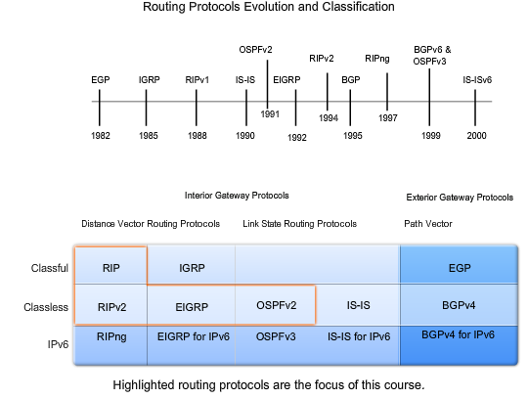
Inter and Intra Domain Routing
Image Source: www.netacad.com
Notes:
Course Overview
The primary focus of this course is on routing and routing protocols. The goal is to develop an understanding of how a router learns about remote networks and determines the best path to those networks. This course includes both static routing and dynamic routing protocols. By examining multiple routing protocols, you will gain a better understanding of each of the individual routing protocols and a better perspective of routing in general. Learning the configuration of routing protocols is fairly simple. Developing an understanding of the routing concepts themselves is more difficult, yet is critical for implementing, verifying, and troubleshooting routing operations.
Each static routing and dynamic routing protocol chapter uses a single topology throughout that chapter. You will be using that topology to configure, verify, and troubleshoot the routing operations discussed in the chapter.
The labs and Packet Tracer activities used in this course are designed to help you develop an understanding of how to configure routing operations while reinforcing the concepts learned in each chapter.
Chapter 1 Introduction to Routing and Packet Forwarding - In Chapter 1, you will be introduced to the router, its role in the networks, its main hardware and software components, and the packet forwarding process. You will also be given an overview of directly connected networks, static routing, and dynamic routing protocols, along with a brief introduction to the routing table. Each of these topics is discussed in more detail in later chapters. Chapter1 also includes a review of basic Cisco IOS commands.
Chapter 2 Static Routing - Chapter 2 focuses on the role and configuration of static routes. The routing table process is introduced, and you will be shown how to verify route entries as they are added and deleted from the routing table. This chapter also discusses Cisco Discovery Protocol, which is a tool that you can use to help verify network operations.
Chapter 3 Introduction to Dynamic Routing Protocols - Chapter 3 provides an overview of routing protocol concepts and the various dynamic routing protocols available for routing in IP networks. In this chapter, you will examine the role of routing protocols. There is an overview of the classification of dynamic routing protocols. This overview is useful for comparing and contrasting the different protocols. Most of the information in this chapter is examined in more detail in later chapters.
Chapter 4 Distance Vector Routing Protocols - Chapter 4 presents two different types of routing protocols: distance vector and link-state. You will examine distance vector concepts and operations, including network discovery, routing table maintenance, and the issue of routing loops. In this chapter, you will also be introduced to the concepts used in RIPv1, RIPv2, and EIGRP routing protocols. These routing protocols are discussed in more detail in later chapters.
Chapter 5 RIP version 1 - Chapter 5 is the first chapter that focuses on a specific dynamic routing protocol. In this chapter, you will learn about RIP (Routing Information Protocol) version 1. RIPv1, a classful, distance vector routing protocol, was one of the first IP routing protocols. You will examine the characteristics, operations, and limitations of RIPv1. You will also learn about RIPv1 configuration, verification, and troubleshooting techniques.
Chapter 6 VLSM and CIDR - Chapter 6 reviews the VLSM (Variable Length Subnet Mask) and CIDR (Classless Inter-Domain Routing) concepts that were presented in the Network Fundamentals course. You will explore the benefits of VLSM along with the role and benefits of CIDR in today’s networks. Next, you will be introduced to the role of classless routing protocols. Classless routing protocols RIPv2, EIGRP, and OSPF are examined in later chapters.
Chapter 7 RIPv2 - Chapter 7 examines the next routing protocol presented in this course, RIPv2. RIPv2 is a classless, distance vector routing protocol. You will see how RIPv2 demonstrates the advantages and operations of a classless routing protocol. The chapter begins with a discussion of the limitations of the classful routing protocol, RIPv1. Then RIPv2 is introduced, to show how a classless routing protocol can be used to overcome these limitations. In this chapter, you will also learn the commands necessary to configure and verify RIPv2.
Chapter 8 The Routing Table: A Closer Look - Chapter 8 examines Cisco’s IPv4 routing table in detail. The chapter begins with a discussion of the structure of the routing table. While examining the routing table, you will learn about the lookup process, how the routing table process determines the best match with a packet’s destination IP address, and how to enter a route in the routing table. The chapter concludes with a discussion about the differences between classful and classless routing behaviors.
Chapter 9 EIGRP - Chapter 9 focuses on Cisco EIGRP (Enhanced Interior Gateway Routing Protocol). EIGRP is a classless, enhanced distance vector routing protocol. You will examine the advantages and operations of EIGRP’s DUAL (Diffusing Update Algorithm). Then you will learn about the configuration of EIGRP, including verification and troubleshooting commands.
Chapter 10 Link-State Routing Protocols - Chapter 10 examines link-state routing protocol concepts. You will be introduced to link-state terminology and the link-state routing process. The chapter discusses the benefits and advantages of a link-state routing protocol compared to a distance vector routing protocol. You will then examine the Shortest Path First (SPF) algorithm and how it is used to build a topology map of the network. The link-state routing protocol OSPF is discussed in the following chapter.
Chapter 11 OSPF - The final chapter in this course is an examination of the classless, link-state routing protocol OSPF (Open Shortest Path First). In this chapter, you will examine OSPF operations and configuration, including verification and troubleshooting commands. By the end of this course, you should feel confident in your knowledge of routing and routing protocols. With continued study and practice, you will be able to put your new skills to work.
--
Chapter 3
The Evolution of Dynamic Routing Protocols
Dynamic routing protocols have been used in networks since the early 1980s. The first version of RIP was released in 1982, but some of the basic algorithms within the protocol were used on the ARPANET as early as 1969.
As networks have evolved and become more complex, new routing protocols have emerged. The figure shows the classification of routing protocols.
One of the earliest routing protocols was Routing Information Protocol (RIP). RIP has evolved into a newer version RIPv2. However, the newer version of RIP still does not scale to larger network implementations. To address the needs of larger networks, two advanced routing protocols were developed: Open Shortest Path First (OSPF) and Intermediate System-to-Intermediate System (IS-IS). Cisco developed Interior Gateway Routing Protocol (IGRP) and Enhanced IGRP (EIGRP), which also scales well in larger network implementations.
Additionally, there was the need to interconnect different internetworks and provide routing among them. Border Gateway Routing (BGP) protocol is now used between ISPs as well as between ISPs and their larger private clients to exchange routing information.
With the advent of numerous consumer devices using IP, the IPv4 addressing space is nearly exhausted. Thus IPv6 has emerged. To support the communication based on IPv6, newer versions of the IP routing protocols have been developed (see the IPv6 row in the table).
Note: This chapter presents an overview of the different dynamic routing protocols. More details about RIP, EIGRP, and OSPF routing protocols will be discussed in later chapters. The IS-IS and BGP routing protocols are explained in the CCNP curriculum. IGRP is the predecessor to EIGRP and is now obsolete.
Reference: IS-IS
http://en.wikipedia.org/wiki/IS-IS

Slide 7
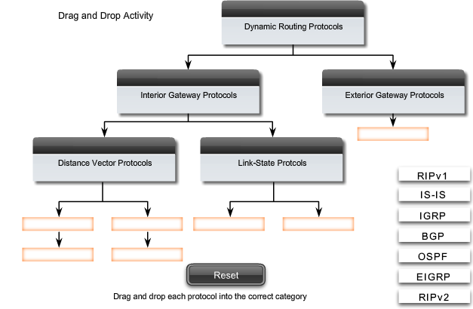
Inter and Intra Domain Routing

Slide 8
Review of Routing
Distance Vector Shortest Path Routing Algorithm
  Bellman-Ford SPRA
  Distributed SPRA
Link State Shortest Path Routing Algorithm
  Dijkstra SPRA
  Centralized SPRA
For more details, let’s go to Lecture 2-2 Routing

Slide 9
Outline
Basic Routing
Routing Information Protocol (RIP)
Open Shortest Path First (OSPF)
Border Gateway Protocol (BGP)

Slide 10
Routing Information Protocol (RIP)
RFC 1058
Uses the distance-vector algorithm
Runs on top of UDP, port number 520
Metric: number of hops
Max limited to 15
  suitable for small networks (local area environments)
  value of 16 is reserved to represent infinity
  small number limits the count-to-infinity problem

Slide 11
RIP Operation
Router sends update message to neighbors every 30 sec
A router expects to receive an update message from each of its neighbors within 180 seconds in the worst case
If router does not receive update message from neighbor X within this limit, it assumes the link to X has failed and sets the corresponding minimum cost to 16 (infinity)
Uses split horizon with poisoned reverse

Slide 12
RIP Protocol
Routers run RIP in active mode (advertise distance vector tables)
Hosts can run RIP in passive mode (update distance vector tables, but do not advertise)
RIP datagrams broadcast over LANs & specifically addressed on pt-pt or multi-access non-broadcast nets
Two RIP packet types:
  request to ask neighbor for distance vector table
  response to advertise distance vector table
    periodically; in response to request; triggered

Slide 13
Outline
Basic Routing
Routing Information Protocol (RIP)
Open Shortest Path First (OSPF)
Border Gateway Protocol (BGP)

Slide 14
Open Shortest Path First
RFC 2328 (v2)
Fixes some of the deficiencies in RIP
Enables each router to learn complete network topology
Each router monitors the link state to each neighbor and floods the link-state information to other routers
Each router builds an identical link-state database
Allows router to build shortest path tree with router as root
OSPF typically converges faster than RIP when there is a failure in the network

Slide 15
OSPF Features
Multiple routes to a given destination, one per type of service
Support for variable-length subnetting by including the subnet mask in the routing message
Distribution of traffic over multiple paths of equal cost
Uses notion of area to partition sites into subsets
Support host-specific routes as well as net-specific routes
Designated router to minimize table maintenance overhead

Slide 16
Flooding
Used in OSPF to distribute link state (LS) information
Forward incoming packet to all ports except where packet came in
Packet eventually reaches destination as long as there is a path between the source and destination
Generates exponential number of packet transmissions
Approaches to limit # of transmissions:
  Use a TTL at each packet; won’t flood if TTL is reached
  Each router adds its identifier to header of packet before it floods the packet; won’t flood if its identifier is detected
  Each packet from a given source is identified with a unique sequence number; won’t flood if sequence number is same

Slide 17
Example OSPF Topology
10.5.1.2
10.5.1.4
10.5.1.1
10.5.1.6
10.5.1.3
10.5.1.5
At steady state:
All routers have same LS database
Know how many routers in network
Interfaces & links between routers
Cost of each link
Occasional Hello messages (10 sec) & LS updates sent (30 min)

Slide 18
OSPF Network
To improve scalability, AS may be partitioned into areas
  Area is identified by 32-bit Area ID
  Router in area only knows complete topology inside area & limits the flooding of link-state information to area
  Area border routers summarize info from other areas
Each area must be connected to backbone area (0.0.0.0)
  Distributes routing info between areas
Internal router has all links to nets within the same area
Area border router has links to more than one area
Backbone router has links connected to the backbone

Slide 19
OSPF Areas
To another AS
N1
R1
N5
N2
R3
R6
N4
R7
R2
N6
R4
R5
N3
Area 0.0.0.0
Area 0.0.0.2
Area 0.0.0.1
R8
ABR: 3, 6, 8
IR: 1,2,7
BR: 3,4,5,6,8
N7
R = router N = network
Area 0.0.0.3

Slide 20
Neighbor, Adjacent & Designated Routers
Neighbor routers: two routers that have interfaces to a common network
  Neighbors are discovered dynamically by Hello protocol
Each neighbor of a router described by a state
Adjacent router: neighbor routers become adjacent when they synchronize topology databases by exchange of link state information
  Neighbors on point-to-point links become adjacent
  Routers on multiaccess nets become adjacent only to designated routers (DR) & backup designated routers (BDR)
    Reduces size of topological database & routing traffic
Notes:
Designated router election
https://study-ccna.com/designated-backup-designated-router/#:~:text=Two%20rules%20are%20used%20to,router%20ID%20wins%20the%20election.
https://packetlife.net/blog/2011/jun/2/ospf-designated-router-election/

Slide 21
Designated Routers
Reduces number of adjacencies
Elected by each multiaccess network after neighbor discovery by hello protocol
Election based on priority & id fields
Generates link advertisements that list routers attached to a multi-access network
Forms adjacencies with routers on multi-access network
Backup prepared to take over if designated router fails

Slide 22
Link State Advertisements
Link state info exchanged by adjacent routers to allow
  area topology databases to be maintained
  inter-area & inter-AS routes to be advertised

Slide 23
OSPF Protocol
OSPF packets transmitted directly on IP datagrams; Protocol ID 89
OSPF packets sent to multicast address 224.0.0.5 (allOSPFRouters on pt-2-pt and broadcast nets)
OSPF packets sent on specific IP addresses on non-broadcast nets
Five OSPF packet types:
  Hello
  Database description
  Link state request; Link state update; Link state ack

Slide 24
OSPF Header
0 8 16 31
Version Type Packet length
Router ID
Area ID
OSPF
common
header
Checksum Authentication type
Authentication
Authentication
OSPF
packet
body
Data
Type: Hello, Database description, Link state request, Link state update, Link state acknowledgements

Slide 25
OSPF Stages
Discover neighbors by sending Hello packets (every 10 sec) and designated router elected in multiaccess networks
Adjacencies are established & link state databases are synchronized
Link state information is propagated & routing tables are calculated

Slide 26
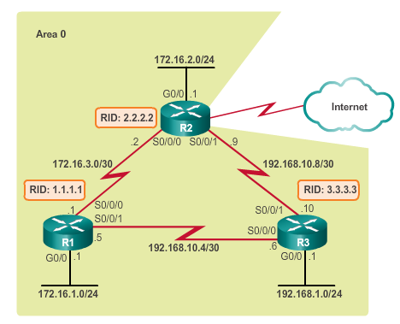
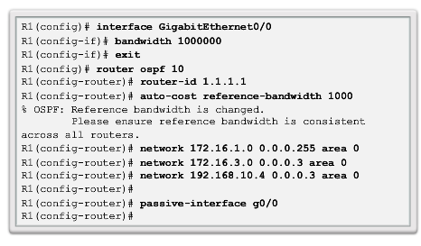
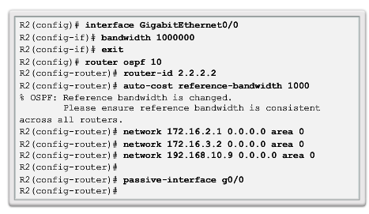
Routing in the Distribution and Core Layers
Configuring Single-Area OSPF
1000000000/1544000 = 647
Cf. default: 100000000/1544000 = 64
Notes:
5.1.1.5 Configuring Single-Area OSPF
Bandwidth command (in kbit term)
Question> Auto-cost reference-bandwidth 1000?
Sol>https://learningnetwork.cisco.com/message/211993#211993 ← currently not available
https://www.oreilly.com/library/view/cisco-ios-in/0596008694/re672.html
1000000000/1544000 = 647
Cf. default: 100000000/1544000 = 64

Slide 27
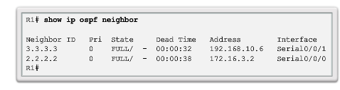
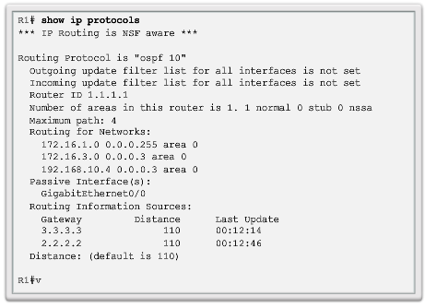
Routing in the Distribution and Core Layers
Verifying Single-Area OSPF
Notes:
5.1.1.6 Verifying Single-Area OSPF

Slide 28
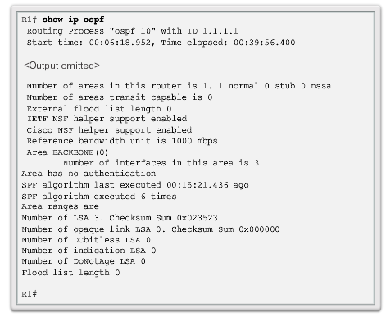
Routing in the Distribution and Core Layers
Verifying Single-Area OSPF (cont.)
Notes:
5.1.1.6 Verifying Single-Area OSPF

Slide 29
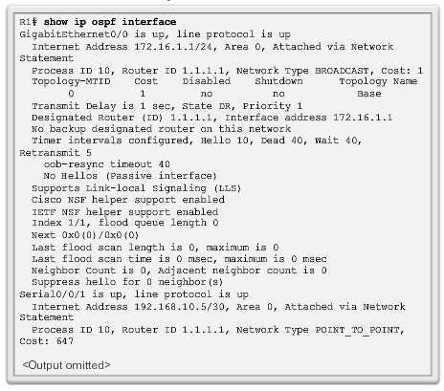
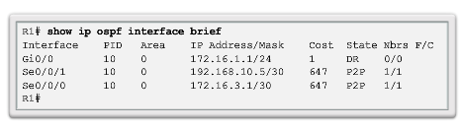
Routing in the Distribution and Core Layers
Verifying Single-Area OSPF (cont.)
Notes:
5.1.1.6 Verifying Single-Area OSPF

Slide 30
Outline
Basic Routing
Routing Information Protocol (RIP)
Open Shortest Path First (OSPF)
Border Gateway Protocol (BGP)

Slide 31
Exterior Gateway Protocols
Within each AS, there is a consistent set of routes connecting the constituent networks
The Internet is woven into a coherent whole by Exterior Gateway Protocols (EGPs) that operate between AS’s
EGP enables two AS’s to exchange routing information about:
  The networks that are contained within each AS
  The AS’s that can be reached through each AS
EGP path selection guided by policy rather than path optimality
  Trust, peering arrangements, etc

Slide 32
EGP Example
Only EGP routers are shown
R2
R3
N1 reachable through AS3
AS2
R1
R4
N1
AS1
AS3
R4 advertises that network N1 can be reached through AS3
R3 examines announcement & applies policy to decide whether it will forward packets to N1 through R4
If yes, routing table updated in R3 to indicate R4 as next hop to N1
IGP propagates N1 reachability information through AS2

Slide 33
EGP Example
R2
R3
N1 reachable through AS2
AS2
R1
R4
N1
AS1
AS3
EGP routers within an AS, e.g. R3 and R2, are kept consistent
Suppose AS2 willing to handle transit packets from AS1 to N1
R2 advertises to AS1 the reachability of N1 through AS2
R1 applies its policy to decide whether to send to N1 via AS2

Slide 34
Peering and Inter-AS connectivity
Peering Centre
Tier 1 ISP (Transit AS)
Tier 1 ISP (Transit AS)
AS
Tier 2 (transit AS)
Tier 2 (transit AS)
Content or Application Service Provider (Non-transit)
Tier 2 (transit AS)
AS
AS
AS
AS
AS
AS
Non-transit AS’s (stub & multihomed) do not carry transit traffic
Tier 1 ISPs peer with each other, privately & peering centers
Tier 2 ISPs peer with each other & obtain transit services from Tier 1s; Tier 1’s carry transit traffic between their Tier 2 customers
Client AS’s obtain service from Tier 2 ISPs

Slide 35
EGP Requirements
Scalability to global Internet
  Provide connectivity at global scale
  Link-state does not scale
  Should promote address aggregation
  Fully distributed
EGP path selection guided by policy rather than path optimality
  Trust, peering arrangements, etc
  EGP should allow flexibility in choice of paths

Slide 36
Border Gateway Protocol v4
AS2
AS1
AS6
AS3
AS5
AS4
AS7
BGP (RFC 1771) an EGP routing protocol to exchange network reachability information among BGP routers (also called BGP speakers)
Network reachability info contains sequence of ASs that packets traverse to reach a destination network
Info exchanged between BGP speakers allows a router to construct a graph of AS connectivity
  Routing loops can be pruned
  Routing policy at AS level can be applied

Slide 37
BGP Features
BGP is path vector protocol: advertises sequence of AS numbers to the destination network
Path vector info used to prevent routing loops
BGP enforces policy through selection of different paths to a destination and by control of redistribution of routing information
Uses CIDR to support aggregation & reduction of routing information

Slide 38
BGP Speaker & AS Relationship
BGP speaker: a router running BGP
Peers or neighbors: two speakers exchanging information on a connection
BGP peers use TCP (port 179) to exchange messages
Initially, BGP peers exchange entire BGP routing table
  Incremental updates sent subsequently
  Reduces bandwidth usage and processing overhead
  Keepalive messages sent periodically (30 seconds)
Internal BGP (iBPG) between BGP routers in same AS
External BGP (eBGP) connections across AS borders

Slide 39
iBGP & eBGP
R
eBGP
iBGP
eBGP
R
R
R
iBGP
iBGP
iBGP
iBGP
R
R
R
iBGP
eBGP
R
eBGP
eBGP to exchange reachability information in different AS’s
  eBGP peers directly connected
iBGP to ensure net reachability info is consistent among the BGP speakers in the same AS
  usually not directly connected
  iBGP speakers exchange info learned from other iBGP speakers, and thus fully meshed

Slide 40
Path Selection
Each BGP speaker
  Evaluates paths to a destination from an AS border router
  Selects the best that complies with policies
  Advertises that route to all BGP neighbors
BGP assigns a preference order to each path & selects path with highest value; BGP does not keep a cost metric to any path
When multiple paths to a destination exist, BGP maintains all of the paths, but only advertises the one with highest preference value

Slide 41
BGP Policy
Examples of policy:
  Never use AS X
  Never use AS X to get to a destination in AS Y
  Never use AS X and AS Y in the same path
Import policies to accept, deny, or set preferences on route advertisements from neighbors
Export policies to determine which routes should be advertised to which neighbors
  A route is advertised only if AS is willing to carry traffic on that route

Slide 42
(Ex) Typical BGP Policies
Typical policies involve political, security, or economic considerations.
  No transit traffic through certain ASes.
  Never put country X on a route starting at the Pentagon.
  Do not use the United States to get from British Columbia to Ontario.
  Only transit country A if there is not alternative to the destination.
  Traffic starting or ending at IBM should not transit Microsoft.

Slide 43
BGP Protocol
Opening & confirming of a BGP connection with a neighbor router
Maintaining the BGP connection
Sending reachability information
Notification of error conditions

