Slide 1
Distributed and Cloud Computing
K. Hwang, G. Fox and J. Dongarra
Lecture Note 1: Enabling Technologies and Distributed System Models
Copyright © Elsevier Inc. All rights reserved.

Slide 2
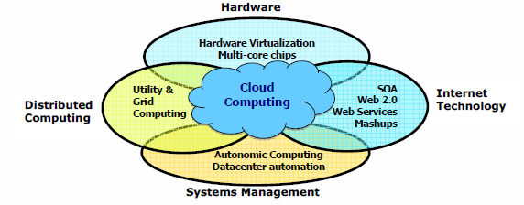
Data Deluge Enabling New Challenges
(Courtesy of Judy Qiu, Indiana University, 2011)

Slide 3
From Desktop/HPC/Grids to Internet Clouds in 30 Years
HPC moving from centralized supercomputers
to geographically distributed desktops, desksides,
clusters, and grids to clouds over last 30 years
R/D efforts on HPC, clusters, Grids, P2P, and virtual
machines has laid the foundation of cloud computing
that has been greatly advocated since 2007
Location of computing infrastructure in areas with
lower costs in hardware, software, datasets,
space, and power requirements – moving from
desktop computing to datacenter-based clouds

Slide 4
Interactions among 4 technical challenges:
Data Deluge, Cloud Technology, eScience,
and Multicore/Pareallel Computing
(Courtesy of Judy Qiu, Indiana University, 2011)
Notes:
E-Science or eScience is computationally intensive science that is carried out in highly distributed network environments, or science that uses immense data sets that require grid computing; the term sometimes includes technologies that enable distributed collaboration, such as the Access Grid.

Slide 5
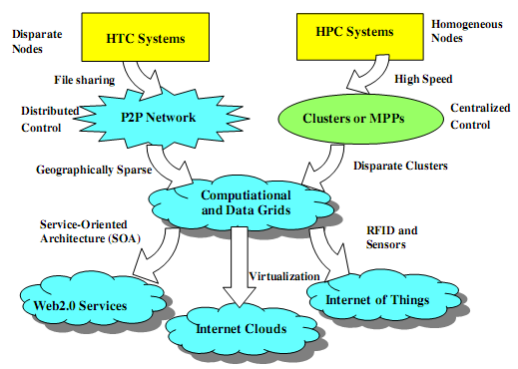
Evolutionary Trend toward Clouds and Internet of Things
HPC: High-Performance Computing
HTC: High-Throughput Computing
P2P:
Peer to Peer
MPP:
Massively Parallel Processors
Source: K. Hwang, G. Fox, and J. Dongarra,
Distributed and Cloud Computing,
Morgan Kaufmann, 2012.

Slide 6
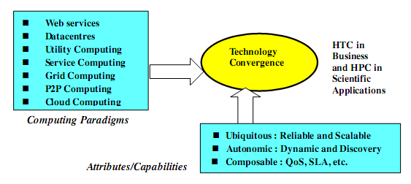
Technology Convergence toward HPC for Science and HTC for Business
(Courtesy of Raj Buyya, University of Melbourne, 2011)
Notes:
Computing Paradigms
Some common characteristics: design objectives
Major technological challenges
(to build distributed system that explore massive parallelism at all processing levels.)
New network-efficient processors
Scalable memory and storage schemes
Distributed OSes
Middleware for machine virtualization
New programming models
Efficient resource management
Application program development

Slide 7
Major technological challenges to build distributed system
New network-efficient processors
Scalable memory and storage schemes
Distributed OSes
Middleware for machine virtualization
New programming models
Efficient resource management
Application program development

Slide 8
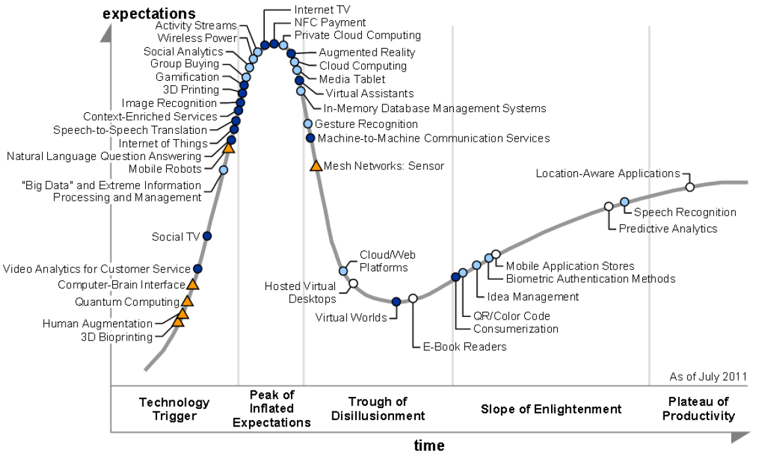
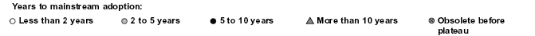
2011 Gartner “IT Hype Cycle” for Emerging Technologies
2010
2009
2011
2008
2007
What is Gartner Hype cycle? https://en.wikipedia.org/wiki/Gartner_hype_cycle

Slide 9
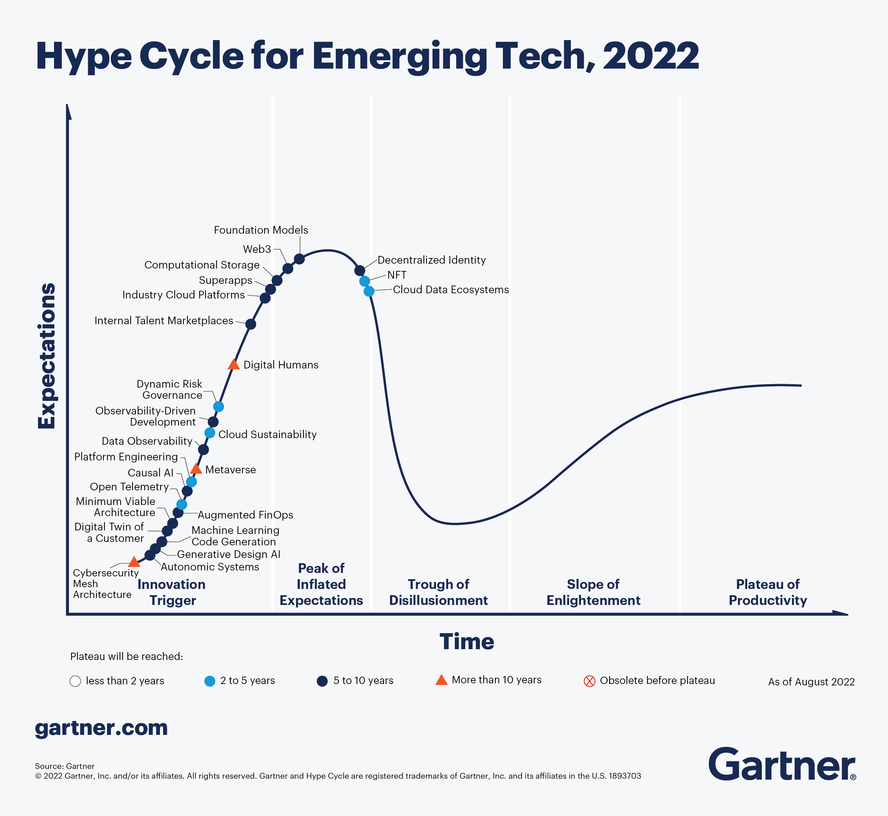
Notes:
https://www.gartner.com/en/newsroom/press-releases/2021-08-23-gartner-identifies-key-emerging-technologies-spurring-innovation-through-trust-growth-and-change
https://en.wikipedia.org/wiki/Gartner_hype_cycle

Slide 10
Internet of Things (IoT)
Introduced in 1999 at MIT
What is IoT?
  The networked interconnection of everyday objects, tools, devices, software, processing ability, sensors, computers, and other technologies.
  A wireless network of sensors that interconnect all things in our daily life.

Slide 11
Internet of Things (IoT)
Idea of IoT
  To tag every object using RFID or a related sensor or electronic technology such as GPS.
  With IPv6 protocol, 2¹²⁸ IP addresses are available to distinguish all the objects on Earth, including all computers and pervasive devices
Let’s review Computer Network Fundamental.
  Lecture Notes 1-1, 1-2, 1-3

Slide 12
Internet of Things (IoT)
Requirements
  Track 100 trillion static or moving object simultaneously.
  Need universal addressability of all of the objects or things.
  To reduce the complexity of identification, search, and storage, one can set the threshold to filter out fine-grain objects.
  Now, we also have IoT which is not connected to the public Internet and just connected to a private network.
All the objects and devices:
  Instrumented, interconnected, and interacted with each other intelligently.

Slide 13
Internet of Things (IoT)
Communication Patterns
  H2H (human-to-human)
  H2T (human-to-thing)
  T2T (thing-to-thing)
What to achieve: a smart Earth
  Intelligent cities
  Clean water
  Efficient power
  Convenient transportation
  Good food supplies
  Responsible banks
  Fast telecommunications
  Green IT
  Better schools
  Good health care
  Abundant resource
  and so on

Slide 14
Cyber-Physical Systems (CPS)
CPS
  Integrates “cyber” (heterogeneous, asynchronous) with “physical” (concurrent and information-dense) objects
  Merges the “3C” technologies of computation, communication, and control into an intelligent closed feedback system between the physical world and the information world.
Difference: IoT vs. CPS
  IoT emphasizes various networking connections among physical objects.
  CPS emphasizes exploration of virtual reality (VR) applications in the physical world to interact with the physical world.
Notes:
More details are in chapter 9
CPS: we may transform how we interact with the physical world just like the Internet transformed how we interact with the virtual world.

Slide 15
Multicore CPUs

Slide 16
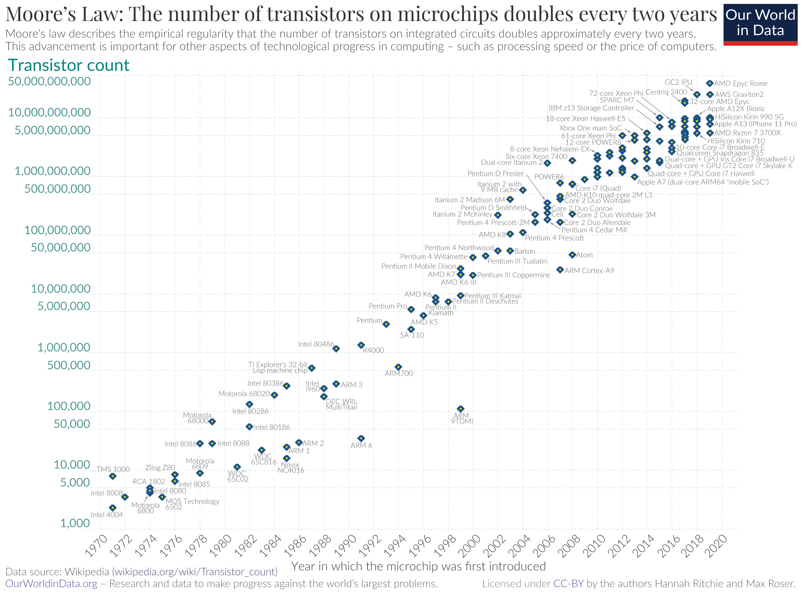
Image Source: https://upload.wikimedia.org/wikipedia/commons/0/00/Moore%27s_Law_Transistor_Count_1970-2020.png

Slide 17
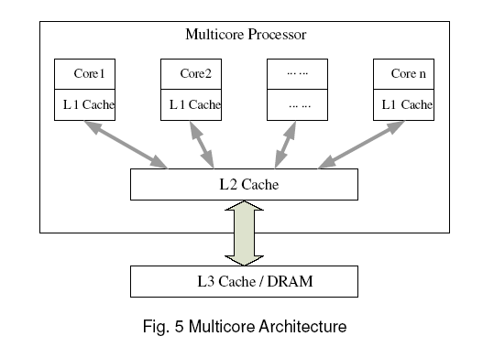
Multicore CPU chip using a hierarchy of caches
L1 cache is private to each core
On-chip L2 cache is shared
L3 cache or DRAM is off the chip
Notes:
DRAM: Dynamic random-access memory

Slide 18
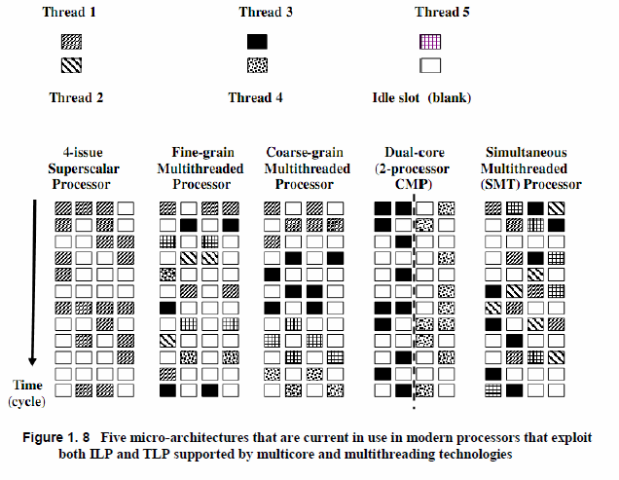
Multicore CPUs and Multithreading Technologies
Notes:
*Two types of parallelism
ILP (Instruction-Level parallelism)
TLP (Thread-level parallelism)

Slide 19
Memory and Disk Technologies

Slide 20
Graphics Processing Unit (GPU)
GPU
  graphics coprocessor or accelerator mounted on a computer’s graphics card of video card.
General-purpose computing on GPU (GPGPU)
  NVIDIA’s CUDA model was for HPC using GPGPUs.
Modern GPUs
  To power supercomputers with massive parallelism at multicore and multithreading levels.
Notes:
CUDA is an Nvidia developed parallel compute environment and API. CUDA once stood for Compute Unified Device Architecture but it's use as an acronym has been dropped. ( CUDA wikipedia) https://developer.nvidia.com/about-cuda

Slide 21
GPU: Architecture of A Many-Core Multiprocessor GPU interacting
with a CPU Processor
For massively parallel execution in 100s or 1000s of processing

Slide 22
NVIDIA Femi GPU built with 16 streaming multiprocessors (SMs)
of 32 CUDA cores each; only one SM is shown.
Notes:
What are CUDA cores? Compute Unified Device Architecture
https://www.gamingscan.com/what-are-nvidia-cuda-cores/
FP: Floating point
INT unit: integer ALU (Arithmetic logic unit)
LD/ST: load/store units allowing source and destination addresses to be calculated for 16 threads per clock
SFU: Special Function Units for executing transcendental instructions.
The transcendental instructions perform trigonometric and logarithmic operations on floating-point operands.
All functional units and CUDA cores are interconnected by an NoC (network on chip) to a large number of SRAM banks (L2 caches)

Slide 23
GPU: (ex) NVIDIA TITAN V as of 2022
Graphics Professing Clusters | 6
Streaming Multiprocessors | 89
CUDA Core (single precision) | 5120
Texture Units | 320
Base Clock (MHz) | 1200 MHz
Boost Clock (MHz) | 1455 MHz

Slide 24
Comparison of the CPU and GPU
in performance/power ratio
Bill Dally of Stanford Univ. considers
power and massive parallelism are major benefits of GPUs
over CPUs for the future.
Notes:
What Is an Exaflop?
https://blogs.nvidia.com/blog/2022/07/26/what-is-an-exaflop/
An exaflop is a measure of performance for a supercomputer that can calculate at least one quintillion floating point operations per second

Slide 25
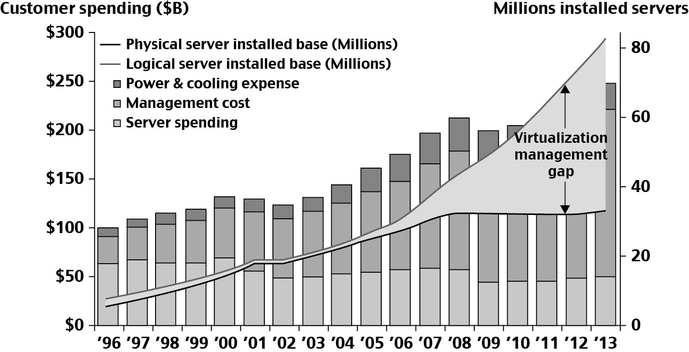
Datacenter and Server Cost Distribution

Slide 26
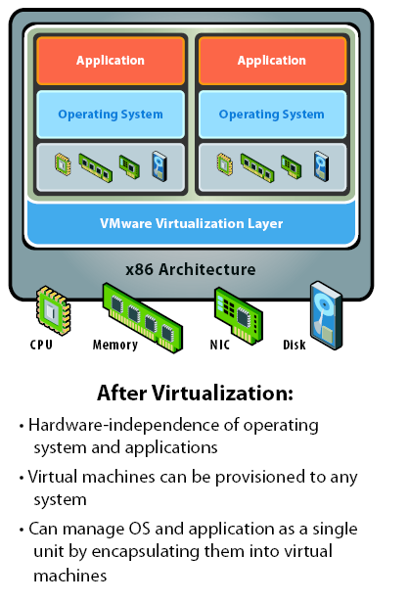
Virtual Machine Architecture
(Courtesy of VMWare, 2010)

Slide 27
Primitive Operations in Virtual Machines:

Slide 28
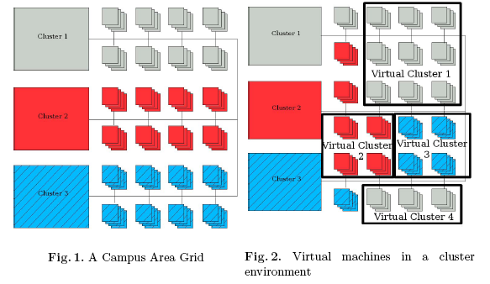
Concept of Virtual Clusters
(Source: W. Emeneker, et et al, “Dynamic Virtual Clustering with Xen and Moab,
ISPA 2006, Springer-Verlag LNCS 4331, 2006, pp. 440-451)

Slide 30
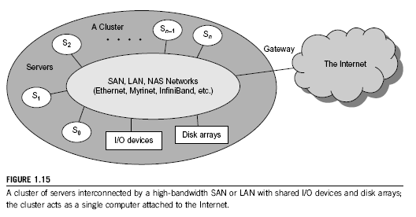
A Typical Cluster Architecture

Slide 32
A Typical Computational Grid

Slide 35
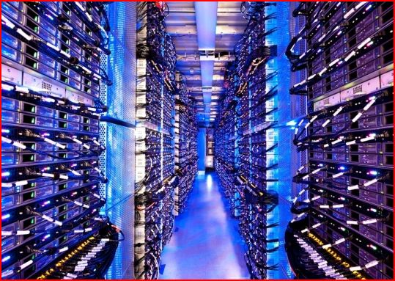
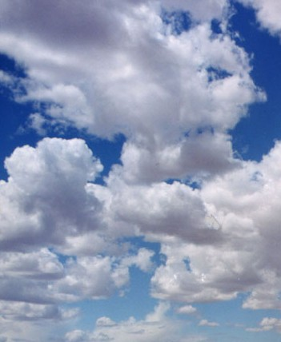
The Cloud
Historical roots in today’s
Internet apps
    Search, email, social networks
    File storage (Live Mesh, Mobile
    Me, Flicker, …)
A cloud infrastructure provides a framework to manage scalable, reliable, on-demand access to applications
A cloud is the “invisible” backend to many of our mobile applications
A model of computation and data storage based on “pay as you go” access to “unlimited” remote data center capabilities

Slide 36
Basic Concept of Internet Clouds

Slide 37
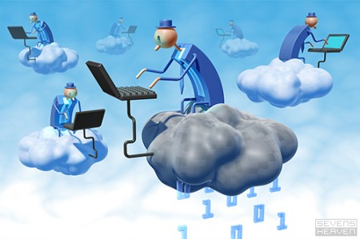
The Next Revolution in IT
Cloud Computing
Classical Computing
  Buy & Own
    Hardware, System Software, Applications often to meet peak needs.
  Install, Configure, Test, Verify, Evaluate
  Manage
  ..
  Finally, use it
  $$$$....$(High CapEx)
Cloud Computing
  Subscribe
  Use
  $ - pay for what you use, based on QoS
Every 18 months?
(Courtesy of Raj Buyya, 2012)

Slide 39
Cloud Computing Challenges:
Dealing with too many issues (Courtesy of R. Buyya)
Pricing
Scalability
Virtualization
Resource Metering
Reliability
QoS
Billing
Service Level
Agreements
Energy Efficiency
Provisioning
on Demand
Utility & Risk Management
Security
Legal &
Regulatory
Privacy
Software Eng. Complexity
Trust
Programming Env.
& Application Dev.

Slide 40
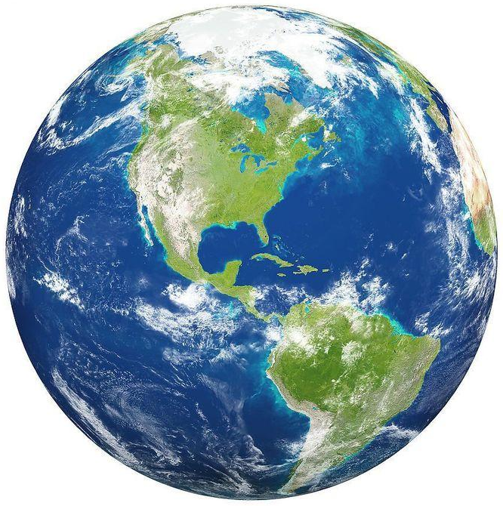
The Internet of Things (IoT)
The Internet
Smart
Earth:
An
IBM
Dream
Internet
Clouds
Internet of Things
Smart Earth

Slide 41
Opportunities of IoT in 3 Dimensions
(courtesy of Wikipedia, 2010)

Slide 42
System Scalability vs. OS Multiplicity

Slide 43
System Availability vs. Configuration Size :

Slide 45
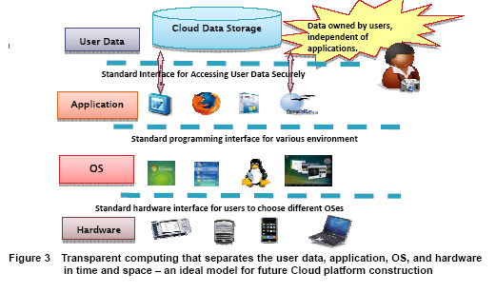
Transparent Cloud Computing Environment

Slide 46
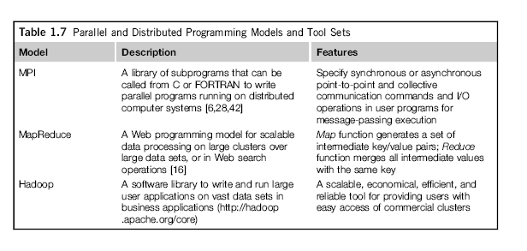
Parallel and Distributed Programming

Slide 47
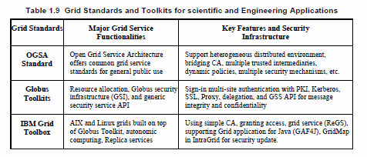
Grid Standards and Middleware :

Slide 49
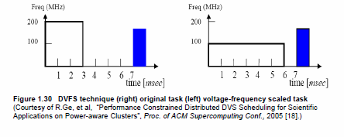
Energy Efficiency :

Slide 50
System Attacks and Network Threads

Slide 51
Four Reference Books:
K. Hwang, G. Fox, and J. Dongarra, Distributed and Cloud Computing: from Parallel Processing to the Internet of Things Morgan Kauffmann Publishers, 2011
R. Buyya, J. Broberg, and A. Goscinski (eds), Cloud Computing: Principles and Paradigms, ISBN-13: 978-0470887998, Wiley Press, USA, February 2011.
T. Chou, Introduction to Cloud Computing: Business and Technology, Lecture Notes at Stanford University and at Tsinghua University, Active Book Press, 2010.
T. Hey, Tansley and Tolle (Editors), The Fourth Paradigm : Data-Intensive Scientific Discovery, Microsoft Research, 2009.

