Slide 1

Welcome to Mason’s Cisco
Academy Support Center & Local
Academy and Accredited IT Courses

Slide 2
George Mason University Academy Support and Instructor Training Center
Louis D’Alessandro
Academy Support & Instructor Training Center Manager
February 2013
Marie Zwickert
Cisco Corporation
Business Development Manager
March 2011

Slide 3

The Cisco Vision
changing the way we
work,
live,
play,
and learn. SM
The Mission
to shape the future of the Internet by creating unprecedented value and opportunity for our customers, employees, investors and ecosystem partners
Notes:
3
What is transforming life around the world is not the dual core microprocessor, the proprietary search engine algorithm, or the software bundle. It’s the networking technology that connects us all and breaks down barriers to human progress.
As the leader in this world-changing technology, Cisco is changing the way we work, live, play and learn. This is bigger and more important than the Internet, productivity or communications. It’s about transforming human experiences and furthering human progress. This is a much broader and bolder aspiration than Cisco has ever endeavored, but no other company can claim this.
Our vision acknowledges that leaders affect positive change in the world and that the network affects every facet of our lives.
Our overriding goal as a business is to create value and have the network be the platform for this growth and prosperity.

Slide 4


Social Media Explosion
These businesses have been around for a collective 200 years.
None of these sites were even here 6 years ago.
SOURCE: Did You Know 4.0 http://www.youtube.com/watch?v=6ILQrUrEWe8
Notes:
[build slide]
Here is another example of the accelerating rate of technology and media change:
TV: top networks ABC, NBC and CBS have 10 million viewers every month.
These business have been around for a combined 200 years.
[click once for animation]
By contrast, MySpace, YouTube and Facebook get 250 million visitors every month.
None of these sites existed 6 years ago.

Slide 5

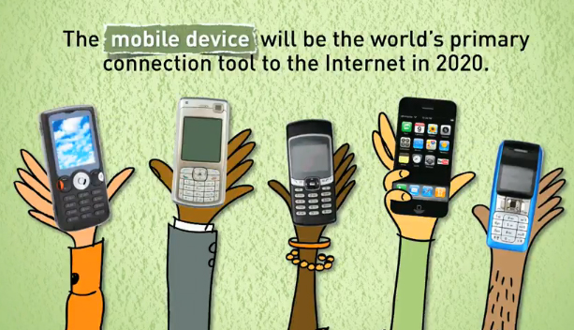
Video and Mobile Wireless Explosion
SOURCE: Did You Know 4.0 http://www.youtube.com/watch?v=6ILQrUrEWe8
Notes:
[build slide]
From the same report, more video was uploaded to YouTube in the last 2 months than if ABC, NBC and CBS had been airing new content every day all year long since 1948.
[click once for animation]
And next, the mobile device, such as a smart phone, will be the world’s primary connection to the Internet by 2020.
So we’re seeing an explosion in the number of users, their own ability to publish and share online, and their increasing ease of access through mobility and wireless.
It’s obvious how powerful technology changes are for transforming the ways people access news, information and entertainment. But that isn’t the only reason we need to integrate more technology in education.

Slide 6
IT Careers and Job Trends in the United States
The Ten Fastest Growing Occupations from 2006 to 2014*
1. Network systems and data communications analyst
2. Physician assistant
3. Computer software engineer, applications
4. Computer software engineer, systems software
5. Network and computer systems administrator
6. Database administrator
7. Physical therapist
8. Medical scientist
9. Occupational therapist
10. College instructor
*Money Magazine
Notes:
These are the 10 fastest growing occupations in the US through 2014, according to Money Magazine.
You’ll note that IT jobs, from network analysts to software engineers and database administrators comprise 5 out of 10 of the fastest growing jobs on the list.
Clearly, careers in information technology will play an important role in the US economy now and in the years to come
6

Slide 7
Fastest Growing ICT Occupations
ITop 50 Occupations from 2008 to 2018
GROWTH
Network Systems and Data Communications Analysts 53%
Computer Software Engineers, Applications 34%
Computer Software Engineers, Systems Software 30%
Computer and Information Scientists, Research 24%
Network and Computer Systems Administrators 23%
Computer Systems Analysts 20%
Database Administrators 20%
NOTE: The national average of all expected employment change is 10.12% for 2008-2018.
National Data Source: Bureau of Labor Statistics, Office of Occupational Statistics and Employment Projections. See also the following:
www.acinet.org/acinet/oview1.asp?printer=&next=oview1&level=BAplus&optstatus=101000000&id=1&nodeid=3&soccode=&stfips=00&jobfam=&group=2&showall=no
Notes:
From the Bureau of Labor Statistics

Slide 8
Security
Digital Video: IPTV
Security
Switching: Modular/Fixed
100%
100%
100%
100%
80%
Cisco/SA
61%
80%
Cisco
80%
80%
73%
60%
35%
60%
60%
60%
Cisco/SA
40%
40%
40%
40%
20%
20%
20%
20%
0%
0%
0%
0%
Voice
Wireless: LAN
Storage: Area Networks
100%
100%
100%
80%
80%
Cisco
58%
80%
60%
34%
60%
60%
40%
Cisco
40%
40%
Cisco
29%
20%
20%
20%
0%
0%
0%
Routing: Edge/Core/Access
Networked Home
Web Conferencing
100%
100%
100%
80%
Cisco
80%
Linksys
80%
49%
59%
26%
60%
60%
60%
40%
40%
40%
Cisco/WebEx
20%
20%
20%
0%
0%
0%
Notes:
Market share and increasing market share is one of the most important objectives used in business as it represents customer demand from a company for a particular product. (Based on the total market size/opportunity).
Cisco is uniquely positioned in various market share product segments – and quickly becomes a leader in product areas – including new markets and existing markets that Cisco enters.
This ability is a testament to our strategy and mindful approach to growing our business and our proven track record of stellar execution and teamwork in accomplishing goals.
Market Share data is based on Calendar Quarters as provided by market analyst's. Data above reflects Q3CY11 (July-August-September 2010)
Starting Timelines for each graph vary
Security Q4CY04
Digital Video Q3CY05
Switching Q1CY06
Voice Q1CY04
Wireless Lan Q2CY03
Storage Q4CY02
Routing Q2CY03
NW Home Q1CY05
Web Conf 2003

Slide 9

Today’s Perspective

Slide 10
Cisco Networking Academy
One of the World’s Largest Classrooms
1 million students engaged in learning this year
3.75 million students touched by the program to date
10 thousand academies operating in 165 countries
1 million online assessments delivered monthly
100 million online assessments delivered to date
125 thousand Facebook fans and growing daily
Notes:
We have a lot to celebrate!
Cisco Networking Academy has touched the lives of 3.75 million students, with 1 million students engaged this year!
The campaign is meant to celebrate the World’s Largest Classroom with its instructors, students, administrators and partners worldwide.
What we are trying to achieve
How this ties in to the NetAcad Strategy
To build awareness with Cisco public sector leadership
Celebrate momentum with the global community of learners, instructors and partners
Reinvigorate the Networking Academy brand
Showcase Cisco Networking Academy as the leading example of Cisco’s corporate social responsibility commitment to Education
Microsite
Video
Global Ed Leader Profiles
Messaging Brief
Speaking Points
FAQs
Email Template
PowerPoint Template
Academy Student Video Contest
Launch: Feb 12
Communications will roll out through end of Feb and into Marchw
Feb 14: CEC Article
Feb 16: Video on Ed Cisco.com
Feb 17: Student Video Contest kicks off
Public Sector sales teams will receive communication with resources available to use with customers

Slide 11
Cisco Networking Academy Impact: United States
Students |  |  |  | 148,293
Female students |  |  |  | 14%
Distinct cumulative students (successfully completing at least one course) |  |  |  | 962,338
Instructors |  |  |  | 3,710
Academies |  |  |  | 2,168
Education level (students/academies at more than one education level are counted proportionately) | Secondary Schools | Community Colleges | Universities | Other²
Students | 37% | 50% | 11% | 2%
Academies | 60% | 31% | 7% | 2%
Curricula ³ (students/academies that take/teach multiple curricula are counted more than once) | ITE | CCNA 1, 2 | CCNA 3, 4 | Advanced Technologies / Other ⁴
Students | 32% | 67% | 20% | 4%
Academies | 53% | 72% | 51% | 15%
In-kind contribution value⁵ (estimated cumulative value to academies including donations and discounts) |  |  |  | $410,517,899
¹ Source: MRE FULL Package of Quarterly Metrics_10.31.10_v1.xlsx
² Includes community-based organizations, middle schools, military, nontraditional educational settings, and post-graduate institutions
³ Includes MRE report 4415P51 Active Students and Academies 2010 11 02 v3.xlsx
⁴ Includes CCNA Security, CCNP, Security, Wireless, IP Telephony, Java, UNIX and Panduit Network Infrastructure Essentials (PNIE)
⁵ Source: MRE report 4483 In-Kind Contribution for United States (v9) 2010.11.11.xlsx
Notes:
11

Slide 12
Cisco Networking Academy Impact: Virginia
Students |  |  |  | 4,149
Female students |  |  |  | 13%
Distinct cumulative students (successfully completing at least one course) |  |  |  | 27,985
Instructors |  |  |  | 131
Academies |  |  |  | 70
Education level (students/academies at more than one education level are counted proportionately) | Secondary Schools | Community Colleges | Universities | Other ²
Students | 49% | 34% | 15% | 2%
Academies | 59% | 33% | 4% | 4%
Curricula ³ (students/academies that take/teach multiple curricula are counted more than once) | ITE | CCNA 1, 2 | CCNA 3, 4 | Advanced Technologies / Other ⁴
Students | 31% | 66% | 21% | 2%
Academies | 43% | 76% | 64% | 17%
In-kind contribution value ⁵ (est. cumulative value to academies, including donations and discounts) |  |  |  | $12,111,153
¹ Source: Quarterly Metrics, October 2010
² Includes community-based organizations, middle schools, military, nontraditional educational settings, and post-graduate institutions
³ Source: MRE report 4415P51, November 2010
⁴ Includes CCNA Security, CCNP, Security, Wireless, IP Telephony, Java, UNIX and Panduit Network Infrastructure Essentials (PNIE)
⁵ Source: MRE report 4541, November 2010

Slide 13
ICT Job Projections: Virginia
Virginia Occupation Projections | Employment |  | Change |  | Average Annual Openings | Occupational Employment as of May 2009²
 | 2008 | 2018 | # | %
Computer Support Specialists | 19,115 | 23,302 | 4,187 | 21.9 | 948 | 18,840
Computer Systems Analysts | 36,518 | 47,978 | 11,460 | 31.4 | 1,933 | 35,030
Network and Computer Systems Administrators | 18,407 | 25,626 | 7,219 | 39.2 | 1,029 | 18,460
Network Systems and Data Communications Analysts | 16,981 | 28,651 | 11,670 | 68.7 | 1,472 | 13,650
Computer and Information Systems Managers | 12,726 | 16,179 | 3,453 | 27.1 | 552 | 12,320
Source: Virginia Workforce Connection, http://www.vawc.virginia.gov/analyzer/default.asp
² Department of Labor, Bureau of Labor Statistics, May 2009 State Occupational Employment and Wage Estimates, http://stat.bls.gov/oes/current/oessrcst.htm

Slide 14
Virginia Cisco Networking Academy
Active Students 4,149
Active Academies 70 *
YOY Student Growth 7%
0
Frederick
Virginia Active Academies (all curricula) as of 10/31/10
Academies that have taught a class with at least three students, or adopted a new curriculum, within the last twelve months.
*NOTE: 16 additional academies are located offshore.
Designates Training Center in County
0
0
Winchester
Clarke
1
0
1
Loudoun
3
District of Columbia
1
Warren
0
Arlington
4
Shenandoah
0
Fauquier
1
Fairfax
0
Manassas
3
Falls Church
0
0
Rappahannock
5
Alexandria
Page
0
Prince William
Rockingham
0
Culpeper
1
0
1
Madison
Stafford
Highland
0
0
2
Harrisonburg
0
Fredericksburg
0
Augusta
Greene
2
0
0
Orange
King George
0
0
Staunton
Spotsylvania
Westmoreland
Bath
0
Charlottesville
0
0
0
2
0
Waynesboro
0
Louisa
Caroline
Essex
Richmond
0
1
Rockbridge
0
Albemarle
0
0
0
Northumberland
0
0
Fluvanna
0
Hanover
0
Alleghany
Nelson
0
0
Covington
Buena Vista
0
Goochland
0
King William
0
Accomack
0
0
0
King And Queen
Lancaster
1
Lexington
Buckingham
Henrico
0
Middlesex
0
Botetourt
Amherst
0
Powhatan
New Kent
0
0
Craig
2
Cumberland
5
0
Gloucester
Mathews
0
1
0
Lynchburg
0
0
Chesterfield
Charles City
0
2
0
1
1
Appomattox
0
Amelia
0
Northampton
Buchanan
Giles
0
James City
0
Roanoke
Bedford
Colonial Heights
2
1
Salem
Campbell
Prince Edward
0
0
1
0
Petersburg
0
0
Montgomery
0
0
Prince George
Newport News
2
Dickenson
2
Tazewell
Bland
1
Charlotte
Nottoway
Dinwiddie
Surry
1
Wise
Russell
1
Pulaski
0
Franklin
0
0
0
Hampton
0
Wythe
Floyd
1
0
Lunenburg
0
Sussex
Isle Of Wight
2
1
1
2
Smyth
0
0
0
Pittsylvania
Halifax
0
0
0
1
Norfolk
Lee
Scott
Washington
0
0
Carroll
Patrick
1
Mecklenburg
Brunswick
Southampton
0
Chesapeake
1
Grayson
Henry
Greensville
Suffolk
6
Bristol
Galax
Martinsville
2
0
Virginia Beach
Danville
Source: GRAND MASTER Starting with 4415P51 Active Students and Academies 2010 11 02 v3_Version v2.xlsx
Emporia

Slide 15
Marketing Resources

Slide 16
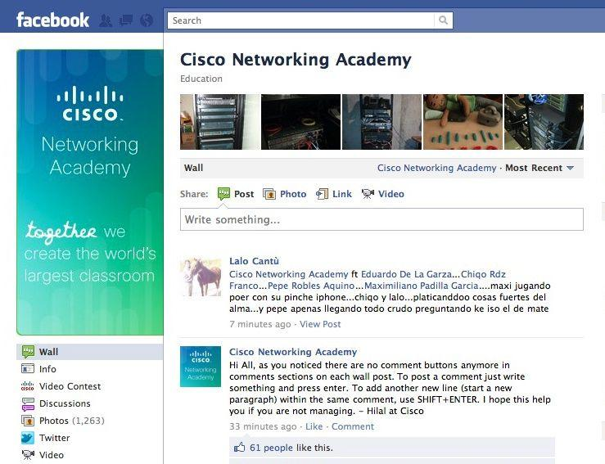


Cisco Networking Academy is on Facebook
http://www.facebook.com/cisconetworkingacademy

Slide 17
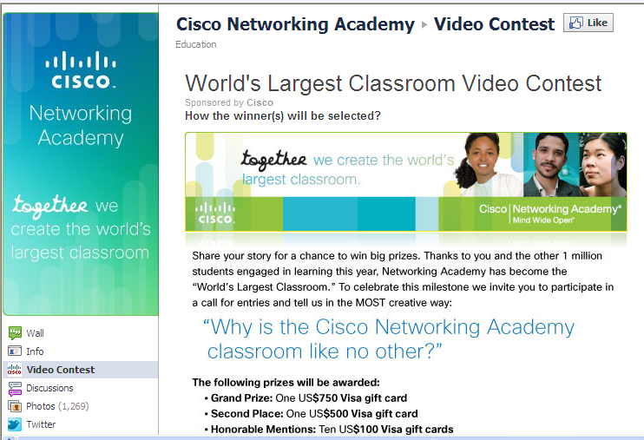

Cisco Networking Academy is on Facebook
http://www.facebook.com/cisconetworkingacademy?v=app_197624863584369
http://www.youtube.com/watch?v=rcW41PvuV2g

Slide 18
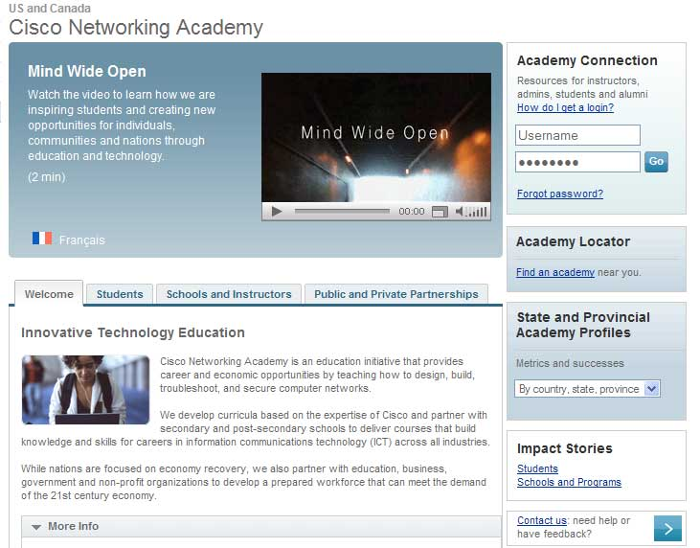
New US/Canada Networking Academy Site
http://www.cisco.com/go/netacad/us-can/
Potential students and instructors
Existing Academies
  Schools and nonprofit organizations
  Government education advocates
  Other public and private entities
Resources include:
  country, state and province profiles and data
  student success stories
  case studies/models of practice
  hot topics and videos
  ICT career resources

Slide 19
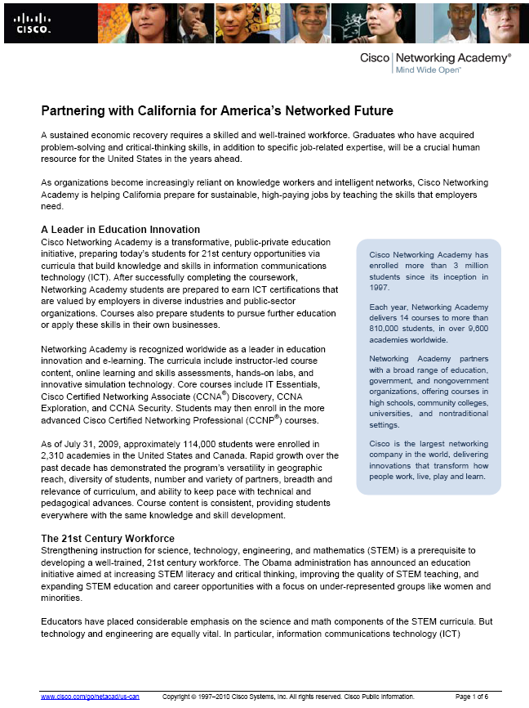
United States Academy Profiles
Improved Messaging
Key Care Abouts
Our Tie In
Relevant Data
Job Demand Stats
Contributed Cisco $s
# of Students Impacted
Academy List
Impact Story
Notes:
For Ops Slides:
Academy Profiles
Refresh data and positioning for Xx regional and country profiles
Raise visibility and intergation with stakeholders
- Communication to NetAcad, Cisco Public Sector Sales and Gov’t Affairs
- Ex: Announce via Bruce Klein’s eBrief to his sales teams (add value coming from leadership)
- Links on internal support pages (SLED, Mktg, etc)
- Customer/Partner email template
- Main landing page on US-C Cisco.com
- Links from Ed global and theater CDC page

Slide 20
Student Opportunities:
Extending Learning Beyond the Classroom
Notes:
20

Slide 21
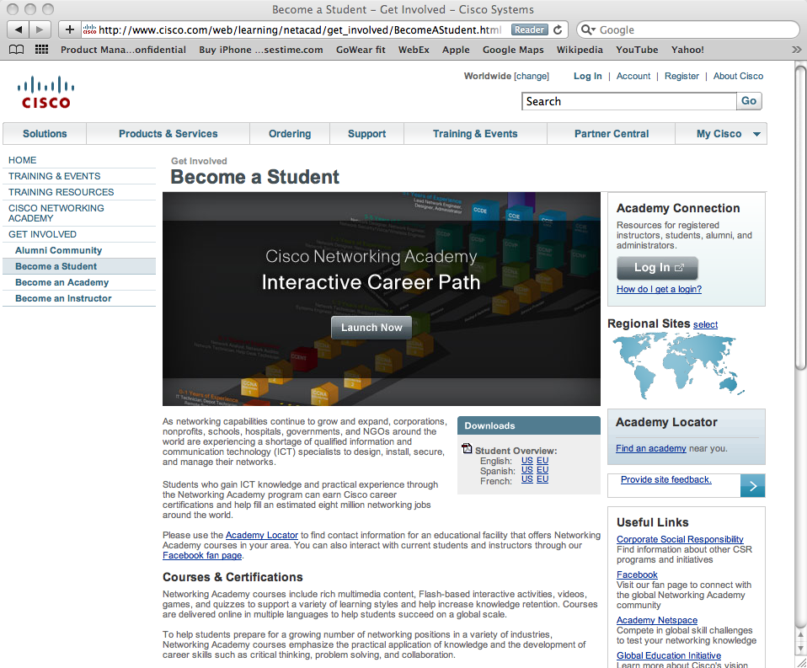
Become a Student page

Slide 22
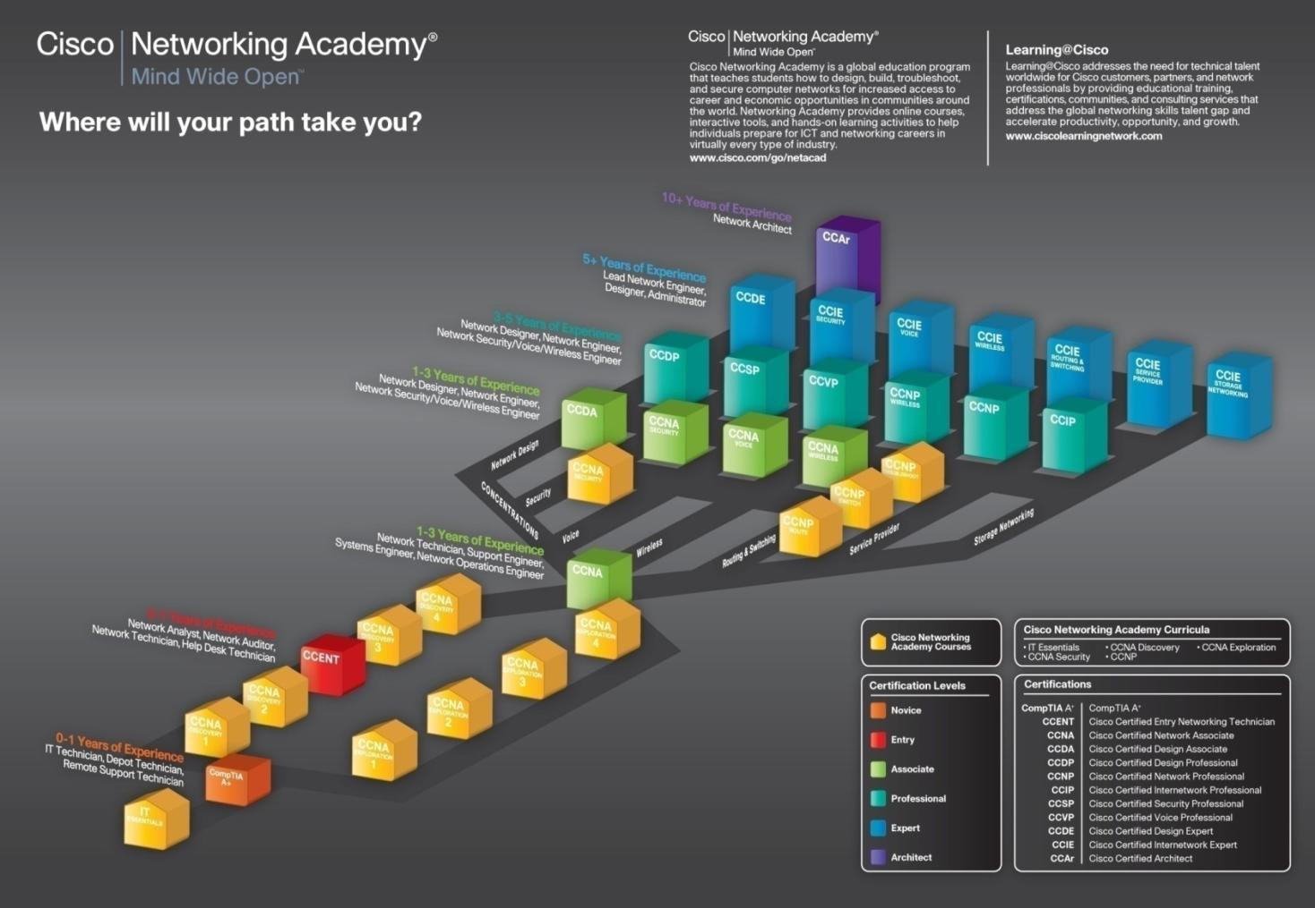
Notes:
And as part of our ongoing marketing efforts, we’ve developed this Career Path poster to help students navigate their career. It gives prospective and current students an idea of what different paths they can take to get to different jobs. By putting both Cisco Networking Academy courses and Learning @ Cisco Certifications on the same diagram, students see the “continuum” of learning and certification opportunities provided by Cisco.
This piece is available as a poster that can be put in classrooms and posted at Academies. We’re working on making this into a flash piece that can be featured on Academy Connection.

Slide 23
Cisco Networking Academy as the “T” in STEM
Notes:
23

Slide 24
Science, Technology, Engineering, Math
STEM Education Objectives
Wrapped
with
Applicable Skills
Improve math and science test scores
Better prepare students for scientific and technological careers
Expose students to related subjects to encourage STEM career paths
Increase sophisticated skills in technology, science, math and engineering
Prepare students with career-ready skills: problem-solving, analysis, communication, intellectual curiosity
Increase qualified educators to support STEM education
Science,
Technology,
Engineering, Math
Knowledge
STEM
Education
Notes:
24

Slide 25

Meeting the “T” in STEM
Technology studies for more the just the “T”
Online coursework, detailed lesson plans, assessments, teacher professional development
Free curriculum to non profit schools, large hardware discount
Technology studies for Career- and College-Ready Students
Applied Technology Learning reinforces skills in Technology, math, science and engineering
21st Century STEM work and thinking Skills
Education standards alignment: STEM, Common Core Standards
Use of technology in coursework strengthens STEM learning
Student Engagement in STEM Studies
Training for Qualified STEM Teachers
Cisco
Networking Academy
A comprehensive, cost-effective
STEM Education program
Notes:
TRANSITION: STEM Education initiatives look for programs that go beyond subject area knowledge. They also emphasize the importance of 21st century skills, student engagement and professional development. Networking Academy delivers all of these.
21st Century STEM career skills – for innovative thinking and for effective workforce skills (e.g. communication, teamwork)
Student engagement – to keep more students choosing STEM studies
More highly qualified STEM teachers – assure long-term solution with more knowledgeable STEM teachers
25

Slide 26
Meeting the “T” in STEM
Technology studies for more the just the “T”
Technology studies for Career- and College-Ready Students
Basic to advanced information communications technology (ICT) and networking skills
Build important system and process thinking skills
Coursework covers all STEM Cluster Topics, and
Teaches many of the reading and writing Common Core Standards
Career-ready students:
  prepare for globally recognized certifications
  qualify for high-demand, high-wage jobs
College-ready students
  strengthen understanding of technology, as well as math, science and engineering
Cisco
Networking Academy
A comprehensive, cost-effective
STEM Education program
Notes:
TRANSITION: STEM Education initiatives look for programs that go beyond subject area knowledge. They also emphasize the importance of 21st century skills, student engagement and professional development. Networking Academy delivers all of these.
21st Century STEM career skills – for innovative thinking and for effective workforce skills (e.g. communication, teamwork)
Student engagement – to keep more students choosing STEM studies
More highly qualified STEM teachers – assure long-term solution with more knowledgeable STEM teachers
26

Slide 27
Meeting the “T” in STEM
Technology studies for more the just the “T”
21ST Century Skills
Coursework includes practicing thinking skills essential for innovative technologists, mathematicians, scientists and engineers, including:
  Information handling
  Problem-solving and analysis
  Reflection and creativity
  Intellectual curiosity
  Communication and collaboration
  Decision making and negotiation
Cisco
Networking Academy
A comprehensive, cost-effective
STEM Education program
Notes:
TRANSITION: STEM Education initiatives look for programs that go beyond subject area knowledge. They also emphasize the importance of 21st century skills, student engagement and professional development. Networking Academy delivers all of these.
21st Century STEM career skills – for innovative thinking and for effective workforce skills (e.g. communication, teamwork)
Student engagement – to keep more students choosing STEM studies
More highly qualified STEM teachers – assure long-term solution with more knowledgeable STEM teachers
27

Slide 28
Meeting the “T” in STEM
Technology studies for more the just the “T”
Student Engagement in STEM Studies
Instruction with real world content and hands on labs increases student relevancy.
Varied teaching enhancements increase student engagement:
  Online instruction
  Project-based tasks
  video
  Web based games
  Lab and job simulations
  Social networking
Cisco
Networking Academy
A comprehensive, cost-effective
STEM Education program
Notes:
TRANSITION: STEM Education initiatives look for programs that go beyond subject area knowledge. They also emphasize the importance of 21st century skills, student engagement and professional development. Networking Academy delivers all of these.
21st Century STEM career skills – for innovative thinking and for effective workforce skills (e.g. communication, teamwork)
Student engagement – to keep more students choosing STEM studies
More highly qualified STEM teachers – assure long-term solution with more knowledgeable STEM teachers
28

Slide 29
Meeting the “T” in STEM
Technology studies for more the just the “T”
More Qualified STEM Teachers
Initial professional development on coursework
Ongoing support for teaching and technical growth
    Webinars, physical and virtual conferences
Global teacher community
  Shared resources and best practices
  Online communities
Cisco
Networking Academy
A comprehensive, cost-effective
STEM Education program
Notes:
TRANSITION: STEM Education initiatives look for programs that go beyond subject area knowledge. They also emphasize the importance of 21st century skills, student engagement and professional development. Networking Academy delivers all of these.
21st Century STEM career skills – for innovative thinking and for effective workforce skills (e.g. communication, teamwork)
Student engagement – to keep more students choosing STEM studies
More highly qualified STEM teachers – assure long-term solution with more knowledgeable STEM teachers
29

Slide 30
How Do We Validate?
Global Relevance
U.S. Relevance
Impact
900,000+ students annually
3+ million students since 1997
165+ countries
Diverse students and communities
2,100+ Academies
130,000+ Students since beginning
3,600+ Instructors
Over 330 million In-Kind Contributions
Average: 15% Girls
In a diverse range of students’ lives
Endorsements from state and federal leaders
Interaction with education organizations on outcomes
Business community collaboration
Notes:
30

Slide 31


Cisco Commitment to Transforming Education
Shaping 21st century teaching and learning by providing thought leadership, practical engagements,
and leadership
capacity.
Together, we
can change
the way we
work, live,
play and
learn.
Notes:
31
NOTE: This answers the WHY CISCO?
To prepare students for the fast-moving demands of this century, radical system-wide education transformation is needed. Cisco Global Education is engaged in shaping a sustainable and replicable model for change through:
Thought leadership that identifies the best directions in education transformation
Practical engagements that focus on developing, scaling and replicating successful working models
Leadership capacity building a community of Education System leader using web 2.0 technologies, example: GETideas.org is a Cisco sponsored open, online community to promote transformation in education.
Two proofpoints: Our successes in the NYC ischool and 21St Century School initiative (Louisiana and Mississippi).
Student testing and other assessment techniques are critical to classroom success. In January 2009, Cisco joined with Intel and Microsoft to announce Assessment and Teaching of 21st Century Skills (ATC21S), a research initiative aimed at making global education more effective by clearly defining the skills needed by today’s students and developing strategies for measuring students’ progress with the aid of information technologies
ADDITIONAL POINTS
Started by two Stanford professors, from it’s very beginnings, Cisco has had close ties to education.
At Cisco, we believe that the same technologies that created the Internet and the information revolution have the power to transform education for the 21st century and lay the foundation for a better future for countless young people.
We are committed to helping educators develop the skills that students need to flourish in today’s economy and society, such as collaboration, creativity, and critical thinking.
When these abilities are supported by integrating technology in the classroom, education transformation becomes a reality, and is more affordable and less intimidating than ever before.
Our education commitment focuses on transforming students, teachers, and systems to engage learners who live in a connected world.
Because of connectivity, 21st century students learn faster and they learn differently.
Their education must allow them to complete engaging projects and collaborate with their peers rather than passively acquiring information.
Technology can help improve and reduce variability in student outcomes, while equipping students with the skills that the marketplace demands and employers value.
With technology, we can build basic educational capacity faster, enhance the quality of education, and give many more children the chance to learn, improve their lives, and strengthen their communities.

Slide 32

Advantages to You
Confidence in a program and its success
Measurable results
Employable graduates
Students more prepared for advanced degrees
Better local PR and business relationships
Access to new STEM Education funding
Positively impact local economy
Engage students in STEM studies
Give career-ready student skills that qualify them for good paying jobs
Provide college-ready students a practical foundation in STEM skills
Enhance STEM teaching skills
Notes:
32

