Slide 1
Computer networks
Hwajung Lee

Slide 2
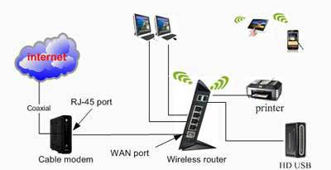
Image Source: https://anggipuspitasariii.wordpress.com/2013/12/06/bagaimana-membangun-jaringan-komputer-dan-internet/

Slide 3

What is Computer Networks?
A collection of autonomous computers interconnected by a single or multiple technologies
  Interconnected via:
    Copper wire
    Fiber optics
    Microwaves
    Infrared
    Communication satellites, etc.
Image Source: www.transcribeyourclass.ca/hts.html

Slide 4
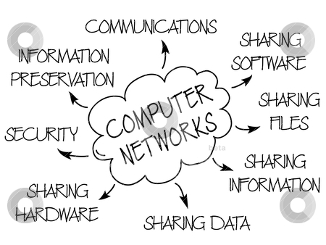
Image Source: http://www.freshersadda.net/2014/09/03/computer-networks-basics-ibps-sbi-rrb-computer-awareness/
Notes:
Why Computer Networks?

Slide 5
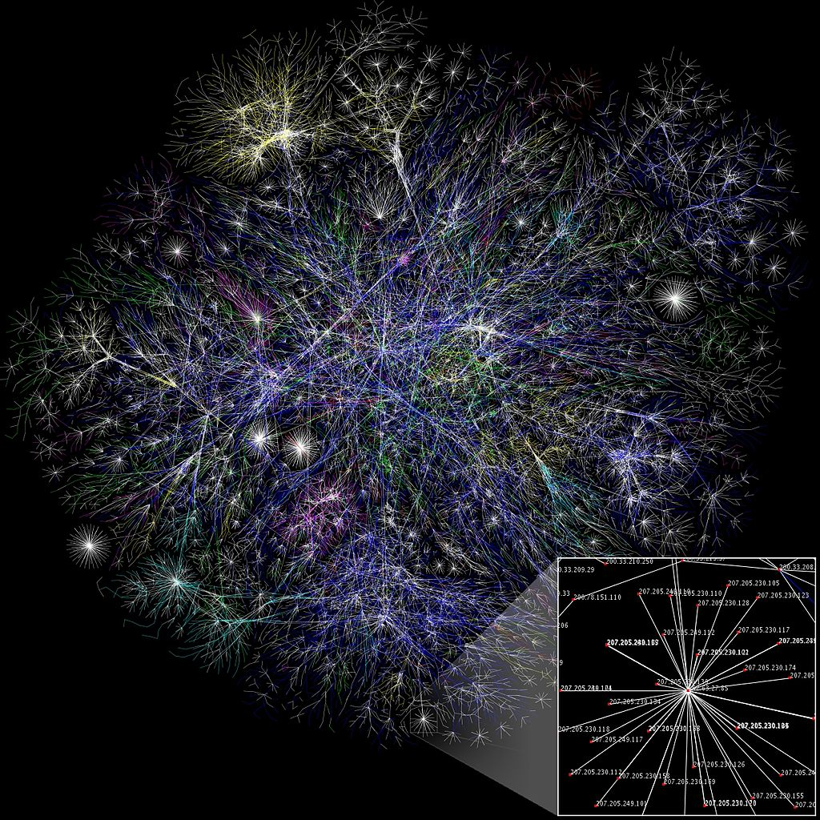
Notes:
https://en.wikipedia.org/wiki/Computer_network#/media/File:Internet_map_1024.jpg
Partial map of the Internet based on the January 15, 2005 data found on opte.org. Each line is drawn between two nodes, representing two IP addresses. The length of the lines are indicative of the delay between those two nodes. This graph represents less than 30% of the Class C networks reachable by the data collection program in early 2005. Lines are color-coded according to their corresponding RFC 1918 allocation as follows: Dark blue: net, ca, us Green: com, org Red: mil, gov, edu Yellow: jp, cn, tw, au, de Magenta: uk, it, pl, fr Gold: br, kr, nl White: unknown

Slide 6
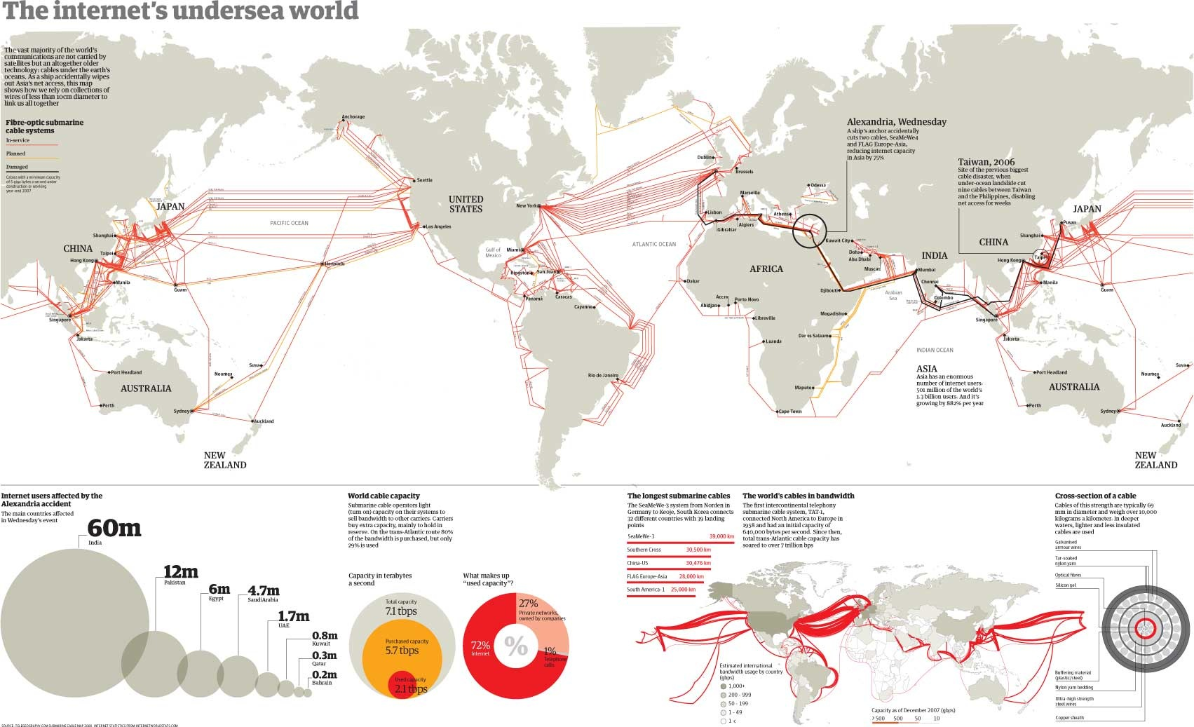

Slide 7
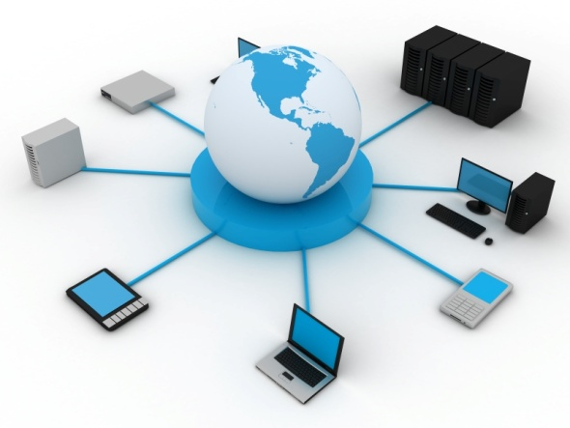
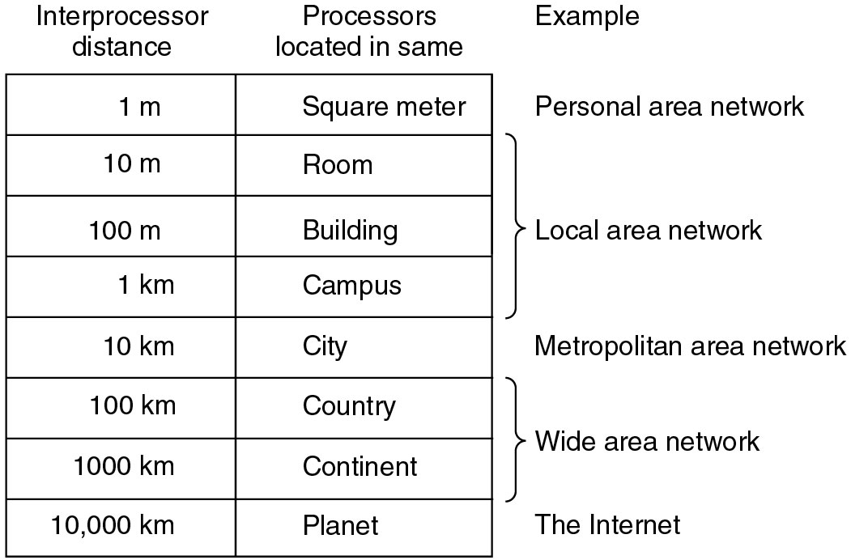
Classification of interconnected processors by scale.
Image Source: www.imagine-net-tech.com/network_services.html

Slide 8
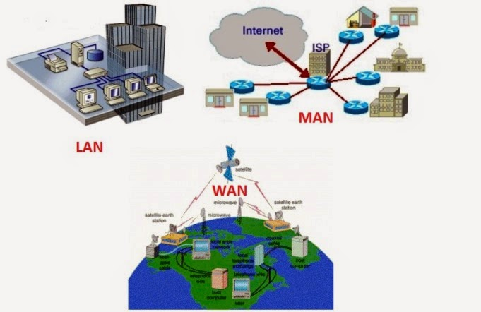
Image Source: http://www.afifmaulana-kbsm.com/2015/04/pengertian-jaringan-lanmanwan-dan.html
Notes:
http://www.afifmaulana-kbsm.com/2015/04/pengertian-jaringan-lanmanwan-dan.html

Slide 9
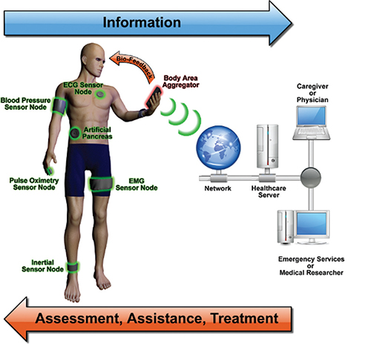
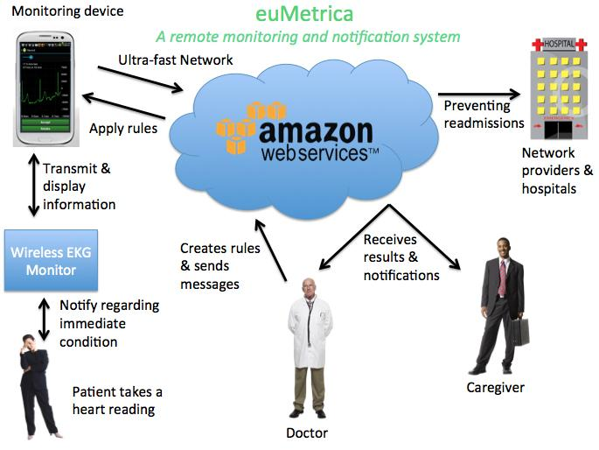
Image Source: https://mozillaignite.org/apps/list/health-it/index.html%3Fpage=2.html
Image Source: https://mozillaignite.org/apps/list/health-it/index.html%3Fpage=2.html
Notes:
https://mozillaignite.org/apps/list/health-it/index.html%3Fpage=2.html

Slide 10


Slide 11

What is a protocol?
Communications between computers requires very specific unambiguous rules
A protocol is a set of rules that governs how two or more communicating parties are to interact
  Internet Protocol (IP)
  Transmission Control Protocol (TCP)
  HyperText Transfer Protocol (HTTP)
  Simple Mail Transfer Protocol (SMTP)
Image Source: www.wallpapers.eu.com/view/agreement-1152x864.html

Slide 12

What is a communication network?
Image Source: http://www.freeiconsdownload.com/Free_Downloads.asp?id=485
The equipment (hardware & software) and facilities that provide the basic communication service
Virtually invisible to the user; Usually represented by a cloud
Equipment
  Routers, servers, switches, multiplexers, hubs, modems, …
Facilities
  Copper wires, coaxial cables, optical fiber
  Ducts, conduits, telephone poles …
How are communication networks designed and operated?

Slide 13
7-Layer OSI Reference Model
Application
Application
End-to-End Protocols
Application
Layer
Application
Layer
Presentation
Layer
Presentation
Layer
Session
Layer
Session
Layer
Transport
Layer
Transport
Layer
Network
Layer
Network
Layer
Network
Layer
Network
Layer
Data Link
Layer
Data Link
Layer
Data Link
Layer
Data Link
Layer
Physical
Layer
Physical
Layer
Physical
Layer
Physical
Layer
Communicating End Systems
One or More Network Nodes

Slide 14
TCP/IP Protocol Suite
HTTP
SMTP
DNS
RTP
Distributed applications
Reliable stream service
User
datagram service
TCP
UDP
Best-effort
connectionless packet transfer
IP
(ICMP, ARP)
Network
interface 1
Network
interface 2
Network
interface 3
Diverse network technologies

Slide 15
Web Browsing Application
World Wide Web allows users to access resources (i.e. documents) located in computers connected to the Internet
Documents are prepared using HyperText Markup Language (HTML)
A browser application program is used to access the web
The browser displays HTML documents that include links to other documents
Each link references a Uniform Resource Locator (URL) that gives the name of the machine and the location of the given document
Let’s see what happens when a user clicks on a link

Slide 16
1. DNS
A. 64.15.247.200
Q. www.nytimes.com?
User clicks on http://www.nytimes.com/
URL contains Internet name of machine (www.nytimes.com), but not Internet address
Internet needs Internet address to send information to a machine
Browser software uses Domain Name System (DNS) protocol to send query for Internet address
DNS system responds with Internet address

Slide 17
2. TCP
ACK
ACK, TCP Connection Request
From: 64.15.247.200 Port 80 To:128.100.11.13 Port 1127
TCP Connection Request
From: 128.100.11.13 Port 1127
To: 64.15.247.200 Port 80
Browser software uses HyperText Transfer Protocol (HTTP) to send request for document
HTTP server waits for requests by listening to a well-known port number (80 for HTTP)
HTTP client sends request messages through an “ephemeral port number,” e.g. 1127
HTTP needs a Transmission Control Protocol (TCP) connection between the HTTP client and the HTTP server to transfer messages reliably

Slide 18
3. HTTP
Content
200 OK
GET / HTTP/1.1
HTTP client sends its request message: “GET …”
HTTP server sends a status response: “200 OK”
HTTP server sends requested file
Browser displays document
Clicking a link sets off a chain of events across the Internet!
Let’s see how protocols & layers come into play…

Slide 19
Example: TCP
TCP is a transport layer protocol
Provides reliable byte stream service between two processes in two computers across the Internet
Sequence numbers keep track of the bytes that have been transmitted and received
Error detection and retransmission used to recover from transmission errors and losses
TCP is connection-oriented: the sender and receiver must first establish an association and set initial sequence numbers before data is transferred
Connection ID is specified uniquely by
(send port #, send IP address, receive port #, receiver IP address)

Slide 20
Example: HTTP
HTTP is an application layer protocol
Retrieves documents on behalf of a browser application program
HTTP specifies fields in request messages and response messages
  Request types; Response codes
  Content type, options, cookies, …
HTTP specifies actions to be taken upon receipt of certain messages

Slide 21
HTTP uses service of TCP
HTTP
server
HTTP
client
Response
GET
Port 1127
Port 80
TCP
TCP
GET
GET
Response
bytes
TCP
80, 1127
1127, 80
Response

Slide 22
Example: UDP
UDP is a transport layer protocol
Provides best-effort datagram service between two processes in two computers across the Internet
Port numbers distinguish various processes in the same machine
UDP is connectionless
Datagram is sent immediately
Quick, simple, but not reliable

Slide 23
Example: DNS Protocol
DNS protocol is an application layer protocol
DNS is a distributed database that resides in multiple machines in the Internet
DNS protocol allows queries of different types
  Name-to-address or Address-to-name
DNS usually involves short messages and so uses service provided by UDP
Well-known port 53

Slide 24
Local
Name
Server
Authoritative
Name
Server
1
5
4
2
3
6
Root
Name
Server
Local Name Server: resolve frequently-used names
  University department, ISP
  Contacts Root Name server if it cannot resolve query
Root Name Servers: 13 globally
  Resolves query or refers query to Authoritative Name Server
Authoritative Name Server: last resort
  Every machine must register its address with at least two authoritative name servers

Slide 25
Summary
Layers: related communications functions
  Application Layer: HTTP, DNS
  Transport Layer: TCP, UDP
  Network Layer: IP
Services: a protocol provides a communications service to the layer above
  TCP provides connection-oriented reliable byte transfer service
  UDP provides best-effort datagram service
Each layer builds on services of lower layers
  HTTP builds on top of TCP
  DNS builds on top of UDP
  TCP and UDP build on top of IP

Slide 26
Network Architecture Evolution
?
Information transfer
per second (bits/second)
Telegraph
networks
Telephone
networks
Internet, Optical
& Wireless
networks
Next Generation Internet

Slide 27
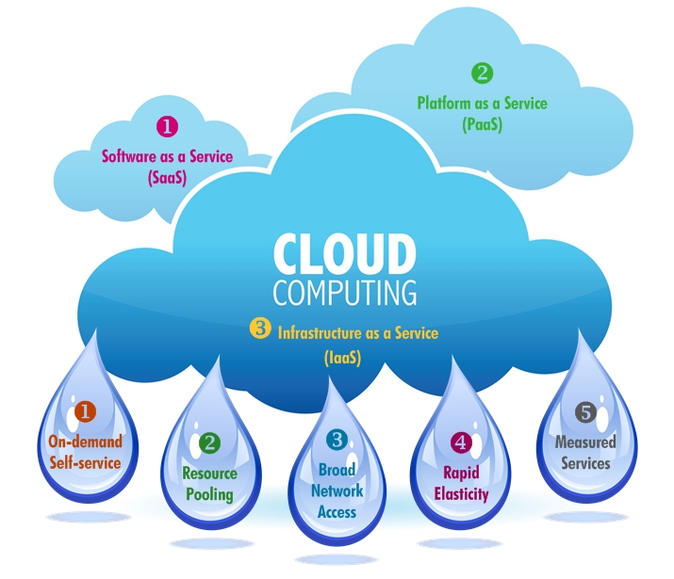

Example: Amazon Echo
Image Source: http://www.itero.co/cloud-computing-recruitment/

Slide 28
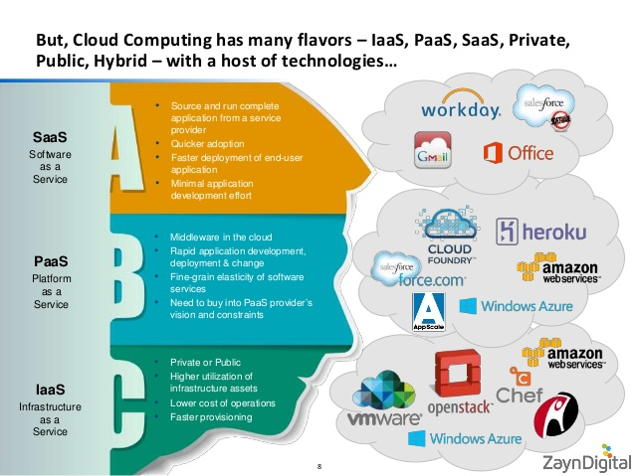
Image Source: http://www.slideshare.net/iahmed91/zayn-digital-cloudcomputing-architecture-v1c-40561364

Slide 29
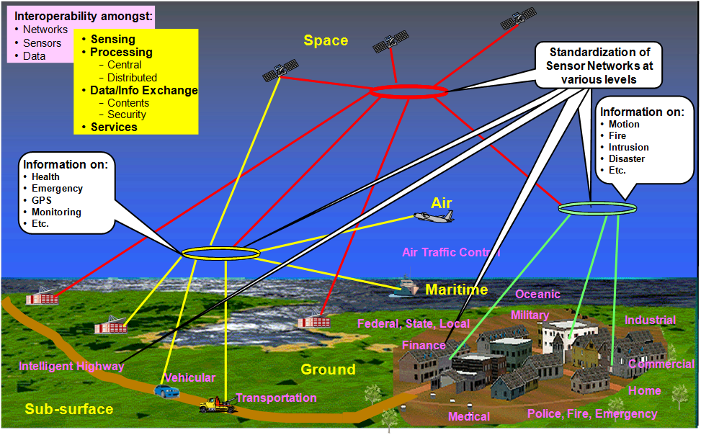
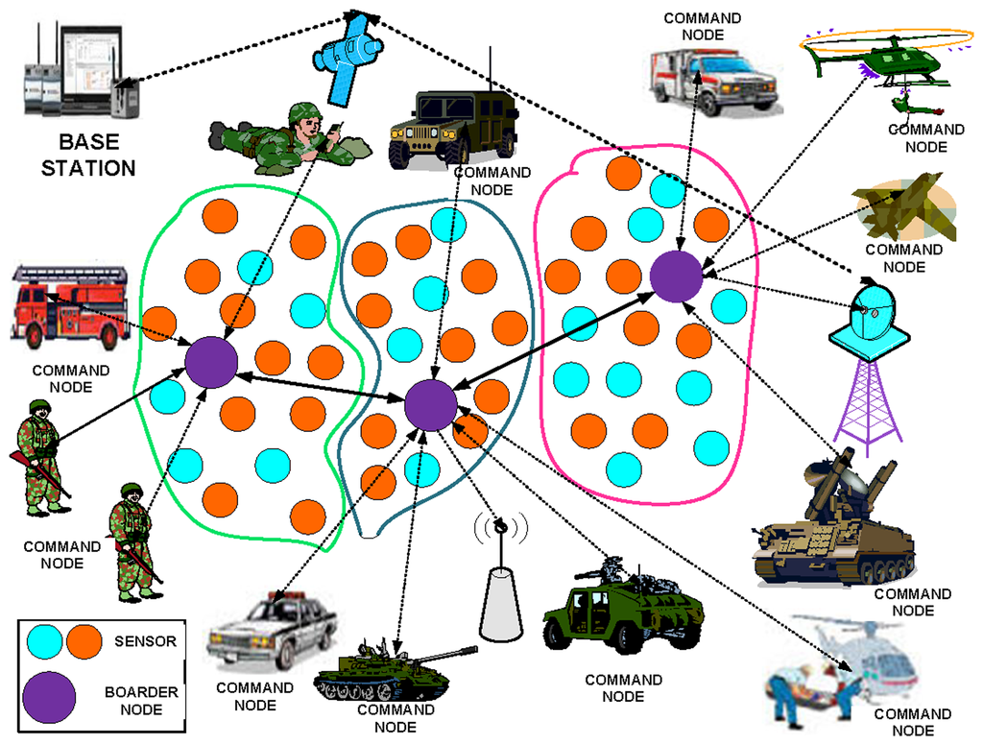
Image Source: http://www.incits.org/news-events/press-releases/rapid-progress-on-standards-for-sensor-networks
More Works with Networks and Sensors
Image Source: http://www.mdpi.com/1424-8220/14/3/5074

Slide 30
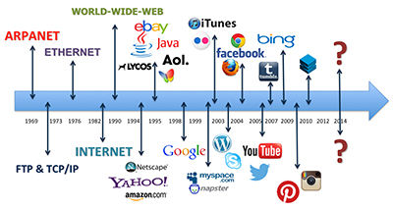
History of Internet
Image Source: http://malonemediagroup.com/history-of-the-internet-timeline-an-ever-evolving-digital-world/

Slide 31
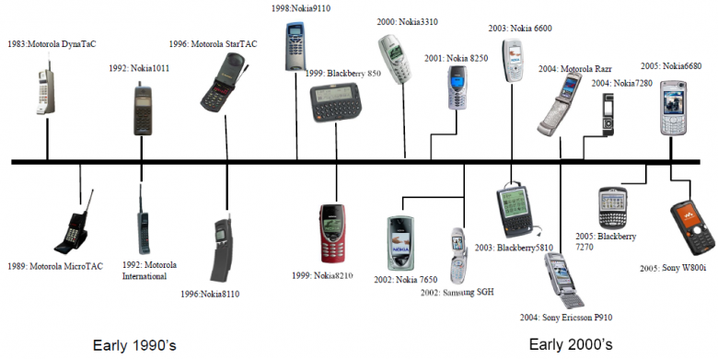
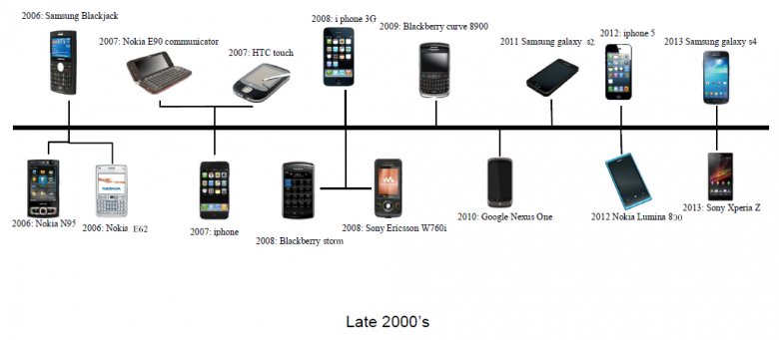
History of Cellphones
Image Source: http://www.ef.org.vt.edu/2013/11/the-evolution-of-the-mobile-phone.html

