Slide 1
Computer networks
Hwajung Lee

Slide 2

What is Computer Networks?
A collection of autonomous computers interconnected by a single or multiple technologies
  Interconnected via:
    Copper wire
    Fiber optics
    Microwaves
    Infrared
    Communication satellites, etc.
Image Source: www.transcribeyourclass.ca/hts.html

Slide 3
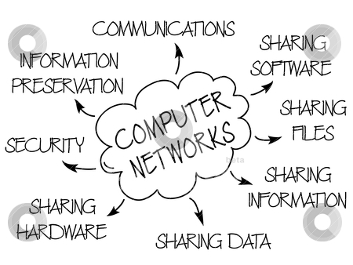
Image Source: http://www.freshersadda.net/2014/09/03/computer-networks-basics-ibps-sbi-rrb-computer-awareness/
Notes:
Why Computer Networks?

Slide 4
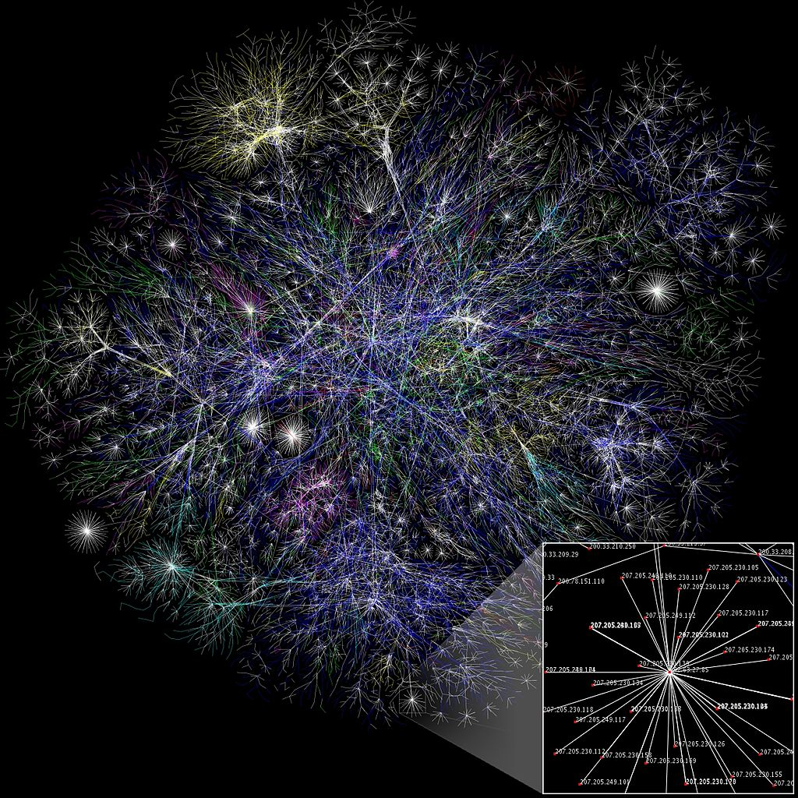
Notes:
https://en.wikipedia.org/wiki/Computer_network#/media/File:Internet_map_1024.jpg
Partial map of the Internet based on the January 15, 2005 data found on opte.org. Each line is drawn between two nodes, representing two IP addresses. The length of the lines are indicative of the delay between those two nodes. This graph represents less than 30% of the Class C networks reachable by the data collection program in early 2005. Lines are color-coded according to their corresponding RFC 1918 allocation as follows: Dark blue: net, ca, us Green: com, org Red: mil, gov, edu Yellow: jp, cn, tw, au, de Magenta: uk, it, pl, fr Gold: br, kr, nl White: unknown

Slide 5
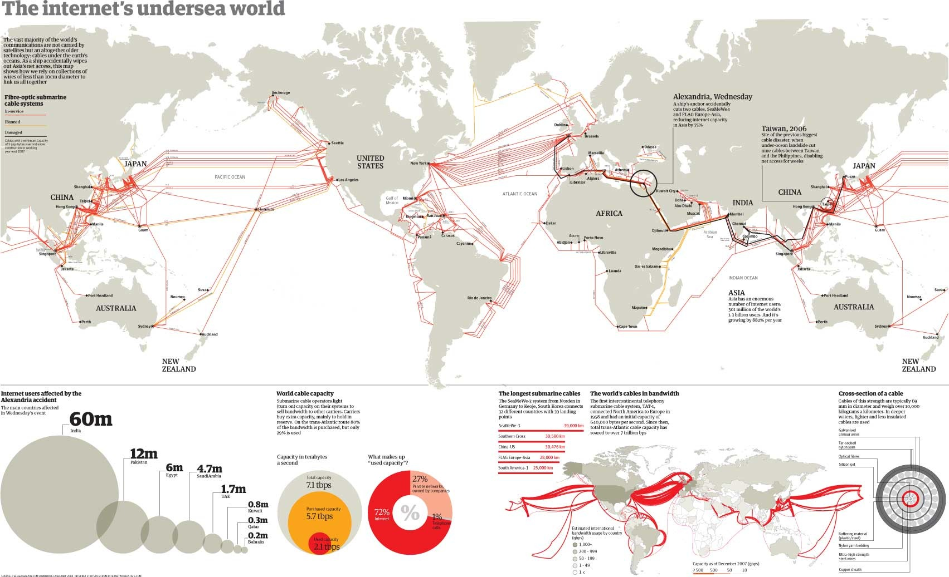

Slide 6


Slide 7

What is a protocol?
Communications between computers requires very specific unambiguous rules
A protocol is a set of rules that governs how two or more communicating parties are to interact
  Internet Protocol (IP)
  Transmission Control Protocol (TCP)
  HyperText Transfer Protocol (HTTP)
  Simple Mail Transfer Protocol (SMTP)
Image Source: www.wallpapers.eu.com/view/agreement-1152x864.html

Slide 8

What is a communication network?
Image Source: http://www.freeiconsdownload.com/Free_Downloads.asp?id=485
The equipment (hardware & software) and facilities that provide the basic communication service
Virtually invisible to the user; Usually represented by a cloud
Equipment
  Routers, servers, switches, multiplexers, hubs, modems, …
Facilities
  Copper wires, coaxial cables, optical fiber
  Ducts, conduits, telephone poles …
How are communication networks designed and operated?

Slide 9
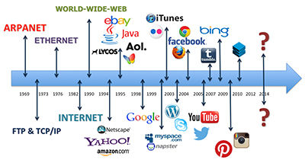
History of Internet
Image Source: http://malonemediagroup.com/history-of-the-internet-timeline-an-ever-evolving-digital-world/

Slide 10
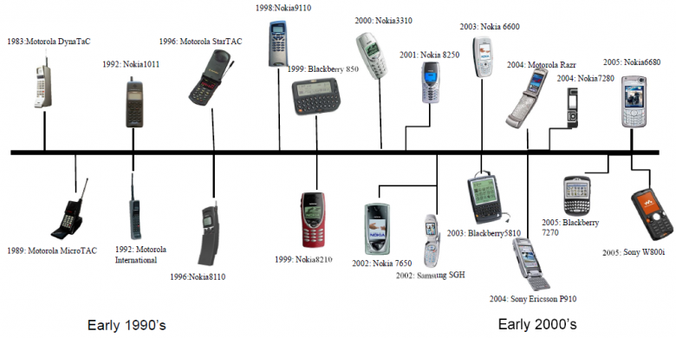
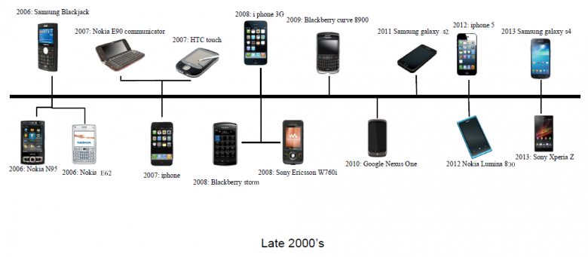
History of Cellphones
Image Source: http://www.ef.org.vt.edu/2013/11/the-evolution-of-the-mobile-phone.html

Slide 11

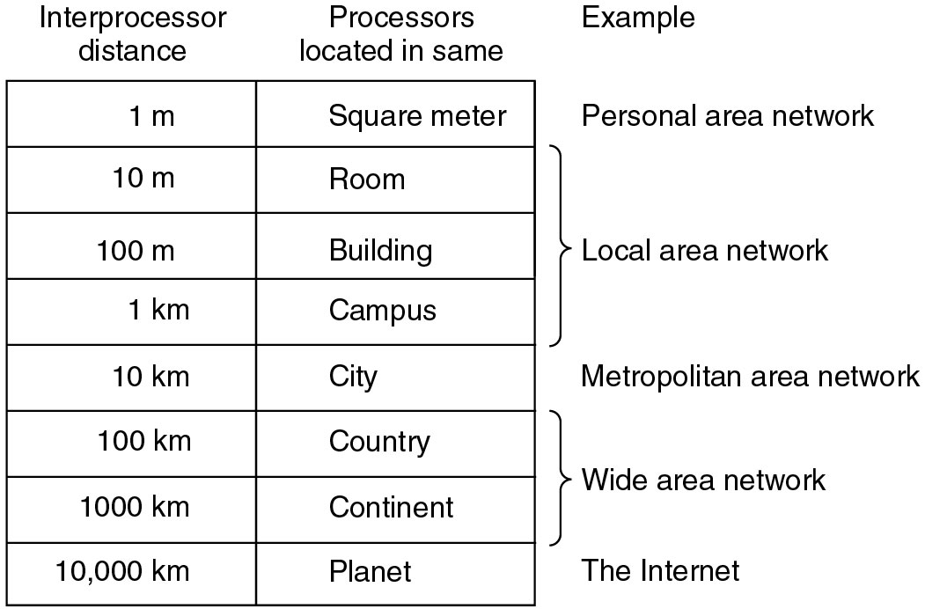
Classification of interconnected processors by scale.
Image Source: www.imagine-net-tech.com/network_services.html

Slide 12
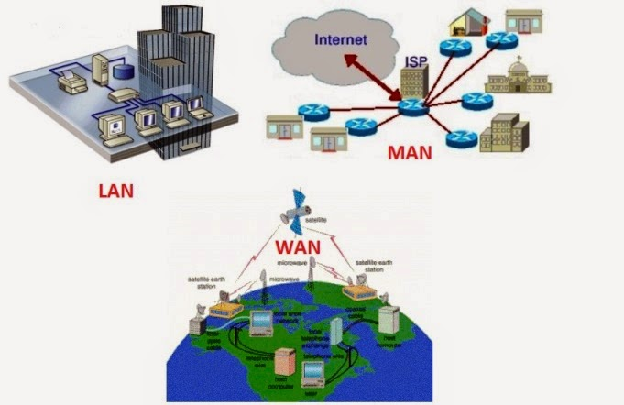
Image Source: http://www.afifmaulana-kbsm.com/2015/04/pengertian-jaringan-lanmanwan-dan.html
Notes:
http://www.afifmaulana-kbsm.com/2015/04/pengertian-jaringan-lanmanwan-dan.html

Slide 13
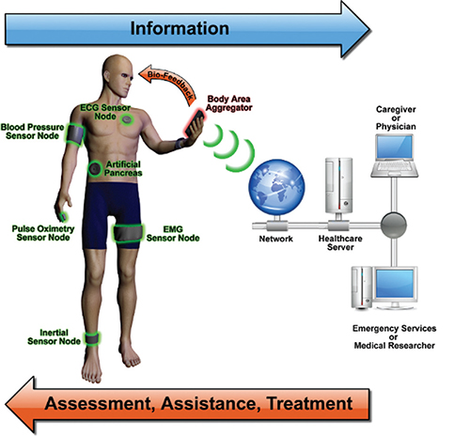
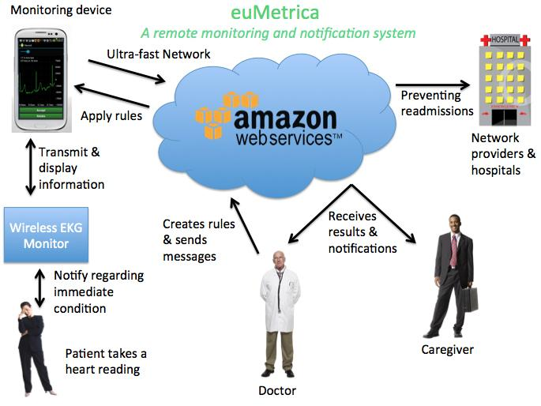
Image Source: https://mozillaignite.org/apps/list/health-it/index.html%3Fpage=2.html
Image Source: https://mozillaignite.org/apps/list/health-it/index.html%3Fpage=2.html
Notes:
https://mozillaignite.org/apps/list/health-it/index.html%3Fpage=2.html

Slide 14
Network Architecture Evolution
?
Information transfer
per second (bits/second)
Telegraph
networks
Telephone
networks
Internet, Optical
& Wireless
networks
Next Generation Internet

Slide 15
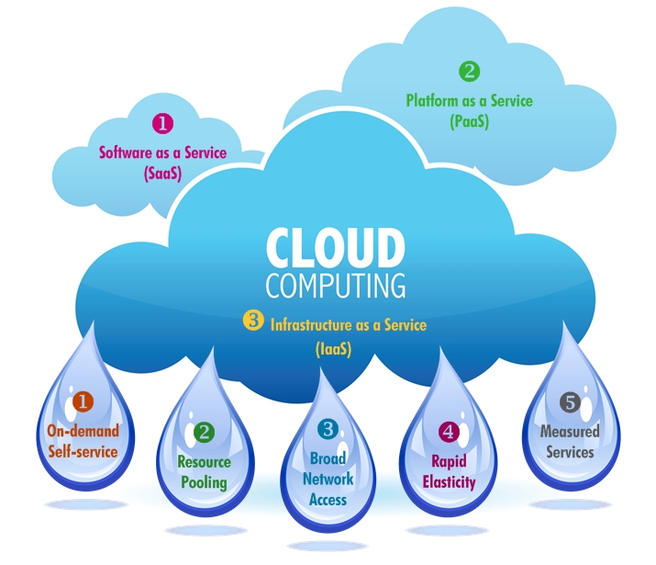

Example: Amazon Echo
Image Source: http://www.itero.co/cloud-computing-recruitment/

Slide 16
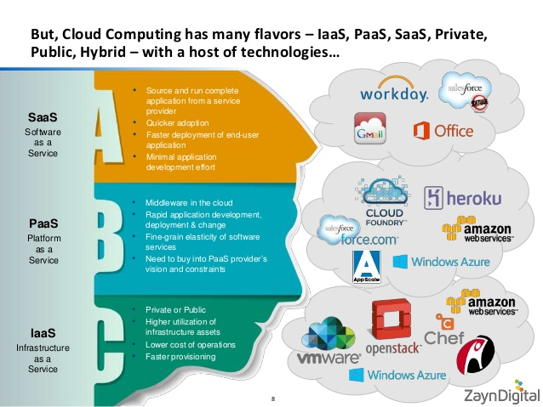
Image Source: http://www.slideshare.net/iahmed91/zayn-digital-cloudcomputing-architecture-v1c-40561364

Slide 17
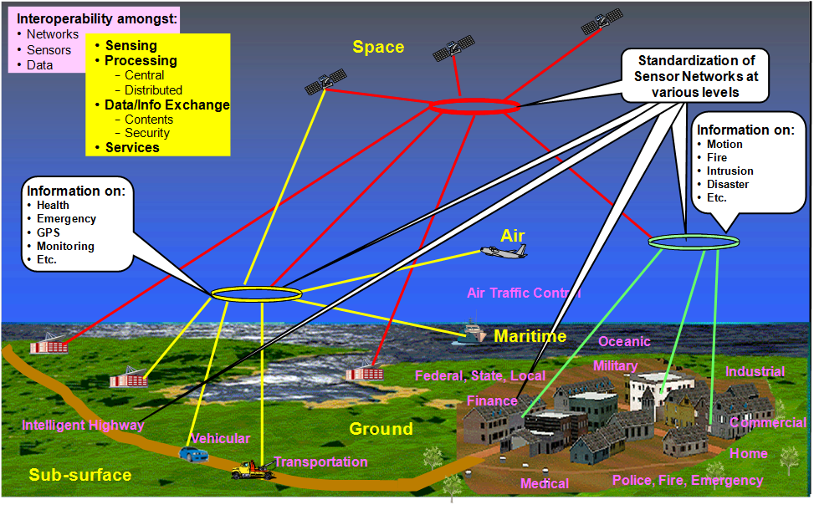
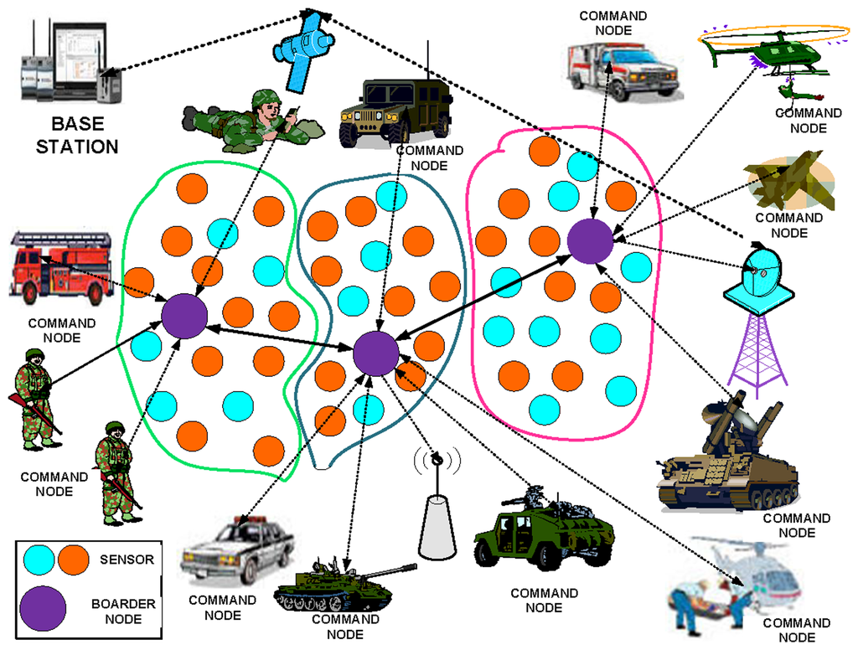
Image Source: http://www.incits.org/news-events/press-releases/rapid-progress-on-standards-for-sensor-networks
More Works with Networks and Sensors
Image Source: http://www.mdpi.com/1424-8220/14/3/5074

