Slide 1
SCIS
School of Computing and Information Sciences
Dr. Hwajung Lee, Director and Professor
Dr. Nathaniel Lahn, Assistant Professor

Slide 2
Why SCIS at RU?
Promotes Student Success
  High faculty/student engagement
  Well balanced curriculum with theory, hands-on, and experiential learning
Offers Diverse Pathways to Student Opportunities
  Curriculum enables students to find their passion
  Concentrations Provide Depth and Increase Starting Salaries
Accessible Double Major in Computer Science and Cybersecurity

Slide 3

School of Computing and Information Sciences
Bachelor of Science Degrees
Computer Science Program, B.S. offers concentrations in
  Advanced Computer Science (ABET accredited)
  Advanced Database
  Advanced Networks
  Advanced Software Engineering
Cybersecurity Program, B.S.
(Virginia’s first ABET accredited; NSA CAE accredited)
Accelerated M.S. in Data and Information Management at RU
Accelerated M.S. and M.Eng. in Computer Science at Virginia Tech
Accelerated M.S. and M.Eng. in Computer Engineering at Virginia Tech
Master of Science & Master of Engineering Degrees

Slide 4
B.S. Curriculum
Offers Diverse Pathways to Student Opportunities
  Curriculum enables students to find their passion
  Concentrations Provide Depth and Increase Starting Salaries
Accessible Double Major
in CS and Cybersecurity
Core: Computer Science Program and Cybersecurity Program
Systems
Security
Application Development
Advanced Computer Science
Advanced
Databases
Advanced Software Engineering
Advanced Networks
No Concentration
Cybersecurity
Notes:
Curriculum: supporting multiple paths/degrees with a core foundation
New Curriculum
https://docs.google.com/document/d/1aSfhInUmFpBDcr2Z2iw5T1OzKJySqjTqtkzyc4ljoSI/edit

Slide 5
B.S. Curriculum
Offers Diverse Pathways to Student Opportunities
  Curriculum enables students to find their passion
  Concentrations Provide Depth and Increase Starting Salaries
Accessible Double Major
in CS and Cybersecurity
Core: Computer Science Program and Cybersecurity Program
Systems
Security
Application Development
Advanced Computer Science
Advanced
Databases
Advanced Software Engineering
Advanced Networks
Cybersecurity
Notes:
Curriculum: supporting multiple paths/degrees with a core foundation
New Curriculum
https://docs.google.com/document/d/1aSfhInUmFpBDcr2Z2iw5T1OzKJySqjTqtkzyc4ljoSI/edit

Slide 6






















Jobs and Graduate Schools: Our Alumni
ML/AI SME
Data Engineer
Database Developer
Lead Security Engineer
Lead Software Engineer
Senior Software Engineer
Network Security Engineer
Application Security Engineer
Senior Data Systems Engineer
Senior Cybersecurity Engineer
Data Science Engineer Biostatistician
Chief Engineer & Enterprise Architect

Slide 7
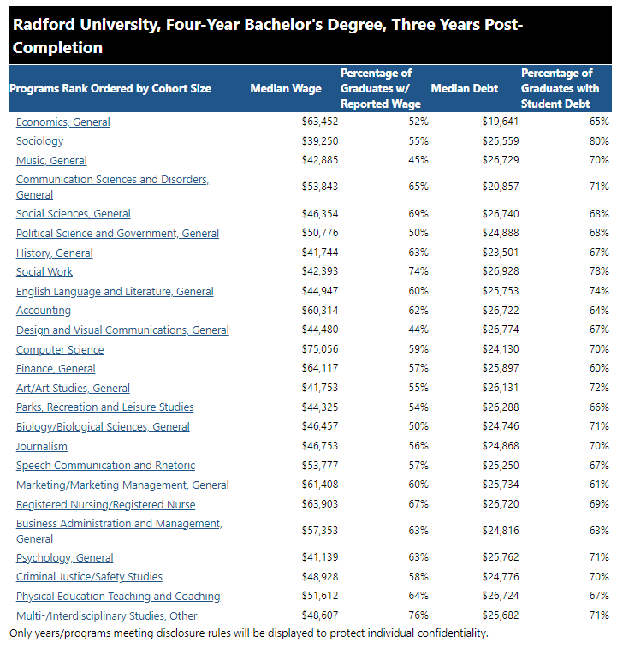
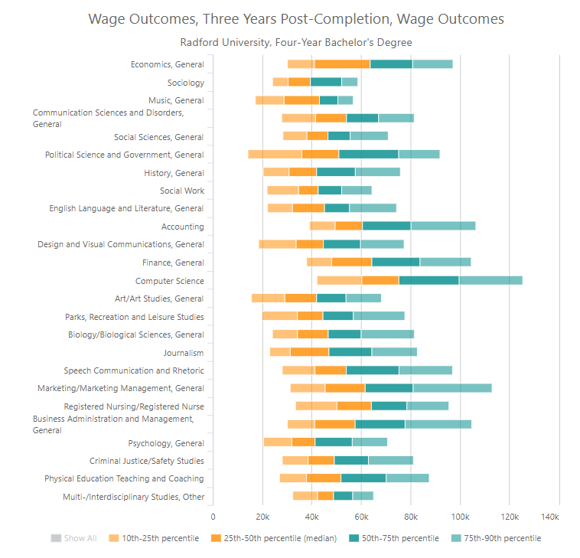
Wage and Debt by Institution and Degree: RU, 2022 Calendar Year
https://research.schev.edu/rdPage.aspx?rdReport=EOM.EOM_DegreeWageDebt_Inst&rdRequestForwarding=Form

Slide 8
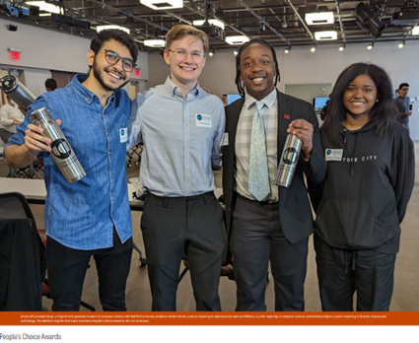
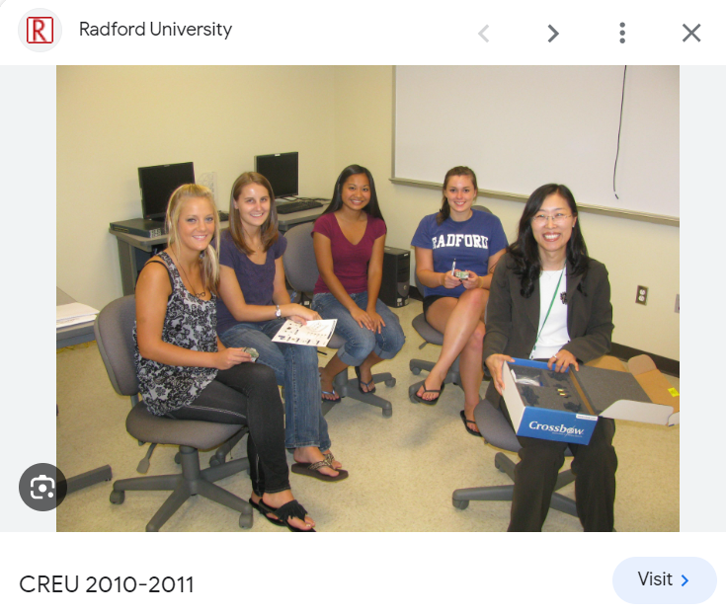
Undergraduate Research and Projects:
Sample publications and presentations (Peer-reviewed Journal, Conference Papers, Abstract, and Poster)
Nicole Linkous, Leveraging Electronic Medical Records (EMRs) to Develop Predictive Models for Community Level Influenza Transmission in Southwest Virginia, SEInforms Conference, Myrtle Beach SC 2023 (advisors: Jeff Pittges, Caleb Bradberry)
Caitlyn Robinson, Cyber RADaR, SEInforms Conference, Myrtle Beach SC 2023 (advisors: Cyber Civilian)
Prem Uppuluri, Joe Chase, Tanner Ketron (student), Humaid Desai (Virginia Tech), Amr Hillal (VT), RUSecure or not? Introducing IoT Security and Privacy in classrooms, Virginia Cybersecurity Education Conference’23 (workshop, Tanner and Humaid could not present but contributed to the work)
Tanner Ketron, Humaid Desai (Virginia Tech student), Keshawn Brooks, Sam Williams, Who’s watching you? A data science approach to user privacy and tracking, Southwest Virginia Commonwealth Cyber Initiative Showcase’23, People’s Choice Award Poster!
Sam Williams, Luke Martin, Josh Adkins, Prem Uppuluri, Joe Chase, Amar Patra, Radford University’s Hackhouse: An IoT Testbed for Undergraduate Cybersecurity Students, Colloquium on Information Systems Security Education 2021 (advisors: Prem Uppuluri, Joe Chase, Amar Patra)
Lauren Rose, Aware and Prepare: The Gamification of Benevolent Hacking to Improve K-12 Cyber Education, Colloquium on Information Systems Security Education June’2018 (advisors: Prem Uppuluri, Joe Chase)
Noah Bieker, Simplify Amazon Analytics to Manage Ad Campaigns More Effectively (mentor: Chris Geiger, Solutions Architect at Amazon Web Services)
Rory McDaniel and Hwajung Lee, “A Low-Cost Heuristic for Pathfinding to Charge Wireless Rechargeable Sensor Networks,” The 16th International Conference on Wireless Networks, Las Vegas, Nevada, July 17-20, 2017.
Hwajung Lee and Andrew Wilson, “Developing Mobile Raspberry Pi Base Station Cloud for Wireless Sensor Networks,” The International Conference of Wireless Networks, Las Vegas, Nevada, July 21-24, 2014 [Abstract and Poster].

Slide 9
Competitions: Cyber Defense Competitions
Competition Winners
Radford University students in the CS and CY programs have won multiple competitions. Here are just a few highlights.
2012 | The first time Radford University started competing in Cyber! 3rd out of 25, MidAtlantic Collegiate Cyber Defense Contest (MACCDC) (only one of 2 VA schools - the other being JMU) 2nd in the Eastern Conference Pilot of National Cyber League https://www.radford.edu/content/radfordcore/home/news/releases/2012/june/cyber-team.html
2013 | 3rd out of 20+, MACCDC (Second time in a row!) - only VA school.
2014 | 3rd out of 20+, MACCDC (Three in a row!) - only VA school to achieve this https://www.radford.edu/content/csat/home/news/releases/20131/ru_cyber_defense_competition.html
2016 | Radford University is in the finals of MACCDC one of 8 colleges out of 25+
2017 | 2nd place at the inaugural Virginia Fusion Cyber Cup Competition at VMI hosted on behalf of Sen Mark Warner and Gov Tery McAuliffe https://www.radford.edu/content/radfordcore/home/news/releases/2017/march/Cyber-Defense-Club-statewide-competition.html
2018 | 3rd Place @ VMI Cyber Cup
2019 | 6th Place @ VMI Cyber Cup
2020 | 3rd @ VMI Cyber Cup
2023 | 6th @ VMI Cyber Cup

Slide 10
Thank you
Dr. Hwajung Lee, Director and Professor
Dr. Nathaniel Lahn, Assistant Professor

