Slide 1
ITEC324 Principle of CS III
Chapter 5 (Horstmann’s Book)
Patterns and GUI Programming
Modified from slides by Dr. Hwajung Lee.

Slide 2
Pattern
A pattern is a description of a problem and its solution that you can apply to many programming situation.
  Standardized patterns
  User defined patterns
Pattern presents proven advice in a standard format.

Slide 3
The Pattern Concept
History: Architectural Patterns by Christopher Alexander
Each pattern has
  a short name
  a brief description of the context
  a lengthy description of the problem
  a prescription for the solution

Slide 4
e.g. a pattern to build a hallway.
Name: short passages
Context: “… long, sterile corridors set the scene for everything bad about modern architecture”.
Problem:
  // This contains a lengthy description of passages with a dismal picture.
Solution:
  Keep passages short. Make them as much like rooms as possible, with carpets or wooden floors, furniture, bookshelves, beautiful windows.

Slide 5
Goal is to build an invoice.
A GUI that allows a user to select one or more products and the invoice keeps computing the total cost along with any discounts.
  We will use this to study some patterns in Java.

Slide 6
COMPOSITE Pattern
Containers and Components
  Issue:
    Line items in the inventory can be some primitive items such as hammer, tongs, horse-shoes etc..
    Or,
      A bundle: e.g., blacksmith special: get a hammer and tong and horse-shoe for 10% less!
  How here is the problem: sometime a primitive type (e.g., the bundle) can itself be a collection of other primitive types (e.g., the hammer and tongs).
  Solution: composite pattern.

Slide 7
Bundles
Bundle = set of related items with description+price
  (ex) stereo system with tuner, amplifier, CD player + speakers
  A bundle has line items
  A bundle is a line item
➔ Therefore, COMPOSITE pattern
  Ch5/invoice/Bundle.java (look at getPrice)

Slide 8
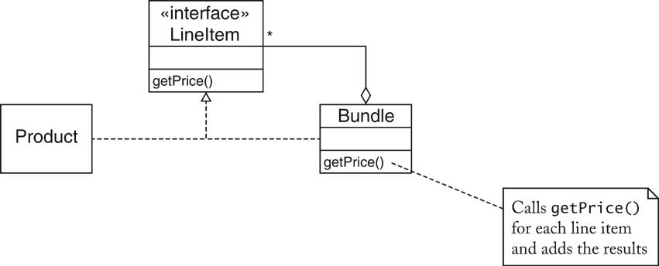
Bundles

Slide 9
COMPOSITE Pattern
Containers and Components
Containers collect GUI components
Sometimes, want to add a container to another container
Container should be a component
Composite design pattern
  Composite method typically invoke component methods
  E.g. Container.getPreferredSize invokes getPreferredSize of components

Slide 10
COMPOSITE Pattern
Containers and Components
Containers collect GUI components
Sometimes, want to add a container to another container
Container should be a component
Composite design pattern
  Composite method typically invoke component methods
  E.g. Container.getPreferredSize invokes getPreferredSize of components

Slide 11
COMPOSITE Pattern
Containers and Components
The COMPOSITE pattern teaches how to combine several objects into an object that has the same behavior as its parts.

Slide 12
COMPOSITE Pattern
Context
  Primitive objects can be combined to composite objects
  Clients treat a composite object as a primitive object
Solution
  Define an interface type that is an abstraction for the primitive objects
  Composite object contains a collection of primitive objects
  Both primitive classes and composite classes implement that interface type (from (1)).
  When implementing a method from the interface type, the composite class applies the method to its primitive objects and combines the results. (e.g., let us see how Bundle class does this).

Slide 13
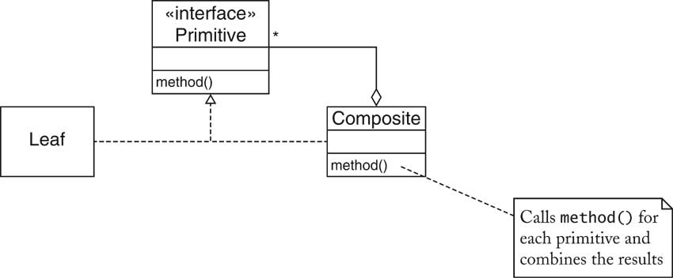
COMPOSITE Pattern

Slide 14
Using your knowledge of Java Swing…
Can you think of any composite patterns you encountered?

Slide 15
COMPOSITE Pattern: examples in Java Swing.
Name in Design Pattern | Actual Name
Primitive | Component
Composite | Container or a subclass such as JPanel
Leaf | A component that has no children such as JButton or JTextArea
method() | A method of the Component interface such as getPreferredSize

Slide 16
Adding decorations: DECORATOR PATTERN
Economy is bad…
The invoice system now wants to add a new feature:
  For a bundle it will give an additional discount.
How can we design our classes to provide this discount?
Solution; DECORATOR pattern.

Slide 17
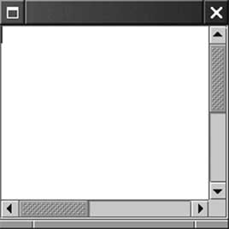
Another example: DECORATOR Pattern
Scroll Bars
Scroll bars can surround component
JTextArea area = new JTextArea(10, 25);
JScrollPane pane = new JScrollPane(area);
JScrollPane is again a component

Slide 18
DECORATOR Pattern
Scroll Bars
The DECORATOR pattern teaches how to form a class that adds functionality to another class while keeping its interface.

Slide 19
DECORATOR Pattern
Context
  Component objects can be decorated (visually or behaviorally enhanced)
  The decorated object can be used in the same way as the undecorated object
  The component class does not want to take on the responsibility of the decoration
  There may be an open-ended set of possible decorations

Slide 20
DECORATOR Pattern
Solution
  Define an interface type that is an abstraction for the component
  Concrete component classes implement this interface type.
  Decorator classes also implement this interface type.
  A decorator object manages the component object that it decorates
  When implementing a method from the component interface type, the decorator class applies the method to the decorated component and combines the result with the effect of the decoration.

Slide 21
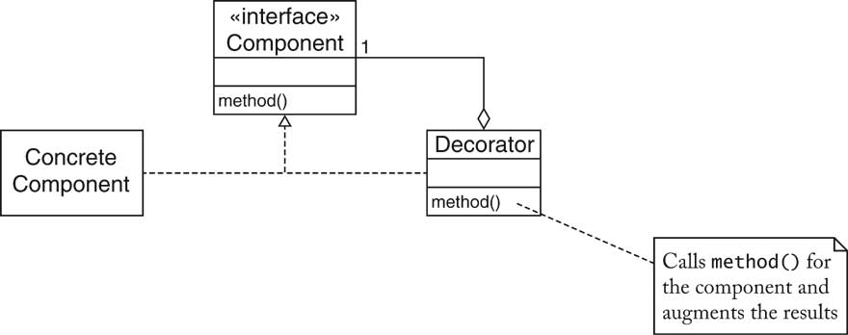
DECORATOR Pattern

Slide 22
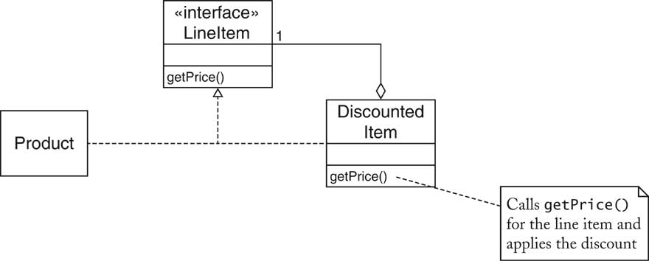
Discounted Items

Slide 23
DECORATOR Pattern
Name in Design Pattern | Actual Name
Component | Component
ConcreteComponent | JTextArea
Decorator | JScrollPane
method() | A method of the Component interface. For example, the paint method paints a part of the decorated component and the scroll bars.

Slide 24
Next issue: displaying the invoice.
→ OBSERVER PATTERN

Slide 25
OBSERVER Pattern
Class exercise:
  Part 1: Create a GUI that contains two frames.
      Frame 1 contains a textbox.
      Frame 2 contains a Jlabel.
      When any text on Frame 1 is changed, the changed text must display on Frame 2 .
  Part 2: Now add another frame, Frame 3, which will display if the number on Frame1 is even or odd.

Slide 26
OBSERVER Pattern
Some programs have multiple editable views of the same data.
  Example: HTML Editor
    WYSIWYG (What you see is what you get) view
    A structural view
    …
When you edit on of the view, the other updates automatically and instantaneously.
  How is this behavior implemented?
  Solution: Model/View/Controller (MVC).

Slide 27
OBSERVER Pattern
Model/view/controller architecture
  Model
    The raw data
    Data structure
    No visual appearance
  Views
    Visual representations
  Controllers
    An object that processes user interaction (using mouse, keyboard, GUI interface, …)
    Each view has a controller.
Next: how a controller works.

Slide 28
OBSERVER Pattern
When a user types text into one of the windows:
  The controller tells the models to insert the text that the user typed.
  The model notifies all views of a change in the model.
  All views repaint themselves.
  During paint, each view asks the models for the current text.
This architecture minimizes the coupling between the model, views, and controllers.

Slide 29
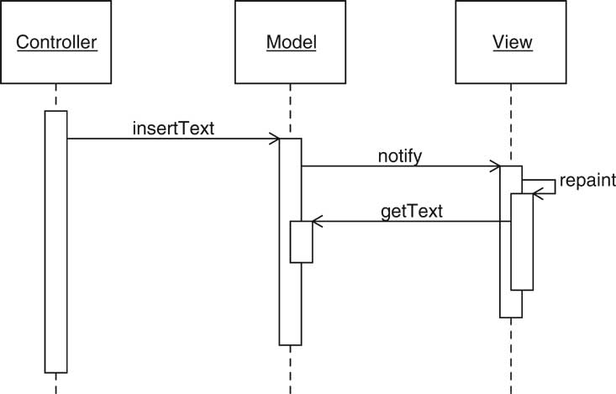
OBSERVER Pattern

Slide 30
OBSERVER Pattern
The OBSERVER pattern teaches how an object can tell other objects about events.
Context
  An object (which we’ll call the subject) is source of events (such as “my data has changed”).
  One or more objects (called the observer ) want to know when an event occurs.

Slide 31
OBSERVER Pattern
Solution
  Define an observer interface type. Observer classes must implement this interface type.
    Java Swing does provide a “ChangeListener” interface that can be used…
      public interface ChangeListener {
      void stateChanged(ChangeEvent event);
      }
  The subject maintains a collection of observer objects.
  The subject class supplies methods for attaching observers.
    We can achieve this by making the main program of our code have some method that keeps adding the new “observers” as they are created. E.g., the “addChangeListener” method in the class Invoice.

Slide 32
OBSERVER Pattern
Solution
  4. Whenever an event occurs, the subject notifies all observers.

Slide 33
Change Listeners
Use standard ChangeListener interface type
public interface ChangeListener
{
void stateChanged(ChangeEvent event);
}
Invoice collects ArrayList of change listeners
When the invoice changes, it notifies all listeners:
ChangeEvent event = new ChangeEvent(this);
for (ChangeListener listener : listeners)
listener.stateChanged(event);

Slide 34
Change Listeners
Display adds itself as a change listener to the invoice
Display updates itself when invoice object changes state
final Invoice invoice = new Invoice();
final JTextArea textArea = new JTextArea(20, 40);
ChangeListener listener = new
ChangeListener()
{
public void stateChanged(ChangeEvent event)
{
String formattedInvoice = …;
textArea.setText(formattedInvoice);
}
};
invoice.addChangeListener(listener);

Slide 35
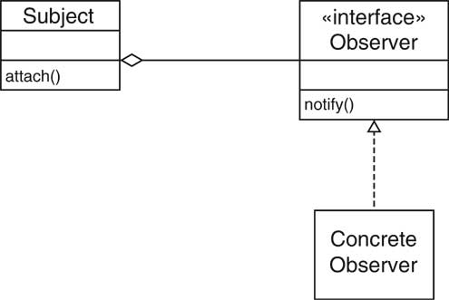
OBSERVER Pattern

Slide 36
OBSERVER Pattern
Name in Design Pattern | Actual Name
Subject | JButton
Observer | ActionListener
ConcreteObserver | The class that implements the ActionListener interface type
attach() | addActionListener
notify() | actionPerformed

Slide 37
Iterating Through Invoice Items
Accessing Invoice items
  Invoice collect line items
  Clients need to iterate over line items
  Don't want to expose ArrayList
  May change (e.g. if storing invoices in database)
➔ITERATOR pattern

Slide 38
List Iterators
Example
LinkedList<String> list = . . .;
ListIterator<String> iterator = list.listIterator();
while (iterator.hasNext())
{
String current = iterator.next();
. . .
}
Why does the Java library use an iterator to traverse a linked list?

Slide 39
Classical List Data Structure
Programmer manipulates the links directly
Link currentLink = countries.head;
while (currentLink != null)
{
do something with currentLink.data;
currentLink = currentLink.next;
}
  Thus, this exposes implementation.
    Break Encapsulation unnecessarily
    Easy to mess up and corrupt the link structure of a linked list

Slide 40
ITERATOR Pattern
The ITERATOR pattern teaches how to access the elements of an aggregate object.

Slide 41
ITERATOR Pattern
Context
  An object (which we’ll call the aggregate) contains other objects (which we’ll call elements).
  Clients (that is, methods that use the aggregate) need access to the elements.
  The aggregate should not expose its internal structure.
  There may be multiple clients that need simultaneous access.

Slide 42
ITERATOR Pattern
Solution
  Define an iterator that fetches one element at a time.
  Each iterator object needs to keep track of the position of the next element to fetch.
  If there are several variations of the aggregate and iterator classes, it is best if they implement common interface type. Then the client only needs to know the interface types, not the concrete classes.

Slide 43
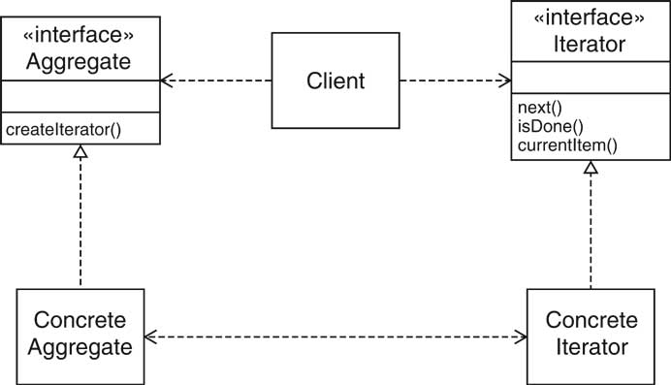
ITERATOR Pattern

Slide 44
ITERATOR Pattern
Names in pattern are examples and may differ in each occurrence of pattern.

Slide 45
ITERATOR Pattern
Name in Design Pattern | Actual Name
Aggregate | List
ConcreteAggregate | LinkedList
Iterator | ListIterator
ConcreteIternator | An anonymous class that implements the ListIterator interface type
createIterator() | listIterator()
next() | next()
isDone() | Opposite of hasNext()
currentItem() | Return value of next()

Slide 46
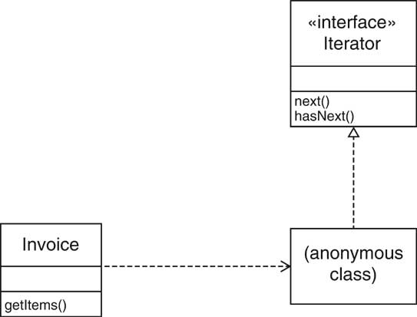
Iterators

Slide 47
Iterators
Use standard Iterator interface type
public interface Iterator<E>
{
boolean hasNext();
E next();
void remove();
}
  remove is "optional operation" (see ch. 8)
    implement to throw UnsupportedOperationException
  implement hasNext/next manually to show inner workings
  Ch5/invoice/Invoice.java

Slide 48
Formatting Invoices
Simple format: dump into text area
  May not be good enough
OR
Invoice on a Web page?
  E.g. HTML tags for display in browser
➔Want to allow for multiple formatting algorithms
➔STRATEGY pattern

Slide 49
STRATEGY Pattern
Layout Managers
What if we need to specify pixel position of components when
  User interfaces are made up of use interface components
  Components are placed in containers
Swing doesn't use hard-coded pixel coordinates for each component.
  Advantages:
    Can switch between various "look and feel"
    Can internationalize strings
Layout manager arranges the components in a container.

Slide 50
STRATEGY Pattern
Layout Managers
FlowLayout: left to right, start new row when full
BoxLayout: left to right or top to bottom
BorderLayout: 5 areas, Center, North, South, East, West
GridLayout: grid, all components have same size
GridBagLayout: the rows & columns can have different sizes and components can span multiple rows and columns

Slide 51
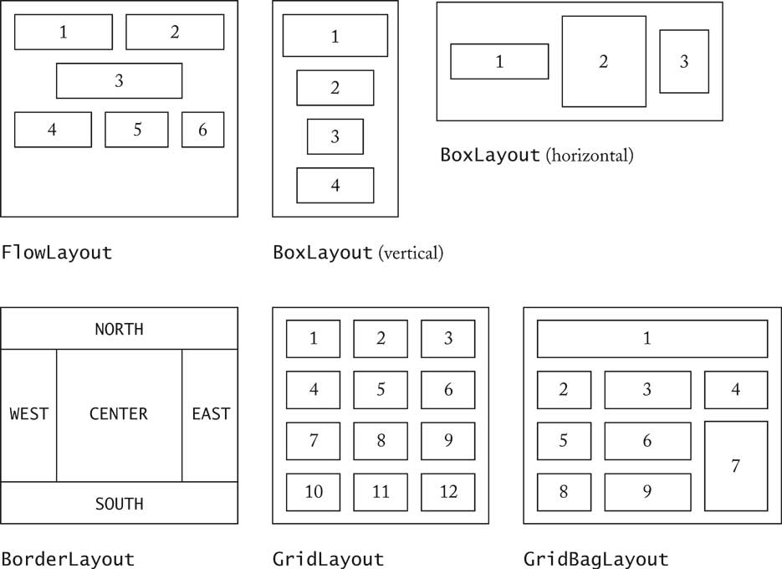
STRATEGY Pattern
Layout Managers

Slide 52
STRATEGY Pattern
Layout Managers
Panel
  Set layout manager
  JPanel keyPanel = new JPanel();
  keyPanel.setLayout(new GridLayout(4, 3));
  Add components
  for (int i = 0; i < 12; i++)
  {
  keyPanel.add(button[i]);
  } //end for

Slide 53
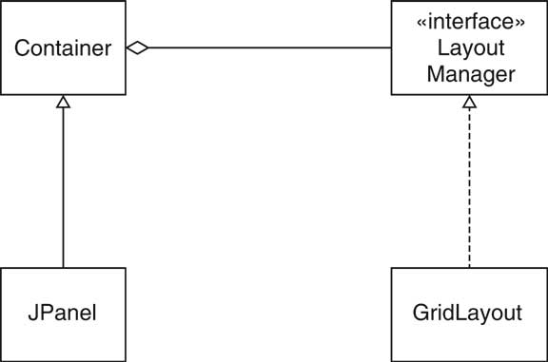
STRATEGY Pattern
Layout Managers

Slide 54
STRATEGY Pattern
(Ex) Voice Mail System GUI
Same backend as text-based system
Only Telephone class changes
Buttons for keypad
Text areas for microphone, speaker

Slide 55
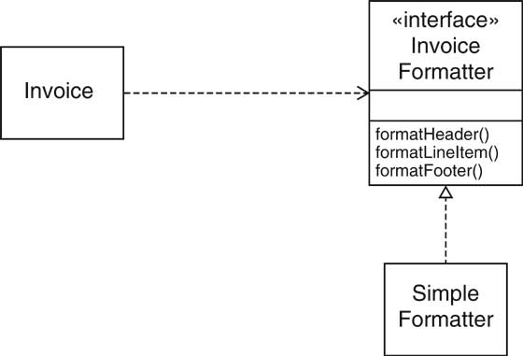
Formatting Invoices

Slide 56
Formatting Invoices
ch5/invoice/InvoiceFormatter.java
ch5/invoice/SimpleFormatter.java
ch5/invoice/Invoice.java
ch5/invoice/InvoiceTester.java

Slide 57
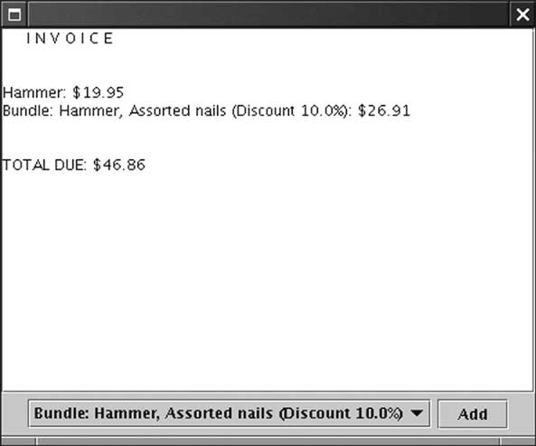
Formatting Invoices

Slide 58
How to Recognize Patterns
Look at the intent of the pattern
(ex1) COMPOSITE pattern: to group component into a whole
(ex2) DECORATOR pattern: to decorate a component
(ex3) STRATEGYpattern: to wrap an algorithm into a class.
Remember common uses (e.g. STRATEGY for layout managers)
Not everything that is strategic is an example of STRATEGY pattern
Use context and solution as “litmus test”

Slide 59
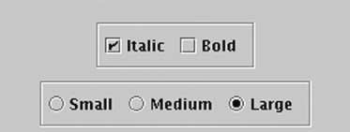
Litmus Test
We can add border to Swing component.
Border b = new EtchedBorder()
component.setBorder(b);
Is it an example of DECORATOR?

Slide 60
Litmus Test
Component objects can be decorated (visually or behaviorally enhanced)
The decorated object can be used in the same way as the undecorated object
The component class does not want to take on the responsibility of the decoration
There may be an open-ended set of possible decorations
PASS
PASS
FAIL--the component class has setBorder method

Slide 61
Recap of Standardized Patterns

Slide 62
ITERATOR Pattern
The ITERATOR pattern teaches how to access the elements of an aggregate object.

Slide 63
ITERATOR Pattern
Context
  An object (which we’ll call the aggregate) contains other objects (which we’ll call elements).
  Clients (that is, methods that use the aggregate) need access to the elements.
  The aggregate should not expose its internal structure.
  There may be multiple clients that need simultaneous access.

Slide 64
ITERATOR Pattern
Solution
  Define an iterator that fetches one element at a time.
  Each iterator object needs to keep track of the position of the next element to fetch.
  If there are several variations of the aggregate and iterator classes, it is best if they implement common interface type. Then the client only needs to know the interface types, not the concrete classes.

Slide 65
ITERATOR Pattern

Slide 66
OBSERVER Pattern
The OBSERVER pattern teaches how an object can tell other objects about events.
Context
  An object (which we’ll call the subject) is source of events (such as “my data has changed”).
  One or more objects (called the observer ) want to know when an event occurs.

Slide 67
OBSERVER Pattern
Solution
  Define an observer interface type. Observer classes must implement this interface type.
  The subject maintains a collection of observer objects.
  The subject class supplies methods for attaching observers.
  Whenever an event occurs, the subject notifies all observers.

Slide 68
OBSERVER Pattern

Slide 69
STRATEGY Pattern
The STRATEGY pattern teaches how to supply variants of an algorithm

Slide 70
STRATEGY Pattern
Context
  A class (called context class) can benefit from different variants for an algorithm
  Clients of the context class sometimes want to supply custom versions of the algorithm
Solution
  Define an interface type that is an abstraction for the algorithm. We’ll call this interface type the strategy.
  Concrete strategy classes implement the strategy interface type. Each strategy class implements a version of the algorithm.
  The client supplies a concrete strategy object to the context class.
  Whenever the algorithm needs to be executed, the context class calls the appropriate methods of the strategy object.

Slide 71
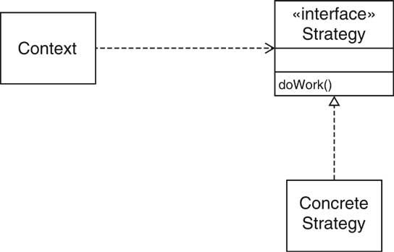
STRATEGY Pattern

Slide 72
COMPOSITE Pattern
Containers and Components
The COMPOSITE pattern teaches how to combine several objects into an object that has the same behavior as its parts.

Slide 73
COMPOSITE Pattern
Context
  Primitive objects can be combined to composite objects
  Clients treat a composite object as a primitive object
Solution
  Define an interface type that is an abstraction for the primitive objects
  Composite object contains a collection of primitive objects
  Both primitive classes and composite classes implement that interface type.
  When implementing a method from the interface type, the composite class applies the method to its primitive objects and combines the results.

Slide 74
COMPOSITE Pattern

Slide 75
DECORATOR Pattern
Scroll Bars
The DECORATOR pattern teaches how to form a class that adds functionality to another class while keeping its interface.

Slide 76
DECORATOR Pattern
Context
  Component objects can be decorated (visually or behaviorally enhanced)
  The decorated object can be used in the same way as the undecorated object
  The component class does not want to take on the responsibility of the decoration
  There may be an open-ended set of possible decorations

Slide 77
DECORATOR Pattern
Solution
  Define an interface type that is an abstraction for the component
  Concrete component classes implement this interface type.
  Decorator classes also implement this interface type.
  A decorator object manages the component object that it decorates
  When implementing a method from the component interface type, the decorator class applies the method to the decorated component and combines the result with the effect of the decoration.

Slide 78
DECORATOR Pattern

