Slide 1
ITEC 109
Problem Solving and Programming
Dr. Ray

Slide 2
Me
3rd year at RU
Focus is teaching introductory programming
Undergraduate research
Robotic bird feeder
iPhone/iPad software development (learning)
Game engines
Graphics

Slide 3
Pairing
On a scale of 1 to 10 how interested are you in this class?
What is the hardest problem you’ve solved?
How is software created?
Find a neighbor / discuss
Share

Slide 4
Introduction
Learn how to solve problems
Computers
4 Days a week
2 Lectures
2 Labs
Free on Friday!
iPods, pictures, sound

Slide 5
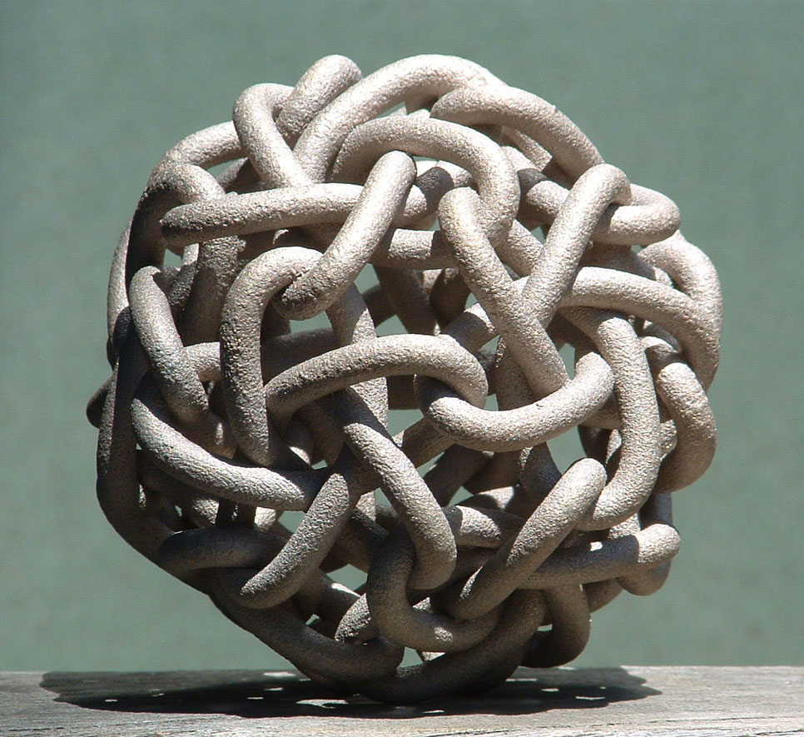
Problem

Slide 6
Problem solving
Process not a formula
Iterative
Creativity encouraged
Walk in the park
Shower
Other methods

Slide 7
Realms

Slide 8
Tools
Original versus derivative
Stand on the shoulders of giants
Innate ability
Apprenticeship
Inspiration
Math
Nature
Sci-Fi novels

Slide 9
Process
Define the problem
Requirements engineer
Identify subparts of the problem
Figure out how to solve each part
Solve each part
Put the parts together
See if you did it right

Slide 10
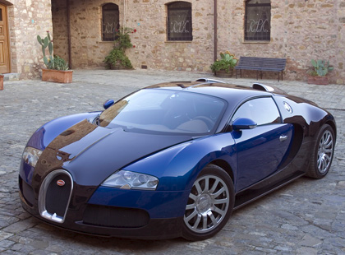
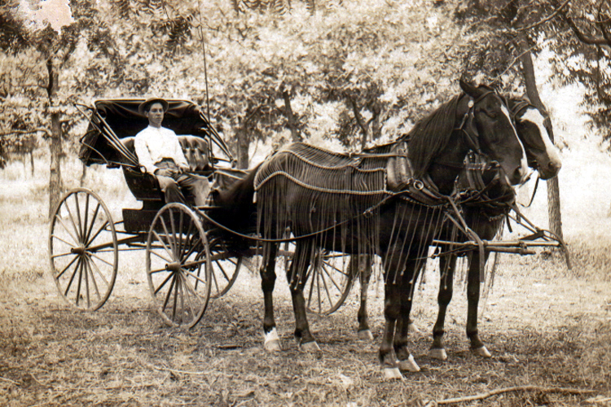
Computers
Do exactly what you tell them
Not exactly what you expect
Power
versus

Slide 11
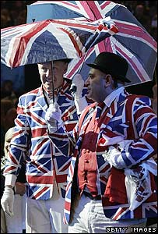
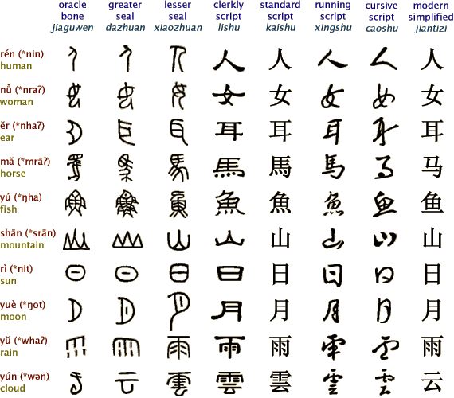
Issue
Communication
<=>

Slide 12
Purpose
Improve your problem solving skills
Basics of instructing a computer to solve your problems
Experience and meaningful problems

Slide 13
Tools
iPods
Lego Robots
Computers

Slide 14
Info
Office hours
10:00 M-F
Point system
Start at 0 and work your way up
Homework (200)
Lab (56)
Attendance (28)
Exams (375)
A = 594-660
B = 528-593
C = 463-527
D = 396-462
F= 0-395
Do the work and come to class
50% of exams and you almost get a C

Slide 15
Website
http://www.radford.edu/~aaray
ITEC 109

Slide 16
Success
Come to class
Experiment
Ask questions
Be a participant not a viewer

Slide 17
Review
Problem solving
Process
Examples
Course policies
Tomorrow
Problem solving lab

