Slide 1
ITEC 109
Lecture 3
Intro to programming

Slide 2
Review
Problem solving
Stages?
Potential pitfalls

Slide 3
Objectives
Mental model of languages
Relationship with hardware
What you can and can’t do

Slide 4
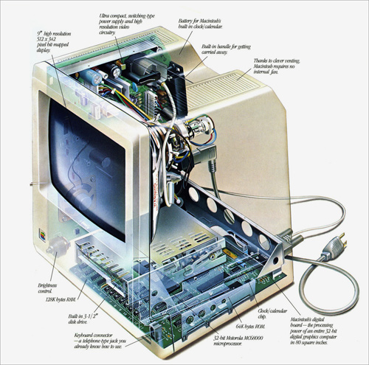
Computers
What is on the inside?
What do the parts do?

Slide 5
Binary
Computers speak binary
Command => Result
CPU
Registers
Calculations
Memory
Hard drives
Graphic cards

Slide 6
Old way
Figure out the binary for the command you wanted
Figure out where to get the input
Figure out where to put the output
Put it together
Result
01101101
Long programs?

Slide 7
Frustration
Speaking in binary isn’t appealing
Work faster if we speak in natural languages
Assembly=>Java=>Python
Translation
Ambiguity issue

Slide 8
Languages
Abstract away from hardware
Whole greater than sum of parts
Several variations
6000+ languages in the world
Over 300 listed on Wikipedia

Slide 9
Classification
Compiled
Java
Scripting
Python

Slide 10
Components
Languages have constructs
Variables
Flow control
Grouping
Sentence => Statement
Statement => Constructs
Program has many statements

Slide 11
Types of statements
Create resources
Modify resources
Alter the flow
Ignore a few statements
Go back and repeat some of them again

Slide 12
Mental model
x=3;
Number = raw_input(‘Enter a number’);
printNow( “You picked “ + Number);
printNow(“ The computer picked”‘ + x);
Linear list
Programs start at a particular line and execute one after the other as fast as possible

Slide 13
Mental model
Branching
Looping
x=x+1;
print ‘x’
print ‘Time to go around again’
x=3;
x=4;

Slide 14
Mental Model
Process
Order
Ship
Order
start

Slide 15
Process
Read the problem
Work through it by hand
Make sure you can envision how it will work before you start
Writing statements before mentally seeing the light at the end of the tunnel = BAD

Slide 16
Design
Formalize what you know about the program
Write down what statements / grouping is needed
Work out math beforehand if needed
Think how to test the software

Slide 17
Implementation
Write a few statements, check
Write on paper first, then computer
Read code and see what it does in your mind

Slide 18
Testing
Figure out what could go in, what goes out
Make test cases
Run them
Modify statements when you are finished

Slide 19
Help
Peer tutors
Office hours
Friends (though only specific questions)

Slide 20
Review
Computer hardware
Languages
Statements

