Slide 1
ITEC 109
Lecture 4
Your second program

Slide 2
Review
What is a computer language?
What is a computer language made of?
What steps should you go through when writing a program using a computer language?
Fill out forms

Slide 3
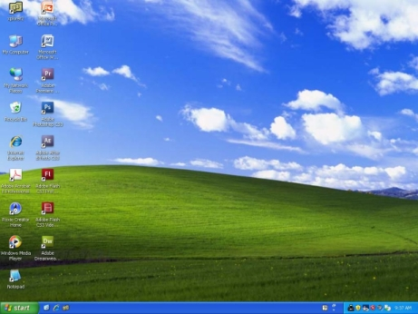
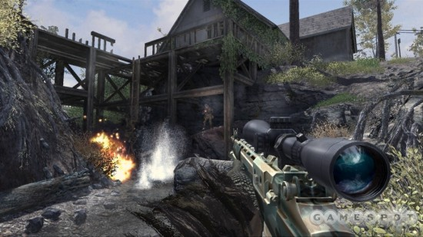
Expectations
What you may want to do…

Slide 4
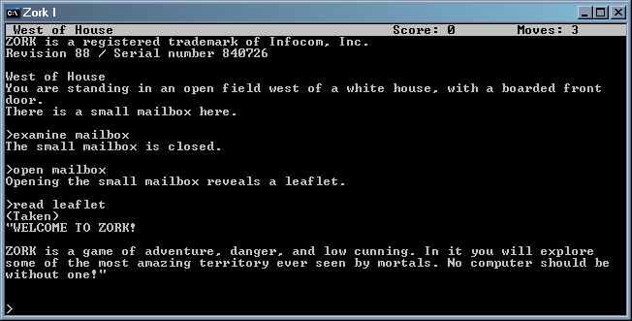
Reality
What you are going to do.

Slide 5
Why?
Writing software is hard
Professional game development
"By month one we had a renderer, terrain, and a playable character (Eddie Riggs),
by month two Eddie could drive his hot rod (the Druid Plow) around the terrain,
and by month three Eddie could run over endless numbers of headbangers with
his Druid Plow around a terrain height field. Hilarity ensued. “
It took industry professionals three months just to make a
car drive around a level and have the ability to run over people

Slide 6
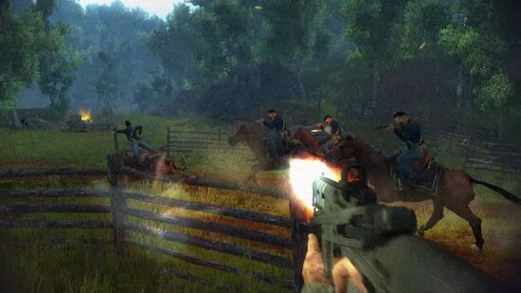
Emphasis
Darkest of days:
24 person team
3.5 years
1.7 million dollars
200,000 lines of code
This class
1 person team
14 weeks
$0
1,000 lines of code

Slide 7
Basics
Variables
Point of contact with hardware
Hold information / pointers to resources
Name
Functions
Use variables to do something
functionName(variableName);
Manipulate variables
Example:
w = makeWorld();
t = makeTurtle(w);

Slide 8
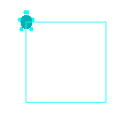
Problem
Draw a square
Algorithm
Create world
Create turtle
Put pen down
Move turtle in a square
w = makeWorld();
t = makeTurtle(w);
penDown(t);
forward(t);
turnRight(t);

Slide 9
Program
Start up JES
Rest of lecture is a hands on demonstration

