Slide 1
ITEC 109
Lecture 18
Looping

Slide 2
Review
Questions?
Conditionals
if / elif / else
and / or / not

Slide 3
Objectives
Learn how to repeat code
Counter variables
Sentinels
Incrementing counter variables

Slide 4
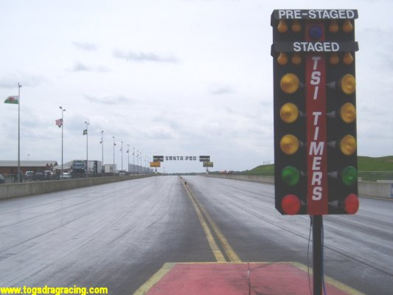
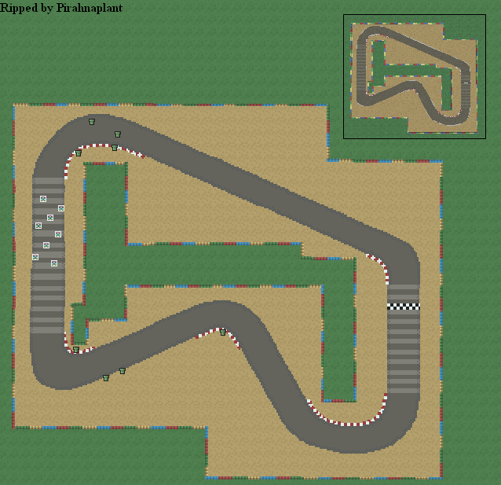
Repetition
Without input, this is your program
What if you wanted to
do it again?

Slide 5
View of code
x=2;
x = x*2;
printNow(x);
Linear execution
def readColor():
robot.readColor()
color = readColor();
printNow(color);
Code to handle a robot
x = int(raw_input())
if (x < 3):
goodCredit();
else:
badCredit();
Linear
Branching

Slide 6
New
x = int(raw_input());
x = x + int(raw_input());
x = x + int(raw_input());
Read in and sum
an integer 3 times
New way
x = x + int(raw_input());
Linear execution
Decision on whether or not to do that again

Slide 7
Python
if (condition ):
#Code executed once
while ( condition ) :
#Code executed as long as condition = true
x = x+int(raw_input());
printNow(x)
x=raw_input()
while (x>0):
Linear execution
Decision on whether or not to do that again

Slide 8
Example
i = 0
i = 1
i = 2
i = 3
i = 4
i = 5
i = 6
i = 7
i = 8
i = 9
i = 10
i=0;
while (i < 10):
i = i+1;
printNow(i);

Slide 9
Example
Enter commands until the user tells system to quit
command = raw_input();
while (command !=“quit”):
command = raw_input();
printNow(command)

Slide 10
Example
See the result of 10 hits on a player
hp = 100;
damage = 6;
i=0;
while (i < 10):
hp = hp – damage;
i = i +1;
printNow(hp);

Slide 11
Basics of looping
What do you need to repeat?
Why do you need to repeat it?
How do you tell when to stop repeating?
How do you update it?

Slide 12
Counter variable
Have: Logic that works on any case
Guide through the loop (provides case)
Starts at initial value
Updates during each part of the loop

Slide 13
Infinite loop
i=0;
while (i < 10):
printNow(“SPAM”);
What does this print out?
What modification should you make?

Slide 14
Examples
i=0;
while (i < 10):
printNow(i);
i = i+2;
i=0;
while (i < 10):
printNow(i);
i = i+3;
i=10;
while (i > 0):
printNow(i);
i = i-1;
i=10;
while (i > 0):
printNow(i);
i = i-2;

Slide 15
Problem
How do you add the even numbers from 0 to10?
Hand version
Code version

Slide 16
Problems
Sum numbers until user types in -1
Interactive menu with commands

Slide 17
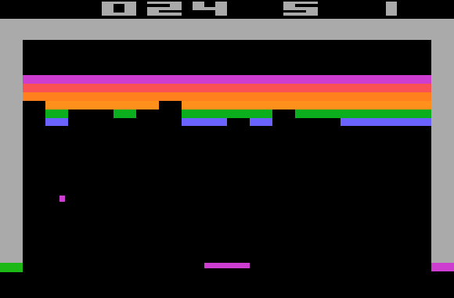
Breaking out
What if you get cold
feet halfway through?
How do you tell a loop to stop executing?
Two statements to modify behavior of loops
continue
break

Slide 18
Continue
Allows you to stop a loop, begin at the top
while(true):
command = raw_input();
if (command == “wait”):
continue;
elif(command == “move”):
move();

Slide 19
Palindromes
What is the counter variable?
What is the sentinel?
How is it updated?
word =raw_input();
left=0;
right = len(word)-1;
while (left < right):
left = left + 1;
right = right -1;
if (word[left] != word[right])
break;
if (left >= right):
printNow(word + “ is a palindrome”);
else:
printNow(word + “ is not a palindrome”);

Slide 20
Review
While loops
Counter variable
Sentinel
Incrementing
Fine grain control
Break
continue

