Slide 1
ITEC 109
Lecture 21
More on lists

Slide 2
Review
Lists
How do you create?
How do you add?
Sum / Average?

Slide 3
Objectives
Examples
Look at functions / arrays / lists
Copying arrays / lists

Slide 4
Arrays/Lists
Problems
Create an array/list that can hold 300 doubles?
Store 0.5 in all the locations?
Print sum of all array/list contents?

Slide 5
Standard Deviation
2000 acres of corn
Average yield of 140 bushels an acre (normal population)
Applying fertilizer increases yield
Obvious
10 acres that produce 80 bushels an acre
Not obvious
How much is it going to take to improve the worst 14% of your fields?
80% gain from 20% effort

Slide 6
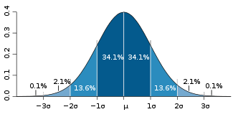
Math
Yield from each acre
Average yield
Figure out the standard deviation
English version:
Take square root of the division of the sum of the square of every element
minus the average over the number of items

Slide 7
Application
Lower than Average – Standard Deviation = Worst offenders
Go through each element in the array and print out that it needs to be fertilized if its yield is less than the previous value

Slide 8
Purpose
Tools for serious work
Farming
Engineering
Business decisions
Computer gaming
Capable of a scale not easily done by hand

Slide 9
Functions
What is going to be printed?
list = range(0,10)
printNow(list)
def func1(aList):
aList.append(3)
func1(list)
printNow(list)

Slide 10
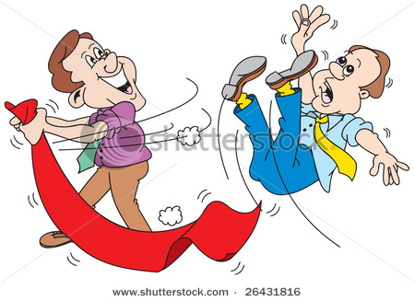
Pass by reference
Functions get the actual list
You don’t need to return it
Need to be careful when doing this

Slide 11
Replication
Copying one array/list into another
def copyList(aList):
newList = []
for item in aList:
newList.append(item)
return newList
list = range(0,10)
newList = copyList(list)
list.append(3)
printNow(list)
printNow(newList)

Slide 12
Coding example
Create 2 arrays/lists
Fill with random values
Print each out
Use array2= array1, modify, check contents
Use proper copy method and repeat

Slide 13
Issues
What happens when you copy a larger list into a smaller list?
How do you reverse the order in a list?

Slide 14
Reversing a list
list1 = range(10,0,-1)
list2 = []
position = len(list1)-1
while (position > -1):
list2.append(list1[position])
position = position – 1
printNow(list)
printNow(list2)
list3 =list1.reverse()
printNow(list3)
[10, 9, 8, 7, 6, 5, 4, 3, 2, 1]
[1, 2, 3, 4, 5, 6, 7, 8, 9, 10]
[1, 2, 3, 4, 5, 6, 7, 8, 9, 10]

Slide 15
Case study
The distance to wall function
for i in range(0,8):
for j in range(0,8):
m_ultra.ping();
m_array[j] = m_ultra.getDistance();
sort(m_array);
//Discard beginning and end b/c sensor is not so good...
value = (m_array[m_array.length-6] + m_array[m_array.length-5] +
m_array[m_array.length-4])/3;
m_results[i] = value;
//Perform the process 8 times
//Perform the measurement 8 times
//Start the echo-location
//Get distance echo traveled
//Sort array contents
Next, sum results and return the average

Slide 16
Remember
Can insert wherever you want into a list
List.insert(position,value)

Slide 17
Visual
3
5
6
7
0
1
2
List.insert(0,3)

Slide 18
Summary
Example usage of arrays/lists
Pass by reference
Copying arrays/lists

