Slide 1
ITEC 109
Lecture 2
The Process of Solving Problems

Slide 2
Review
What are the steps of the problem solving process?
Why do we use computers to solve problems?
What is one hallmark of a good problem solver?
Lab

Slide 3
Process
Define the problem
  Requirements engineer
Identify subparts of the problem
Figure out how to solve each part
Solve each part
Put the parts together
See if you did it right

Slide 4

Define the problem
All may not be as it seems

Slide 5
Guidelines
Define what the problem is and isn’t
Walkthrough or flow-chart
Define what a successful solution is
Goal: Not having to come back and ask questions about the problem
  Is ok to show progress

Slide 6
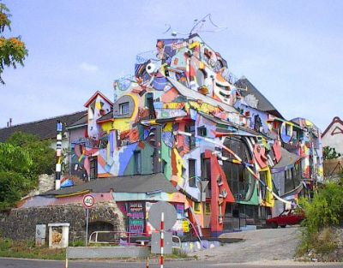
Computers
Guidelines for what to build
Requirements engineering
Don’t tack it on

Slide 7
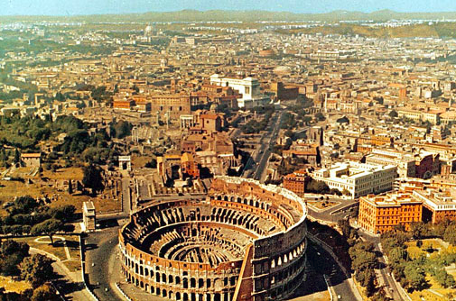
Identify subparts of the problem
Rome wasn’t built in a day

Slide 8
Strategies
Figure out granularity
Identify pieces
Figure out how they go together
Blueprints not materials list

Slide 9
Computers
Functions
Flow of the program
Tests to see if it works

Slide 10
Create Solutions
Components
  Lumber, nails
Algorithms
  A recipe for how to create X
    Sort a list of numbers
    Manage communication between airplanes

Slide 11
Computers
Math
Building construction
Philosophy

Slide 12

Solving Parts
Physical labor
Writing software
  Languages
  Testing

Slide 13
Put Parts Together
Large projects can’t be done in one fell swoop
Dozens of peoples work have to be put together
Some, but not considerable practice here at RU

Slide 14
Computers
Hardest part of the process
Slight deviations from the plan
Expectations gone wrong
Drawing board

Slide 15
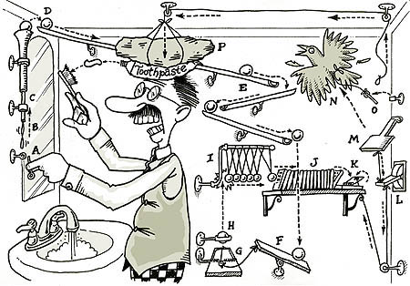
Does it work?
Actual working products are important

Slide 16
Computers
Give it to the user and say do X
Cross fingers
Take notes

Slide 17
Perspective
Can’t be an architect on Day 1
Start with the basics
  Become a brick layer (Solving parts)
Be aware of the higher layers
  Observe and learn
Find your niche

Slide 18
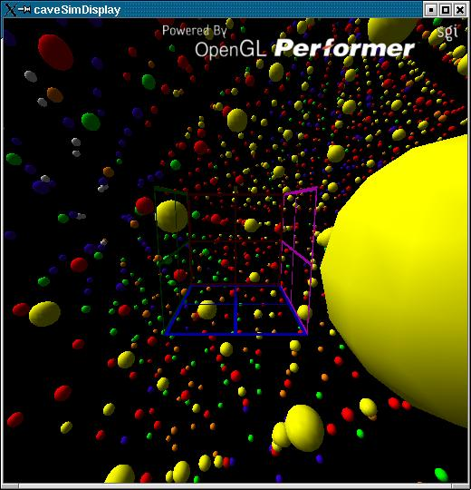
Example
Virtual Reality
Engine replacement
Application

Slide 19
Lessons
Learning tools overwhelms you
Easy to lose sight of big picture
Takes years to move up the chain
  Work
  Direction

Slide 20
Review
Steps of problem solving
Unique aspects relating to computers
Focus is on brick laying

