Slide 1
ITEC 109
Lecture 5
Algorithms / Programming

Slide 2
Review
Introduction to python
What are variables?
What are functions?
How do you make a turtle move forward one spot?

Slide 3
Objectives
Difference between algorithms and programs
Solve a simple problem with python
Learn how to write functions

Slide 4
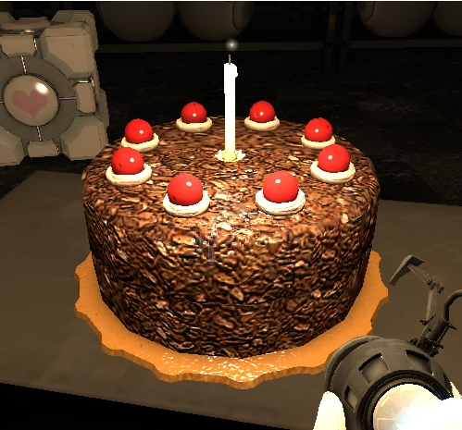
Difference
Algorithm
3 eggs
1 cup water
1/3 cup vegetable oil
1 box cake mix
Mix ingredients
Pour in pan
Put pan in oven at 350 for 30 minutes
Program
Algorithms tell you
what to do to accomplish
something
Programs are the result
of following an algorithm’s
instructions

Slide 5
Problem
I want my newspaper
It is in a box outside
It is too hot
Solution
  I have a turtle go get it for me

Slide 6
Algorithm
Go down 2 places
Pick up paper (Put the pen down)
Move up two spaces
Drop paper

Slide 7
Program
Turtle limitations
Adapt tools to match algorithm
Task: move down one space
Capabilities: turn left and move forward
Animation:
  Add import time at beginning of program
  Insert time.sleep(.5) after each movement
Solution: ?

Slide 8
Solution
Algorithm
Program
Go down 2 spaces
Pick up paper
Move up two spaces
Drop paper
w = world();
t = turtle(w);
turnLeft(t);
turnLeft(t);
forward(t);
forward(t);
penDown(t);
turnLeft(t);
turnLeft(t);
forward(t);
forward(t);
penUp(t);

Slide 9
Functions
turnLeft(t);
turnLeft(t);
turnLeft(t);
Turning right
Why not just have the
idea of turn right that
uses 3 turn lefts?
def right(t):
turnLeft(t);
turnLeft(t);
turnLeft(t);
right(t);
right(t);
Create Once
Use many times

Slide 10
Pro/Con
Algorithm
Go down 2 spaces
Pick up paper
Move up two spaces
Drop paper
Pro
  Hide details
  Maps to algorithm
Con
  Overhead
  Requires thought / planning
Program
turn (t);
move(t);
penDown(t)
turn(t);
move(t);
penUp(t)
Functions
def turnAround(t):
turnLeft(t);
turnLeft(t);
def move(t):
forward(t);
forward(t);

Slide 11
Functions
Without
With
w = world();
t = turtle(w);
turnLeft(t);
turnLeft(t);
forward(t);
forward(t);
penDown(t);
turnLeft(t);
turnLeft(t);
forward(t);
forward(t);
penUp(t);
w = world();
t = turtle(w);
def around(t):
turnLeft(t);
turnLeft(t);
def move(t):
forward(t);
forward(t);
around(t);
move(t);
penDown(t);
around(t);
move(t);
penUp(t);
Overhead for simple tasks
Beneficial for large tasks

Slide 12
Homework
Write a program that uses functions
Demo on Wed. for credit
All turtle HW assignments count as one homework assignment grade

