Slide 1
ITEC 109
Lecture 6
Variables

Slide 2
Review
Homework
Questions?
Algorithm / Program difference
Variables / Functions
Functions
  How do you make one?
  Why would you make one?
  Pros?
  Cons?

Slide 3
Objectives
Learn about variables

Slide 4
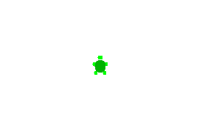
Question
Is all software just moving a turtle around to do different tasks?

Slide 5
Programs
Variables
  Store information
Functions that modify information stored in variables
  Turtle movement
  Input
  Manipulation
Assignments
  Put information in variables
10, Hello,4.5

Slide 6
Strings
Store text
Composed of multiple characters (A-Z)
Have functions for manipulating text
  Get the number of characters of in a string
aWord = “Hello World”;
length = len(aWord);

Slide 7
Assignments
Get text into a String
Done through assignment
  Target variable for assignment (sink)
  Specify where info comes
  from (source)
1. Create a variable of
2. Store the constant value Hello in it
To allow the user to type it in:
word = raw_input();
Or
word = raw_input(“Enter a word>”);

Slide 8
Output
printNow(variable);
Lets you know what happens when programs run
How you get contents of variables out
Type printNow( ); into your program
Put the name of the variable you want to display inside of the ( )
Save and load your program in JES

Slide 9
Problem
Read in two numbers
Convert to integer and float
  int(var) and float(var)
Mathematical operations
String variable
Assignment
Function Call
Operation
FunctionCall

Slide 10
Homework
Create a program that welcomes the user, asks them to input two integers, then display the result of adding, multiplying, dividing, and subtracting them
Use at least one function in your program

