Slide 1
ITEC 109
Lecture 7
Operations

Slide 2
Review
Variables / Methods
Functions
Assignments
  Purpose?
  What provides the data?
  What stores the data?
  What type of variable holds: Hello World

Slide 3
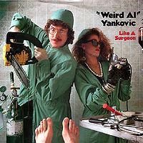
Objectives
Other types of variables
Operations on variables

Slide 4
Variables
Character
The 3 pigs had a big find, 1.5 bars of true gold.
String
  Text
Integer
  Whole numbers
Float
  Decimal places (double in other languages)
Boolean
  True or false

Slide 5
Operations
Modify a particular variable
Result of: + / - *
2 other variables necessary
Program
b=3;
c=4;
a=b+c;
printNow(a);

Slide 6
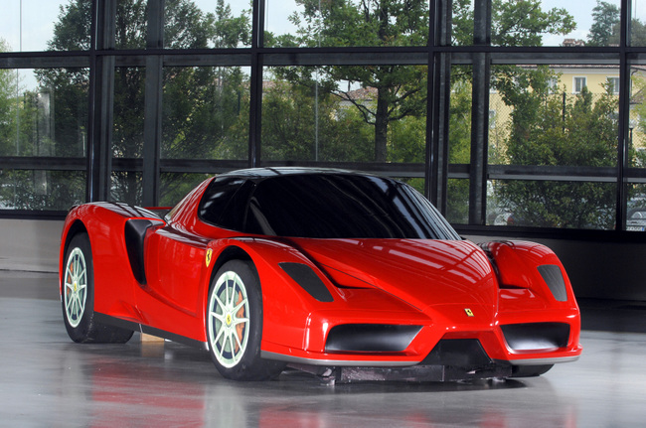
Problem
Using JES, calculate how many seconds it takes for…
3 feet
20 feet
Going
3 FPS
Hint: only use ints if no chance of decimal places!

Slide 7
Homework
Celsius to Fahrenheit converter
  Ask user for input
Testing: Convert 20C to F
Experiment: One operation per line, no chaining together
F=C*9/5 + 32

