Slide 1
ITEC 109
Lecture 8
Conditionals

Slide 2
Review
Questions?
raw_input reads strings
What if a String is 3.5 ?
You need to multiply it by 2?
Turn a string into float
Function call!
Exercise:
temp = “3.5”;
value = float(temp);
amount=2;
value = value * amount;
printNow(value);

Slide 3
Objectives
Converting between variable types
Add capability to make decisions in our programs

Slide 4
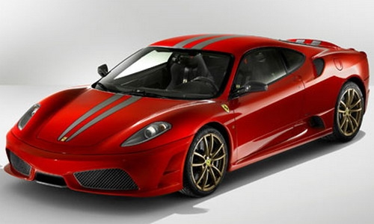
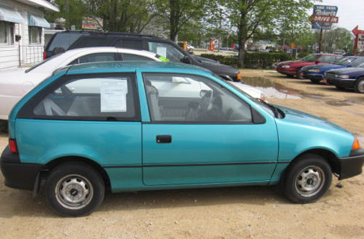
Choices
First
Last

Slide 5
How
if (accountBalance > $1,000,000):
else

Slide 6


Decisions
Weather Applications
If temperature greater than 50
else
> Greater than
< Less than
>= Greater than or equal to
<= Less than or equal to
== Equal to
!= Not equal
if ( variable operation variable):
Only executes if it is true
else:
Only executes if it is false

Slide 7
Exercise
Modify homework so that it prints out it is Warm if temp > 50 or Cold if it is less than 50
Modify input to check both cases

