Slide 1
ITEC 109
Lecture 9
Iteration

Slide 2
Review
Questions?
Variable conversion
Conditionals
  Why do we use them?
  What is possible with them?

Slide 3
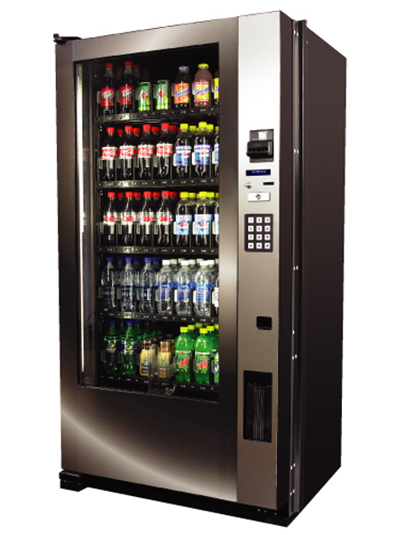
Iteration
Repeat an action several times
Drinks cost $1.25
Insert 5 quarters into the machine
insertCoin(.25);
insertCoin(.25);
insertCoin(.25);
insertCoin(.25);
insertCoin(.25);
for i in range(0,5):
insertCoin(.25);

Slide 4
Turning
Turn left ( Can it be put in a function?)
3 turn lefts is one turn right
Program
import time
w = makeWorld();
t = makeTurtle(w);
for i in range(0,3):
turnLeft(t);
time.sleep(.05);

Slide 5
Square
Write a program that causes the turtle to move around a square of size 2
You may assume that you start on a corner of the square
Algorithm?

Slide 6
Multiplication
Multiply a number by 3 by addition
Exercise
test=3;
int sum;
sum=0;
for I in range(0,3):
sum= sum + test;
What happens if we don’t use sum?
After time
1
2
3
3*3 = 9
Sum is
3
6
9

Slide 7
Homework
Swim around the world
  Your turtle lives in a 4x4 grid
  You start at the center of the grid
  Move turtle to one of the corners of the world
  Move turtle around border of it’s world using for loops

