Slide 1
ITEC 109
Lecture 10
More on Repetition / Choices

Slide 2
Review
Questions
Mini-exam next Tuesday
Iteration
What is it
How do we use it
What are reasons why we would use it

Slide 3
Objectives
Extend choices beyond just one or the other
Work on a homework assignment

Slide 4
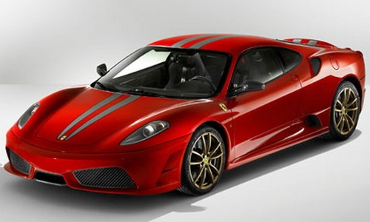
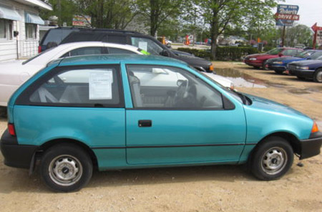
Reality
There are more than 2 cars in the world

Slide 5
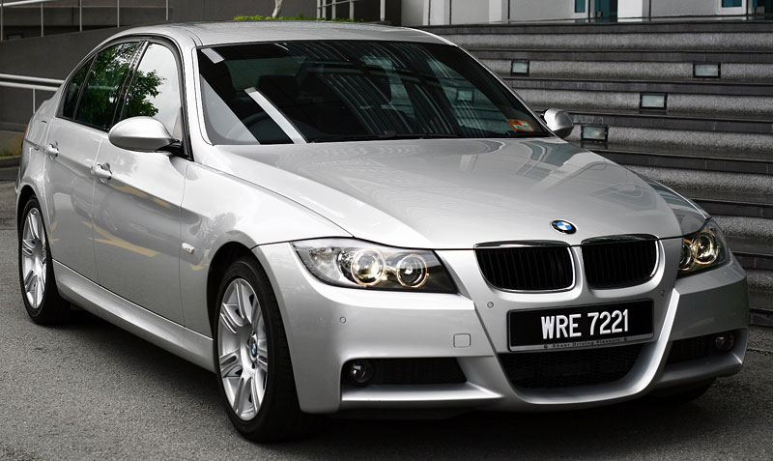
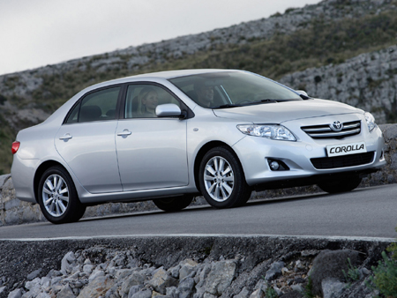
Example
Extremely
expensive
Expensive
Average
Cheap

Slide 6
Problem
Want to buy a car, but not multiple cars
Have $200k in the bank, want to get best car
Are you always going to buy
a camry?
bankAccount=200000;
if (bankAccount>500000):
buyferrari();
bankAccount = bankAccount-500000;
if (bankAccount > 60000):
buybmw();
bankAccount = bankAccount -60000;
if (bankAccount > 20000):
camry.buy();
bankAccount = bankAccount – 20000;

Slide 7
Multiple Choices
1st choice
if
2nd to Xth choice
else if
Last choice
else
bankAccount=200000;
if (bankAccount>500000):
buyferrari ();
bankAccount = bankAccount-500000;
elif (bankAccount > 60000):
buybmw();
bankAccount = bankAccount -60000;
elif (bankAccount > 20000):
buycamry();
bankAccount = bankAccount – 20000;
Optional

Slide 8
Homework
Create a program that asks the user to input one of four possible commands
Use if /elsif / else to call a function that implement the command
Come up with your own commands
Ideas
Turtle movement
Math formulas

