Slide 1
ITEC 109
Lecture 12
Higher level concerns

Slide 2
Review
JES– What did you learn?
Questions?

Slide 3
Changes
Before
4 days a week of interactive lecture
Rest of semester
Lecture MW
M => Introduction to topic, simple examples
W => Answer Questions, Best practices, Homework
Lab TR
Hands on practice

Slide 4
Objectives
History
Examples

Slide 5
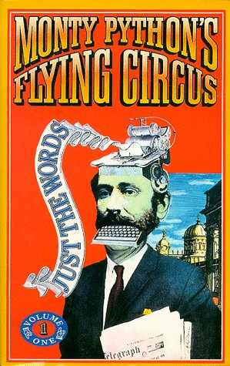
Python

Slide 6
History
Created in 1990 by Guido van Rossum
Benevolent dictator for life
The C language powers it
Multiple paradigms
Not a one trick pony
Used by Google, Yahoo, BF2, ILM, Walt Disney, NASA, IBM
Meant to make computing fun

Slide 7
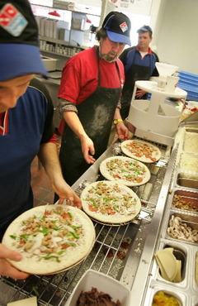
Process
Write
Save
Load program
Inspect results
Change the program
Assembly line

Slide 8
Cycle
Get input from
user
Calculate information
Output result
Repeat until user is satisfied

Slide 9
What maps to…
Input?
Computation?
Output?

Slide 10
Advanced computation
Trigonometry
math.cos(radians)
math.acos(radians)
Raising
math.sqrt(num)
math.pow(num,exponent)

Slide 11
Summary
History
Higher level cycle

