Slide 1
ITEC 109
Lecture 13
Strings

Slide 2
Review
Input + Computation + Output

Slide 3
Objectives
Functions calls for strings in python
Working with text

Slide 4
Representation
temp = “Hello World”;
H | e | l | l | o |  | W | o | r | l | d
0
1
2
3
4
5
6
7
8
9
10
printNow(temp[0])
printNow(temp[0:4])
Single character
Range of characters

Slide 5
Variables
Collection of characters (array)
Access parts of the variable
x = “Hi You”
First = x[0:1]
printNow(First)

Slide 6
Function calls
How big is it?
Where is X character?
Upper or lower case it
Replace characters in the string

Slide 7

Motivation
John Doe|Debt|300
Credit card bill:
Dear John,
You owe us $300.

Slide 8
Functions
str = “Hello World”;
index and length
H | e | l | l | o |  | W | o | r | l | d
0
1
2
3
4
5
6
7
8
9
10
num = index(‘ ‘);
num2 = len(str)
result = str[num+1:num2]

Slide 9
More
str = “Hello World”;
Upper case
Lower case
Replace
str = str.upper();
str = str.lower();
str = str.replace(‘H’,’W’);
Method call, similar to function call (OO style vs procedural)

Slide 10
Advanced
test="Hello|World|End"
num = test.find('|')
first = test[0:num]
num2 = test.find('|', num+1)
second = test[num+1:num2]
third = test[num2+1:len(test)]
printNow(first+second+third)
Hello
Get the 2nd bar
World
End

Slide 11
Functions
def parseAString(name):
num = name.find(‘|’)
one = name[0:num]
two = name[num+1:len(name)]
printNow(one +” “ + two)
parseAString(“Hello|World”)
parseAString(“One|Two”)

Slide 12
Conditionals
a="one"
b="two"
if (a != b):
printNow("Test")
elif (a == b):
printNow(“Equal”)
else:
printNow(“End of the world”)

Slide 13
Loops
counter=0
source="World"
target=""
while (counter < 4):
target = target+source
counter = counter +1
printNow(target)

Slide 14
Example
Find the first character in the first name and store it in a string called formatted
Print out “Welcome” then print out the value of formatted then a . then a space then the last name
Andrew Ray
A. Ray

Slide 15
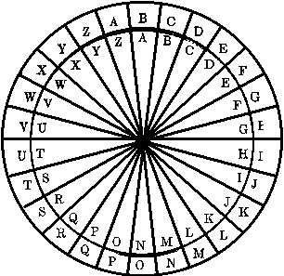

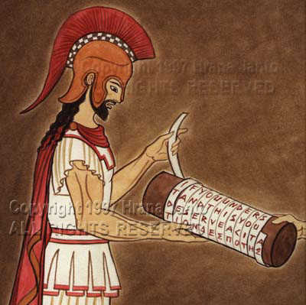
Background

Slide 16
Methods
Any that you remember?
Caesar
A->C, B->D, etc…
Substitution
  Replace A with 7
  Replace E with 3

Slide 17
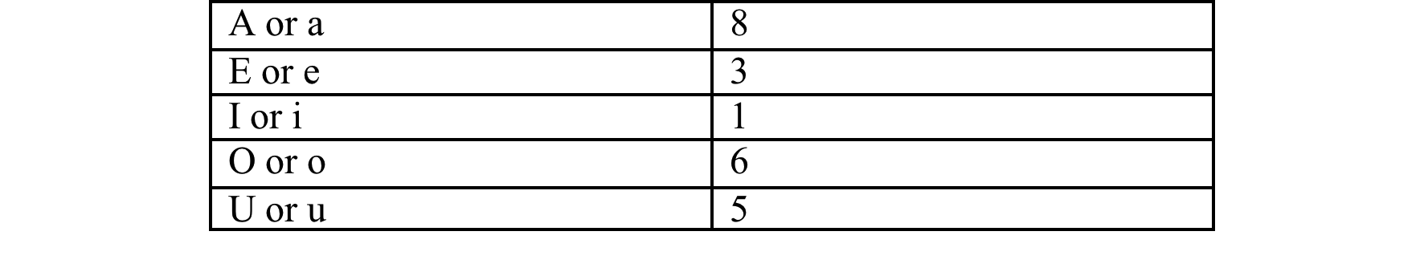
Sample
What code would you need to write to create this encryption ?

Slide 18
Summary
Strings
  Methods
  Functions
  Conditionals
  Loops

