Slide 1
ITEC 109
Lecture 14/15
Strings
+
Functions

Slide 2
Review
Strings
What can we do?
Why?

Slide 3
Example
Find the first character in the first name and store it in a string called formatted
Print out “Welcome” then print out the value of formatted then a . then a space then the last name
Andrew Ray
A. Ray

Slide 4
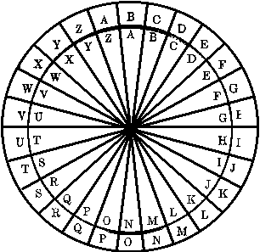
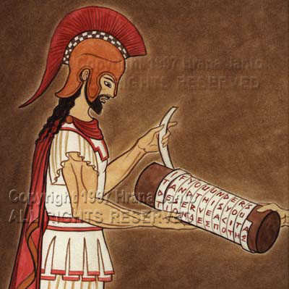
Background

Slide 5
Methods
Any that you remember?
Caesar
A->C, B->D, etc…
Substitution
Replace A with 7
Replace E with 3

Slide 6
Sample
What code would you need to write to create this encryption ?

Slide 7
Objectives
Functions
Parameters
Return statements
Scope
Examples

Slide 8
Basics
What is the purpose of functions?
What are the benefits?
What are the downsides?

Slide 9
Visualization
Current view of a program
New view
0 – x=3;
1 – y=x*2;
2 – printNow(y);
Function call
Function return

Slide 10
Function Syntax
def [Name] ():
def firstFunction():
Name is just like a variable name
( begins parameters
) ends parameters
: begins the code
Tab delimited (function begin / end implied)

Slide 11
Syntax
def FunctionName():
printNow(“I am a function”)
Function body
def FunctionName():
printNow(“I am a function”)
FunctionName()
Function call

Slide 12
Visualization
Step 1: Ignore function
def FunctionName():
printNow(“I am a function”)
FunctionName()
Step 2: Call Function
Step 3: Execute Function
Print
Step 4: Return back to main
Step 5: End program

Slide 13
Return
Have a function send info back
2 way street
Return trip
def secretValue():
return 15
myValue = secretValue()
printNow(myValue)

Slide 14
Parameters
Provide input to a function
Comma separated list
A copy of other variables
Required when function is called
def add(var1,var2):
return var1+var2;
result = add(3,4)
printNow(result)

Slide 15
Scope
Where variables can be used
def example():
test=“Hello”
printNow(test)
test=“apple”
example()
printNow(test)
Is this test the same as this test?
Answer: not it isn’t

Slide 16
Rules
Functions are like prisons, you don’t have the freedom to go outside
One way in
Parameters
One way out
Return statement

Slide 17
Example
Writing a function that reads an int, squares, and returns it [Math.pow(var,2)]

Slide 18
Example
Writing a function that performs the quadratic formula

Slide 19
Example
Write two functions that return a separate piece of the of a string
First|Last
getFirst / getLast

Slide 20
Philosophy
Group information together
Make it useful
Subdivide tasks to developers

Slide 21
Review
Functions
Parameters
Return types

