Slide 1
ITEC 109
Lecture 15
Advanced functions

Slide 2
Review
Functions
Parameters
Return statements
Variable scope

Slide 3
Objectives
Functions calling other functions
Patterns
Examples

Slide 4
Easy
Main to function and back
def FunctionName():
printNow(“I am a function”)
def FunctionTwo():
printNow(“I am the second”)
FunctionName()
FunctionTwo()

Slide 5
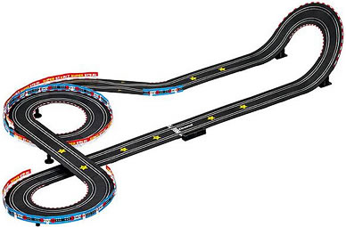
Driver
Driver
Curve1
Curve2
Curve3

Slide 6
Pro/Con
Pro
Breaks a problem into steps
Easy to re-order operations in the code
Con
Initial setup cost is high
Requires design, can’t just code it ™

Slide 7
Application
Driver
IO
Compute
Output
Standard cycle pattern
def getValue1():
return 3;
def getValue2():
return 5;
def compute(a, b)
return a+b;
def ouput(value)
printNow(value)
x =getValue1();
y= getValue2();
result = compute(x,y);
output(result);

Slide 8
Pro/Con
Pro
Separates parts of implementation (keyboard vs file)
Scaling of project
Con
Data management
Questions of what happens when you need to mix input / computation

Slide 9
Chooser
def getBalance():
return 55;
def badCredit():
printNow(“Work harder”)
def goodCredit():
printNow(“Keep it up”)
amount = getBalance();
if (amount > 50):
goodCredit();
else:
badCredit();
Driver
Choice
Input
Function2
Function3

Slide 10
Stair step
Driver
Function 1
Function2
Function3
def function1():
function2();
def function2():
function3();
def function3():
printNow(“Complicated”)
function1()

Slide 11
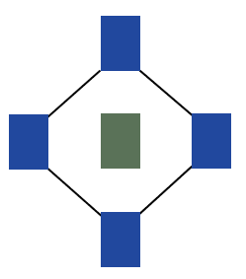
Pro/Con
Pro
Models more complex problems
Con
What happens when something goes wrong?
If A calls B, which calls C, which calls A, what happens?

Slide 12
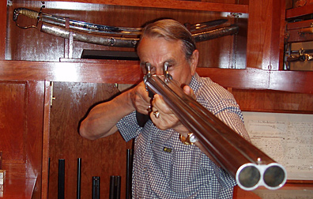
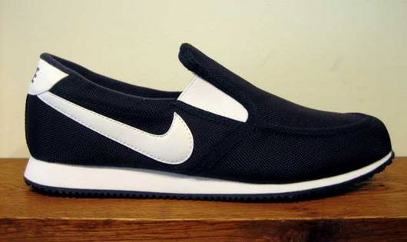
Stair climbing
Go back up
Driver
Function 1
Function2
Start
Function3
*Warning*

Slide 13
Example
//Prints out sum of 4+3+2+1
def sum4():
return 4 + sum3();
def sum3():
return 3 +sum2();
def sum2():
return 2 + sum1();
def sum1():
return 1;
answer =sum4();
printNow(answer)

Slide 14
Pro/Con
Pro
Crazy and semi-useful tool
Brain bending mental exercise
Con
Algorithm design complexity
Debugging (100% CPU usage)
Recursion

Slide 15
Combination
Driver
Function 1
Choice
Function2
Function3
What kind of code would we need for this?

Slide 16
Pro/Con
Pro
Divide and conqueror
Flexibility
Con
You have to figure it out
Requirements
Design
Implementation

Slide 17
Review
Function review
Functions calling functions
Pattern review

