Slide 1
ITEC 109
Lecture 16
Functions (3)
Conditionals

Slide 2
Review
Functions
  Parameters
  Returns
  Syntax
  Scope

Slide 3
Objectives
Review functions
Examples
Introduce iteration

Slide 4
Functions
Why use them?
What is a parameter?
What is a return value

Slide 5
Example
def fun1():
fun2()
printNow("Done")
def fun2():
printNow("Test")
fun1()

Slide 6
Example
def fun1(var1,var2):
return var1+var2
printNow("Done")
def fun2():
return int(raw_input())
x = fun2()
y = fun2()
z = fun1(x,y)
printNow(z)

Slide 7
Example
def mystery(var1):
printNow(var1)
if (var1 > 25):
return;
else:
mystery(var1+1)
mystery(1)

Slide 8
Conditionals
What is the purpose of if
What is the purpose of elif
What is the purpose of else
What is the syntax for the three?

Slide 9

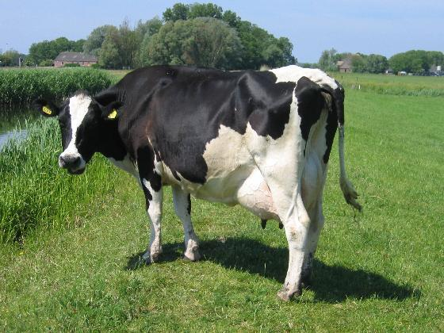
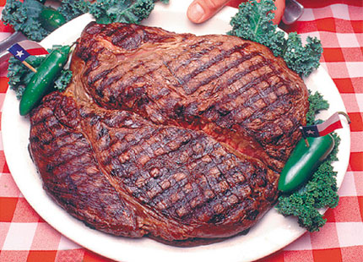
Example
If you shoot a cow
Then you get steak

Slide 10
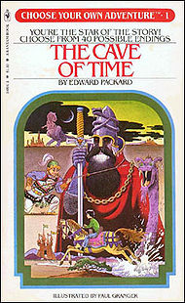
Choose your own adventure
Book where you make choices
as you read
Choices you make impact the story
  Wildly rich
  Horrible deaths
If you decide to start back home, turn to page 4.
If you decide to wait, turn to page 5.

Slide 11
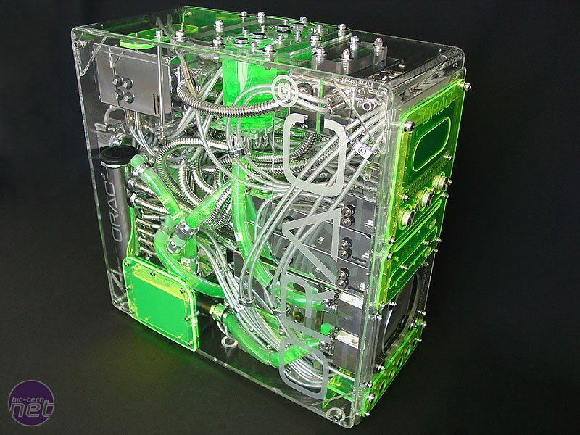
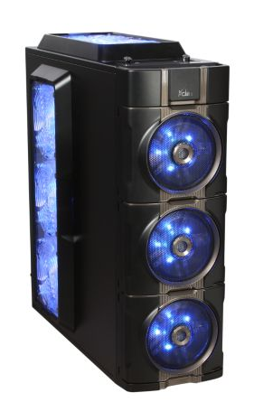
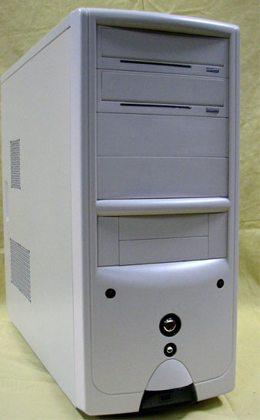
Priorities

Slide 12
Visually
public static void main
{
//Code before
//Code after
}
Only when if
not met and
condition is true
if (condition)
{ }
First choice
Second choice
else if (condition)
{ }
Last choice
else (condition)
{ }

Slide 13
Structure
Expression (True or false)
  All vars: <,>,==, !=
Based on the word / expression a block of code gets executed

Slide 14
Python
First choice = if
Second choice = elif
Third choice = elif
Last choice = else
Linear progression
Begins with if
Ends with else

Slide 15
Example
var1=3
if (var1 > 3):
printNow("1")
elif (var1 < 3):
printNow("2")
else:
printNow("3")

Slide 16
Example
x=3;
y=4;
if (x>3):
printNow(“X is big”);
elif (y <4):
printNow(“Y is small”);
elif (x == y):
printNow(“Same”);
else:
printNow(“Can you see me now?”);

Slide 17
Example
Can you guess the number between 1-10 that I’m thinking of exercise
Check to see if it is between 1 and 10
Then say Exact if it is 5, Higher than my choice if is above 5, Lower than my choice if it is less than 5

Slide 18
Chaining
total=3;
max=3;
sum=4;
//Scanner code to read in the values
if (total == max):
if (total < sum):
printNow(“T < S”);
else:
printNow(“ T = M < S”);

Slide 19
Review
Functions
Conditionals

