Slide 1
ITEC 109
Lecture 17
Conditionals

Slide 2
Review
Function examples
if / elif /else
Questions?
HW1 due next Friday
One website

Slide 3
Objectives
Learn the last two pieces of conditionals
Examples

Slide 4
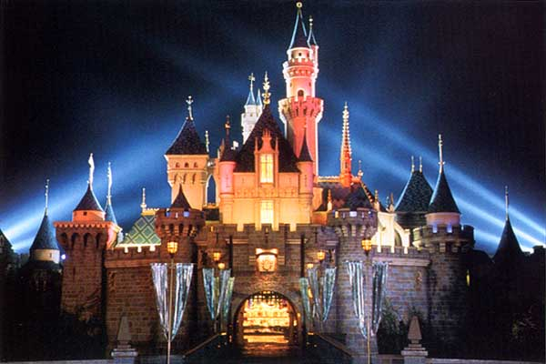
Traveling
Do you want to visit Disney World or Jurassic Park

Slide 5
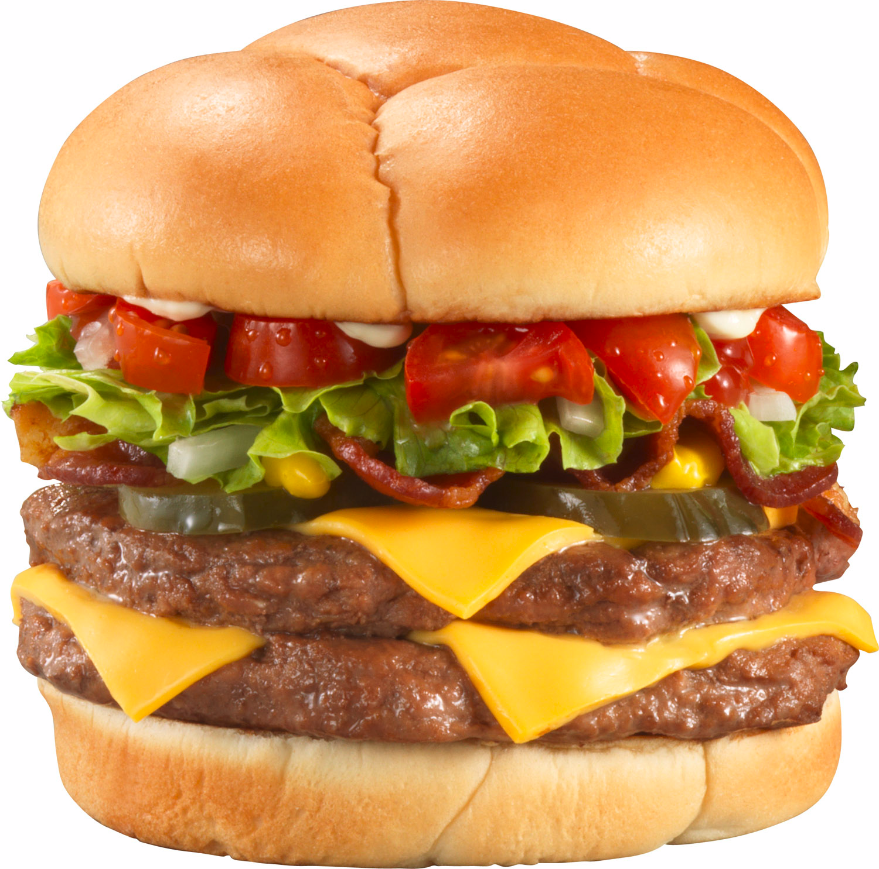
Food
Marketing campaign:
You know you want to order a burger and fries

Slide 6
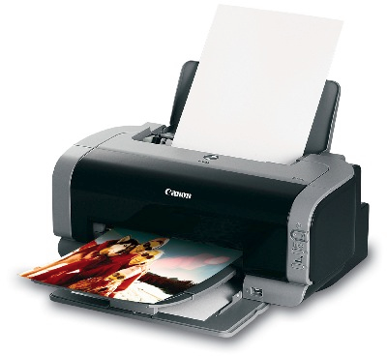
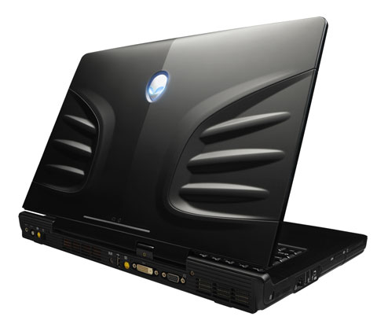
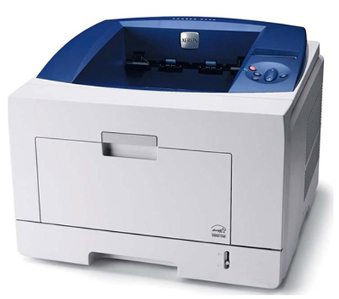
Acquisition
or
or
and

Slide 7
And
Function that takes two Booleans and returns a Boolean
Represented by boolA and boolB in Python
Truth table
boolA
boolB
Result of and
True | True | True
True | False | False
False | True | False
False | False | False

Slide 8
Example
x = readNuclearTemperature();
y = readAvailableCooling();
if ( x > 0 and x <= y):
beginCooling();
else:
soundAlarm();

Slide 9
Conversion
x = readQuantity();
y = getOrderDescription();
Allows for nesting on 1 line
if ( y == “Sweater”):
if (x > 5):
printNow(“Bulk pricing”);
OR
if ( y == “Sweater” and x > 5):
printNow(“Bulk pricing”);

Slide 10
Or
Function that takes two Booleans and returns a Boolean
Represented by boolA or boolB in Python
Truth table
boolA
boolB
Result of or
True | True | True
True | False | True
False | True | True
False | False | False

Slide 11
Example
x = getResidency();
#0 == Citizen
#1 == Green card
#2 == Visa
if (x == 0 or x ==1 or x ==2):
printNow(“You meet the requirements”);

Slide 12
Chaining
x = getFlyerStatus();
if (x == 3):
System.out.println(“VIP”);
if (x == 2):
System.out.println(“Standard”);
if (x == 1):
System.out.println(“VIP”);
if (x ==1 or x == 3):
System.out.println(“VIP”);
if (x ==2):
System.out.println(“Standard”);

Slide 13
Scenarios
Website entering a password twice
Why? How do we enter it?
Picking courses from the Core
Core 1 = Art, Philosophy, English, History
Core 2 = Math, ITEC, Stat
How do we tell if you meet core1 and core 2 requirements?

Slide 14
Scenarios
Determine what letter grade to display for a numeric score
90->100 = A
80->89 = B
70->79 = C
60->69 = D
0->50 = F

Slide 15
Example
x=0;
y=3;
z=4;
z=z+x+y;
if ((( z> y-x or x+z > y) and (x != x)):
printNow(“Am I printed?”);

Slide 16
Transistors
Electricity
Video card pin associated with X pixel on monitor
Transistor

Slide 17
Gates
Control over what goes out
Electricity
A
Only emits electric charge when A/B are
at a specific voltage
B
And gate

Slide 18
Simple CPU
4 basic operations, 2 inputs
Add circuitry
Multiply circuitry
A
Divide circuitry
B
Subtraction circuitry
2 to 4 Mux
True | True | Add
True | False | Multiply
False | True | Divide
False | False | Subtract

Slide 19
Python CPU
a = getInput1();
b = getInput2();
if (a and b):
add();
if (a and not b):
multiply();
if (not a and b):
divide();
if (not a and not b):
subtract();

Slide 20
Computer power
And gate has 6 transistors
Core2Duo has 291 million transistors
48.5 million low level gates
How we can do games at > 30 FPS

Slide 21
Review
And
Or
Syntax
Examples

