Slide 1
ITEC 109
Lecture 19
For loops

Slide 2
Review
While loops
Sentinels
Counter variable
Break
Continue

Slide 3
Objectives
For loops
Difference from while loops

Slide 4
Disadvantages
While loops
3 things to worry about
Bugs happen when you are writing code
i=0
while (i <10):
i=i+1

Slide 5
While
2 types of problems
Numeric control
Alphabetic control
i=0;
while (i <10):
i = i+1;
command = raw_input();
while (command != “quit”):
command = raw_input();

Slide 6
Rationale
Standard problem
Problematic practice
Keeping track
Placement issues
Updating issues
Need to simplify it

Slide 7
Arrays
List of numbers
Range takes
Number to start at
Number to end at
Number to increment by (1 by default)
Goal: Do something for each value in list
y = range(0,10)
printNow(y)
[0, 1, 2, 3, 4, 5, 6, 7, 8, 9]

Slide 8
For
int i=0;
while (i <10):
i = i+1;
All in one place
Initial value
Sentinel check
Increment
for i in range(0,10):
printNow(i)

Slide 9
English
Start at the first item in the list, execute the block of code, move to the next value in the list, and repeat until the list runs out
for i in range (0,10):
#Block of code here

Slide 10
Examples
What does this print?
for i in range(0,10):
printNow(“SPAM”);
sum=0;
for i in range(0,5):
sum=sum+i;
printNow(sum);
What does this print?

Slide 11
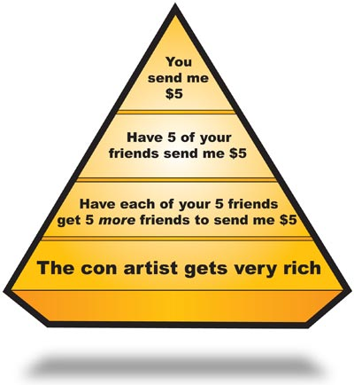
Pyramid Scheme
Get a percentage of profit from those who generate money underneath you
purchaseAmount=10;
for sucker in range(0,10):
val = sucker*(.05*purchaseAmount);
printNow(“Amount made with “ + numSuckers
+ “ underneath you: “ + str(val));

Slide 12
Examples
value=0;
for num in range(0,40,10):
value = value + num;
printNow(value);
value=10;
for (num in range(0,40,10):
value = value + num;
printNow(value);

Slide 13
Example
for num in range(10,0,-1):
printNow(num)
for num in range(10,-5,-1):
printNow(num)

Slide 14
Finding min
Assume first entry is what you are looking for
Read in another entry
Compare against assumption
val=int(raw_input())
min= val
for i in range(0,10):
val = int(raw_input())
if (min > val):
min = val;
printNow(min)

Slide 15
2D grid
x,y location
Need to perform action at
each grid location
for i in range(0,10):
for j in range(0,10):
printNow(“At location “ + str(i) + “,” + str(j));

Slide 16
String parsing
Ever wonder how index works?
This splits a string into two parts
Before and after the :
input = raw_input();
part1=“”
part2=“”;
found=false;
for i in range(0, len(input)):
if (input[i] == “:”)
found = true;
if (not found):
part1 = part1 + input[i]
else:
part2 = part2 + input[i]
printNow(part1 + “-” + part2)

Slide 17
String replace
Need to find a particular character and replace it with another character
How do we do this without the built-in python function…

Slide 18
Summary
For loops
Range - List of numbers
All in one line
Can access variable that tells you where you are at in the list

