Slide 1
ITEC 109
Lecture 20
Arrays / Lists

Slide 2
Review
For loops
  Rationale
  Syntax
  Examples

Slide 3
Objectives
Look at arrays / lists in python
Motivation
Syntax
Examples

Slide 4
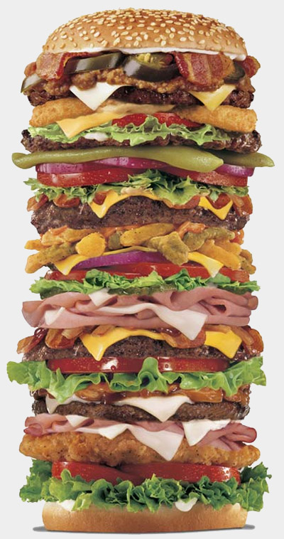
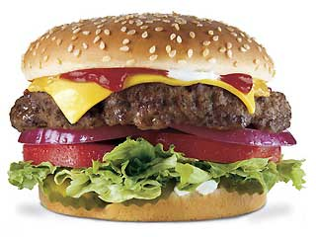
Variables
If one is good
More is better

Slide 5
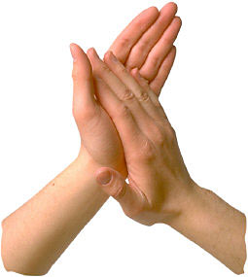
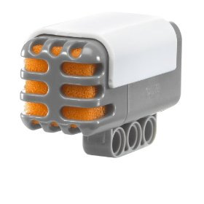
Problem
Data sensor that produces 100 whole numbers a second
Need to perform calculations on them

Slide 6
Problem
var3
var4
int var1,var2,var3,var4;
var2
var1
-Painful if you have large amounts of data to work on
-Need a way to refer to lots of variables with one variable

Slide 7
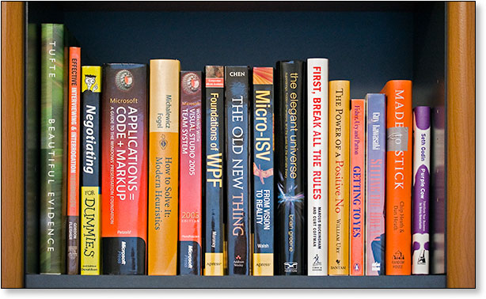
Idea
Two tiered reference mechanism (SAME TYPE OF INFO)
On the top bookshelf
Book 0 => Beautiful Evidence
Book 1 => Effective C++
Book 2=> Negotiating
Book 3=> Applications
Bookshelf
0
1
2

Slide 8
Visualization
How it looks like in memory

Slide 9
Syntax
Creation
Adding a value
Removing a value
myList= []
Adds to end of list
myList.append(3)
myList.insert(0,4)
Inserts into a particular place
In the list
myList.remove(3)

Slide 10
Accessing
Get a particular value in the list
Get a range of values
Exactly the same as strings!
value = myList[0]
subList = myList[0:4]

Slide 11
Accessing
example = [];
First element
Last element
Middle element
example[?];
example[?];
example[?];
*Candy example

Slide 12
Loops
example = [];
example[0] = 2;
example[1] = 3;
example[2] = 4;
example[3] = 5;
example[4] = 6;
What you want
What code do we need to do this?

Slide 13
Functions
Parameters
def getValue(data, index):
if (index > 0 and index <len(data)):
return data[index];
return 0;

Slide 14
Loops
values = []
for i in range(0,10):
values.append(i)
for num in values:
printNow(num)

Slide 15
Example
Read in X numbers
Find min
x = int(raw_input("Enter array size>"));
array = [];
for i in range(0,x):
array.append(int(raw_input("Enter number " + str(i) + ">")));
min=array[0];
for i in array:
if (i < min):
min = i;
printNow("Minimum is " + str(min))

Slide 16
Find average
Read in X numbers, print out average

Slide 17
Counting #s
Generate numbers between 0-50
Count how many of each number we have
What problems could this be applied to?

Slide 18
Problems
Return an int array length 3 containing the first 3 digits of pi, {3, 1, 4}.
Reverse a list of numbers

Slide 19
Review
Arrays / Lists
  Declaration
  Length
  Syntax
  Examples

