Slide 1
ITEC 109
Multimedia Lecture
Lecture 23

Slide 2
Review
Lists / Arrays

Slide 3
Objectives
Learned basics of programming languages
What can you do with them?
Is programming really about writing functions?
Learn how to do image manipulation

Slide 4
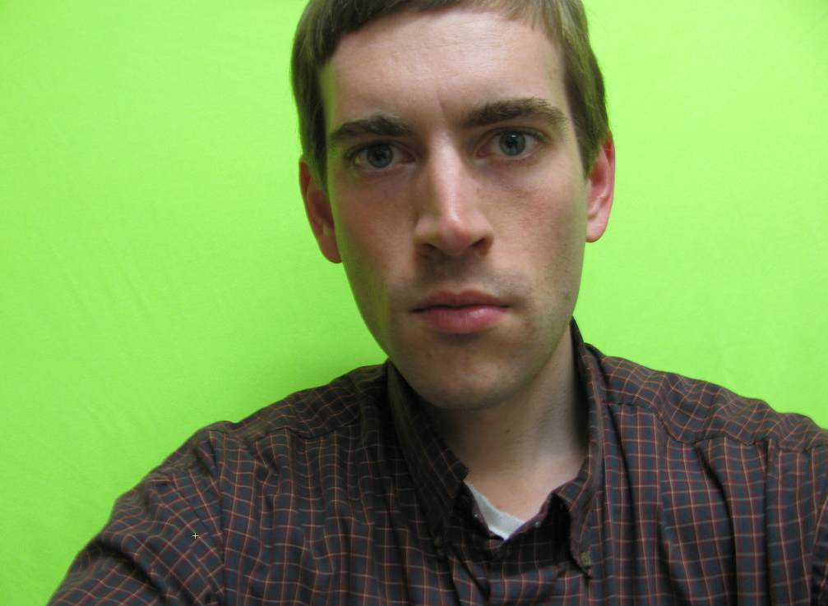
Source

Slide 5
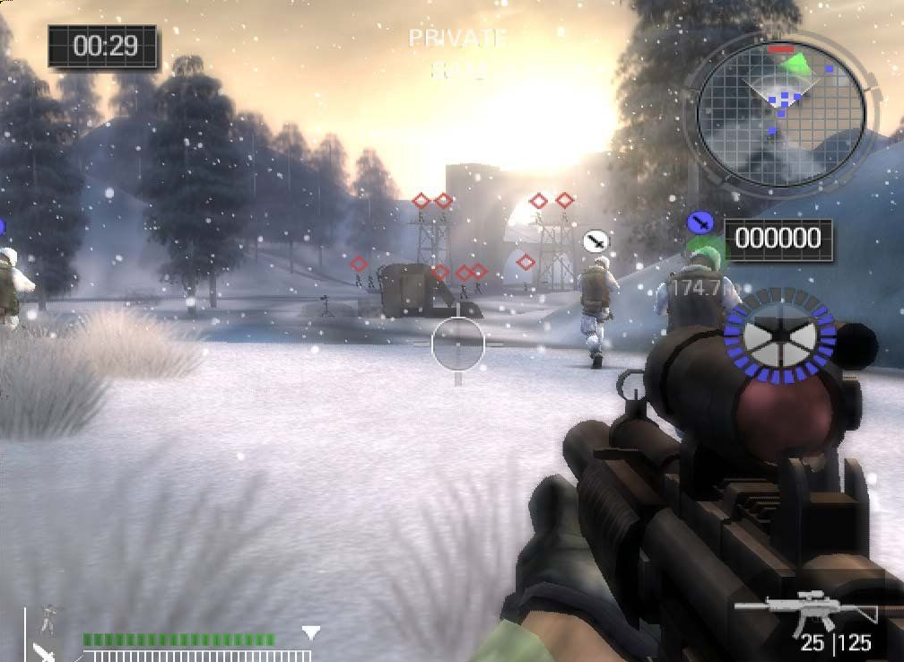
Background

Slide 6
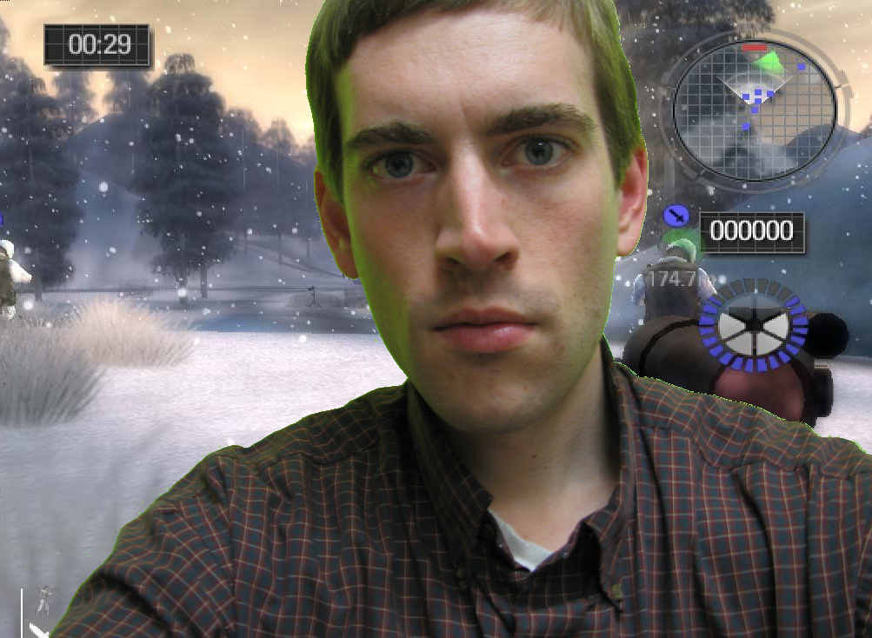
Get in the game

Slide 7
Tools
Pixels:
Red
Green
Blue
Range:
0-255 (Intensity of color at position)
Pictures are pixels are stored in a list:
[ P0, P1, P2, P3, P4…P786432]
Resolution: 1024x768
Load a picture from disk:
file = "/Users/Andrew/greenScreen/test3.jpg"
picture = makePicture(file)
Get list of pixels:
list = getPixels(picture)
Show picture to user:
explore(picture)

Slide 8
Using Pixels
Go through each pixel in a list
Print out red value, set to 0 (no red)
Print x,y position in original picture
file = "/Users/Andrew/greenScreen/test3.jpg"
picture = makePicture(file)
for pixel in getPixels(picture):
printNow(pixel.getRed())
pixel.setRed(0)
#Also works for Blue and Green

Slide 9
Back to X,Y
Deal with X,Y coords of original picture
file = "/Users/Andrew/greenScreen/test3.jpg"
picture = makePicture(file)
list = getPixels(picture)
for pixel in list:
printNow(“X,Y=“ + str(getX(pixel))+str(getY(pixel)))
#Get the color (r,g,b) for pixel at 0,0
Pix = getPixel(picture,0,0)
color = getColor(Pix)
#Make pixel at 0,1 identical to 0,0
list[1].setColor(color)

Slide 10
Process
Find a green pixel, replace with pixel from other picture

Slide 11
Experimentation
Use the explore method to see what the r,g,b values of parts of the picture are
Clicking on x,y positions
Start thinking of ranges to use

Slide 12
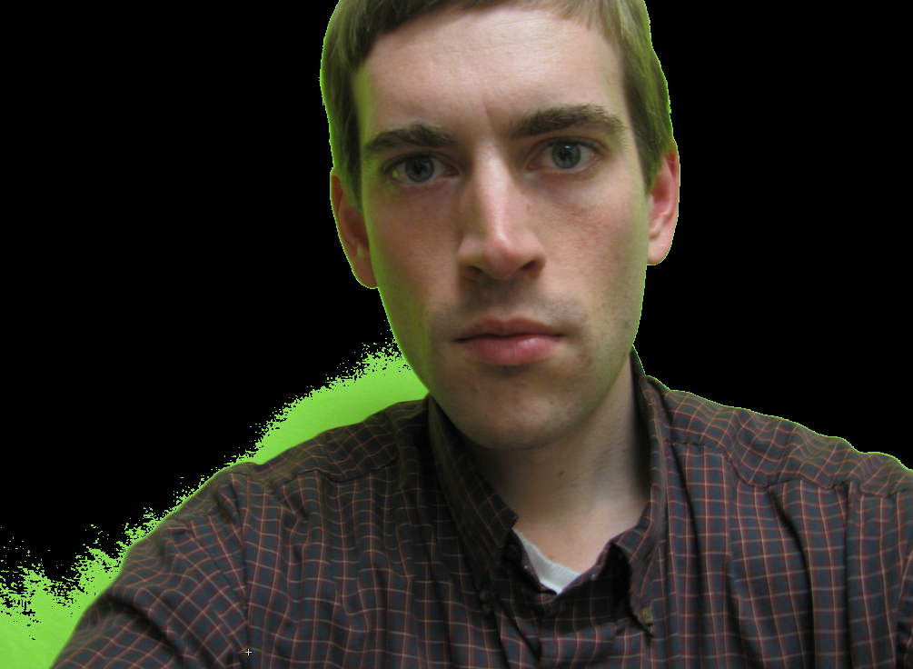
Only green
Green > 220
Find a green pixel, set it to black
(0,0,0)
Useful for seeing how good it is

Slide 13
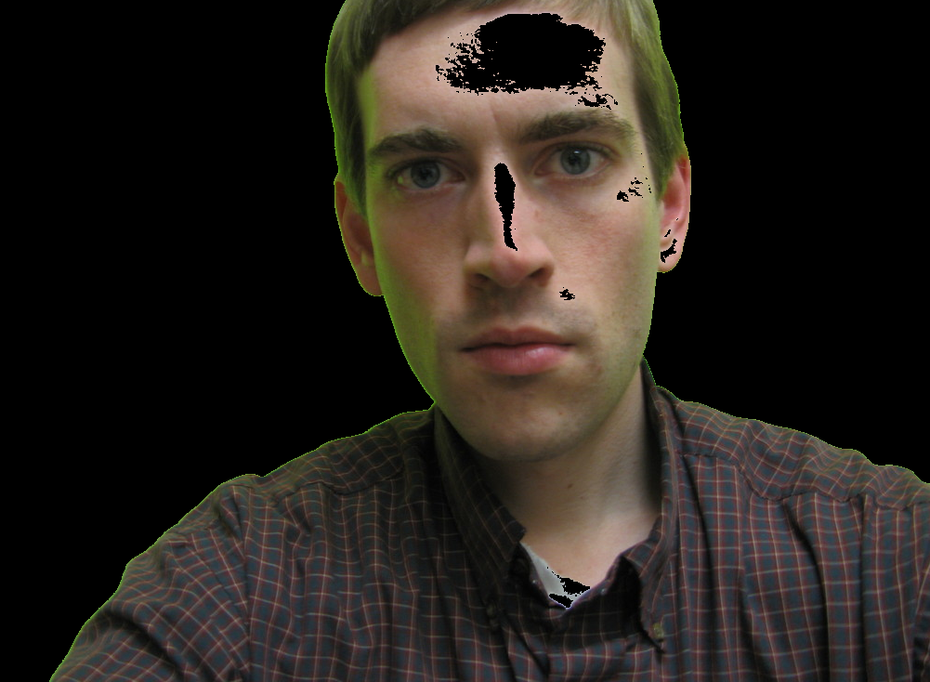
Lower intensity
Green > 170

Slide 14
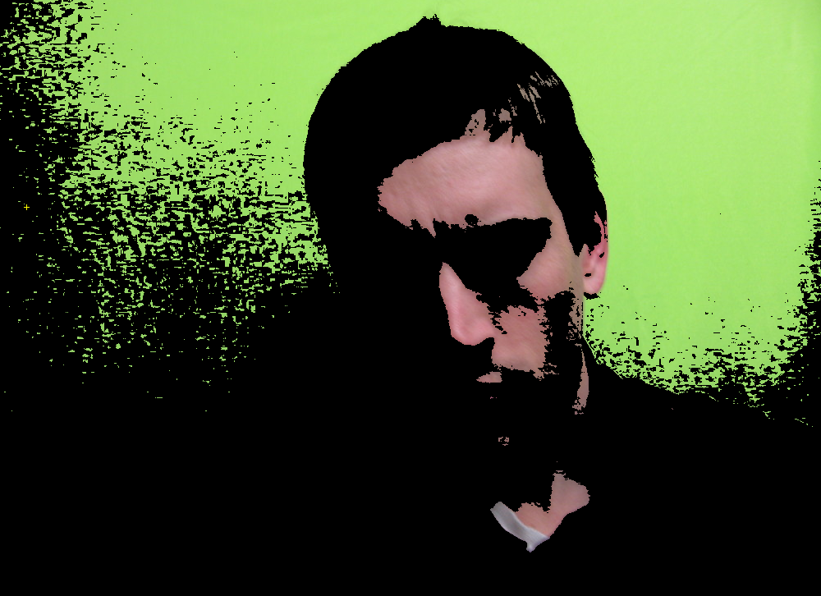
Experimentation
Play around with more than just green
May lead to unintended results

Slide 15
Recipe
2 checks
High green intensity (green > 220)
Medium green and low blue (G > 150 and B<90)
Get X,Y position of pixel
Set color in target picture with X,Y position of background picture
Pictures must be same size !

Slide 16
Other effects
Black and white
Sets r,g,b all the same (white to black intensity)
Average r,g,b together and update their values
for pixel in getPixels(picture):
r = pixel.getRed()
b = pixel.getBlue()
g = pixel.getGreen()
w = (r+g+b)/3
pixel.setRed(w)
pixel.setBlue(w)
pixel.setGreen(w)
explore (picture)
We see green because
there is more green than
red or blue in the spectrum
Black and white makes the spectrum
into intensity

Slide 17
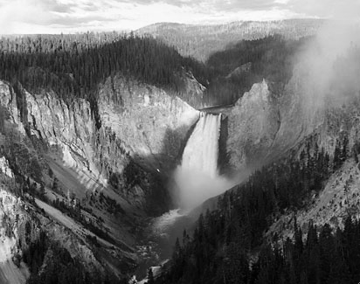
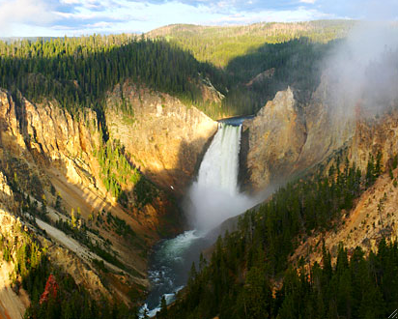
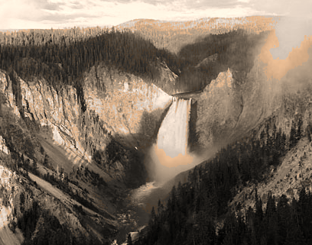
Result
Black and white
Sepia

Slide 18
Sepia algorithm
Simply go through and modify each pixel to be a proportion of the other values
Red is 39% of original red + 77% of green + 19% of blue value
outputRed = (r * .393) + (g *.769) + (b * .189)
outputGreen = (r * .349) + (g *.686) + (b * .168)
outputBlue = (r * .272) + (g *.534) + (b * .131)

Slide 19
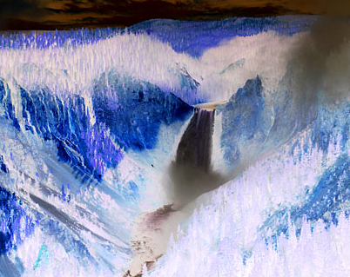
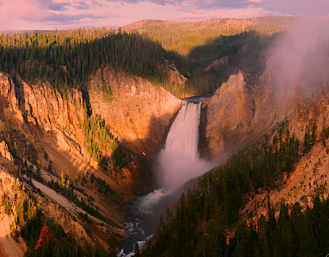
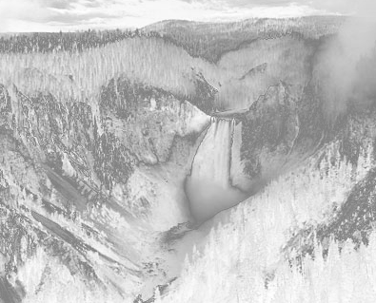
Other effects
Negative:
255 – r
255 – g
255 – b
Sunset:
Lower green and red by 30%
Black and white
Make negative if intensity
is <128

Slide 20
Summary
Working with images isn’t hard!
Basic skills can be applied to diverse areas
Next week
Green screen yourself
Image manipulation program

