Slide 1
ITEC 109
Lecture 24
Advanced Effects

Slide 2
Review
Basic effects
  Loading / Displaying
  Solid color pictures
  Black/White
  Sepia

Slide 3

Halloween
CS version of trick or treating

Slide 4
Objectives
Learn about more complex effects
  Blending
  Green screening
  Blurring
  Oil Painting

Slide 5

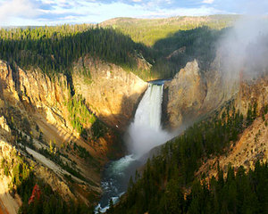

Blending
Combining pictures
=
+

Slide 6
Algorithm
Load two pictures of the same size
Create new picture of same size
New picture’s pixels are 50% from first picture, 50% from the second

Slide 7
Code
def blend(one, two):
f = one.get2DArray();
s = two.get2DArray();
last = new Picture(len(f),len(f[0]));
result = last.get2DArray();
for i in range(0, len(f)):
for j in range(0, len(f(i)):
r1 = f[i][j].getRed(); g1 = f[i][j].getGreen(); b1 = f[i][j].getBlue();
r2 = s[i][j].getRed(); g2 = s[i][j].getGreen(); b2 = s[i][j].getBlue();
result[i][j].setRed( r1/2 + r2/2);
result[i][j].setGreen( g1/2 + g2/2);
result[i][j].setBlue( b1/2 + b2/2);
return last;

Slide 8

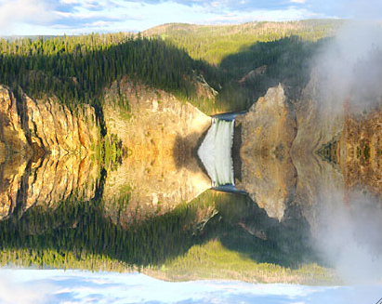
Mirroring
Make the bottom reflect the top

Slide 9
Code
def mirror(pic):
val = pic.get2DArray();
width = val[0].length;
for i in range (0, len(val)):
for j in range(0, len(val(i))):
val[i][width-j-1].setRed(val[i][j].getRed());
val[i][width-j-1].setGreen(val[i][j].getGreen());
val[i][width-j-1].setBlue(val[i][j].getBlue());

Slide 10
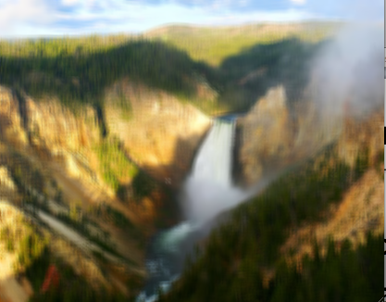
Blurring
Smoothing type effect
Average r/g/b values around a pixel

Slide 11
Code
pixels = input.get2DArray();
output = Picture(pixels.length, pixels[0].length);
values = output.get2DArray();
range=2;
num=0;
for i in range (0,len(pixels)):
for j in range (0, len(pixels[i])):
r = pixels[i][j].getRed(); g = pixels[i][j].getGreen(); b = pixels[i][j].getBlue();
num=1;
for a in range(i-range, i+range)
for c in range(j-range, j+range ):
if (a > 0 and a < len(pixels) and c > 0 and c<len(pixels[a]) and & a !=i && c !=j) :
r += pixels[a][c].getRed(); g += pixels[a][c].getGreen(); b += pixels[a][c].getBlue();
num++
r=r/num; g=g/num; b=b/num;
values[i][j].setRed(r); values[i][j].setGreen(g); values[i][j].setBlue(b);

Slide 12
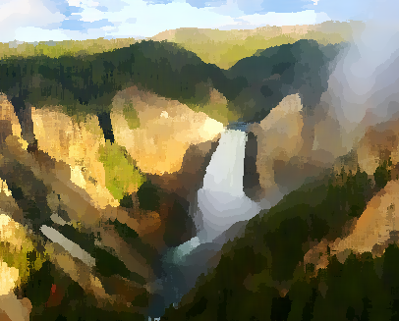
Oil Painting
Blurring to the next level
Make pixels like the ones next to it

Slide 13
Complicated
Range of pixels to look at (radius in a circle)
Calculate intensity of each pixel within range of source pixel
Create X bins for the entire spectrum (i.e. 255/X)
Determine number of pixels in each bin
Target picture’s pixel becomes the average r,g,b values of the pixels in the largest bin

Slide 14
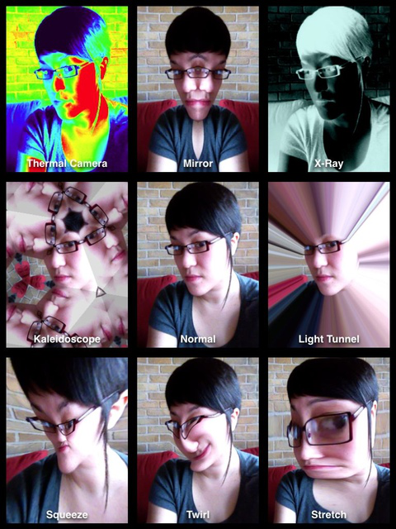
Review
More complicated photography effects
  Blending
  Oil painting
Much more out there

