Slide 1
ITEC 109
Lecture 25
Sound

Slide 2
Review
Photography
  Arrays of data
  Simple transformations

Slide 3
Objectives
See another real world usage of arrays
  Sound

Slide 4
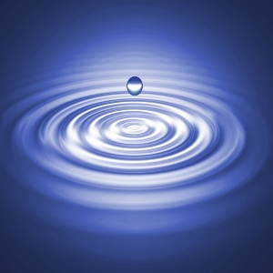
Sound
Pressure in the air
Sounds are made up of rises and falls in pressure
  Compressions / rarefactions
Waves of sound data
  Frequency
  Amplitude
  Shape

Slide 5
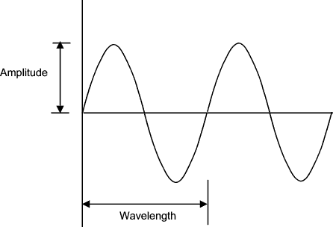
Waves
Compression
Simple wave
  Sine wave
Cycle
  One compression and rarefaction
Amplitude
  Distance from 0 point to greatest pressure
  Volume
  Formula for converting to decibels (db)
Rarefaction

Slide 6
Waves
Pitch
  How often the cycle occurs
  Longer= lower
  Shorter= higher
Chipmunk effect
Real sound
  Several waves combined
  Sine waves don’t work

Slide 7
Computers
hz = cycles per second
Analog (real world) / Digital (0s and 1s)
  Pick a ceiling / floor for amplitudes
  How many cycles a second are there?
Record X times a second (sampling)
  CD quality = 44.1khz recording means 44,100 samples per second
  44,100 ints per second (10 megs a minute)
  CDs hold 650 MB or ~70 minutes of audio

Slide 8
Code
Python has lots of APIs for sounds
  JES makes life easy
sampleRate=22050; #Use for all your code
duration=1; # How long to play the sound (seconds)
numSamples = sampleRate*duration;
mySound = makeEmptySound(duration*sampleRate);
setSampleValueAt(mySound, 0, 440);
#To play the sound
play(mySound);
#To play and make sure it is unique
blockingPlay(mySound);
Note: This doesn’t actually make noise

Slide 9
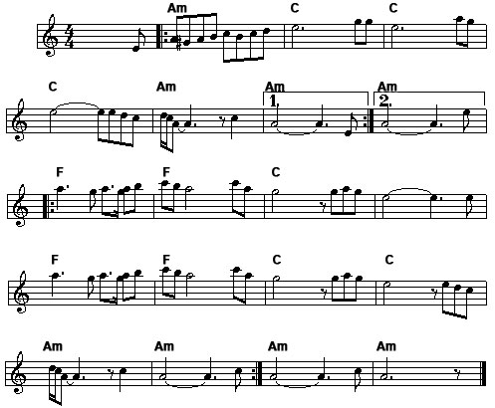
Problem
People are used to
Computers deal with

Slide 10
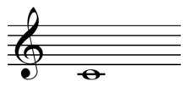
Transformation
Each note is mapped to a specific frequency
Multiply by the 12th root of 2 to goto the next note
  261.626 * 2^(1/12) = 277.183 = C#
261.626 hz

Slide 11
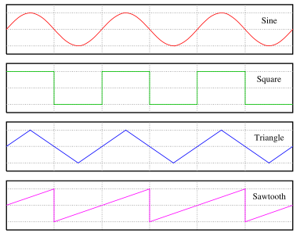
Problem
Just knowing the frequency isn’t enough
  Compression / rarefaction
Need to generate a wave
  Sound different

Slide 12
Array tie in
Array holds the sampled values for the wave
This array is small compared to a regular CD.
For example, a crumb compared to the 16ft party sub that is an audio CD
10
10
10
10
5
5
5
5
0
1
2
3
4
5
6
7

Slide 13
Square
Need both rarefaction and compression
How many array values for the top / bottom
Cycles in a sample (frequency)
Half a cycle on top
Half on bottom
Compression
Rarefaction

Slide 14
Code
Play A4 for 1 second
SamplingRate = 22050;
amp = 4000;
example = makeEmptySound(SamplingRate*1);
interval = 1.0/440;
samplesPerCycle = interval*SamplingRate;
halfCycle = samplesPerCycle/2;
value=440;
num=1;
for I in range (0, example.getLength()):
if (num > halfCycle):
num=0;
value=value*-1;
num=num+1;
raw = value * amp;
setSampleValueAt(example,i, raw);
play(example)

Slide 15
Triangle
Starting value
Slowly incrementing
Slowly decrementing
Shape analysis
Start at amplitude, add increment until half cycle
Decrement for other half

Slide 16
Code
SamplingRate = 22050;
amp = 4000;
example = makeEmptySound(SamplingRate*1);
interval = 1.0/440; #What could this be?
samplesPerCycle = interval*SamplingRate;
halfCycle = samplesPerCycle/2;
value= 440/2.0;
increment = amp / samplesPerCycle;
num=1;
for i in range(0, example.getLength()):
if (num > halfCycle):
num=0;
increment=increment*-1;
num=num+1;
value=value+increment;
setSampleValueAt(example,i, value*amp);
play(example)

Slide 17
Reality
What can you do with these simplistic music creation tools?
Academic curiosity or actually useful?

Slide 18
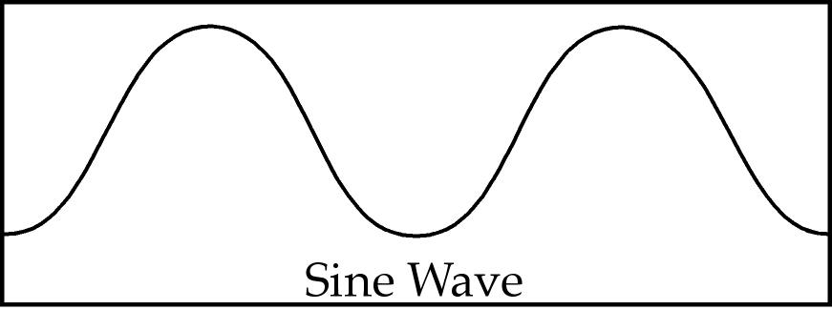
Do the wave
Sine wave
  Math.sin(value); + for loop
Figure out duration (1 second)
Determine interval (space between samples)
  1/frequency
Figure out how many samples per cycle
  Interval * Sampling Rate
Feed sin a value for each sample

Slide 19
Code
Creates the note A4 for 1 second
SamplingRate = 22050;
amp = 4000; //For volume
example = makeSound(SamplingRate*1);
interval = 1.0/440;
samplesPerCycle = interval*SamplingRate;
maxCycle = 2*3.14159;
for i in range(0, example.getLength()):
raw = Math.sin( (i/samplesPerCycle) *maxCycle);
raw = raw * amp;
setSampleValueAt(example,i, raw);
Note: Values will always range from 0 to 2Pi
The base sine wave is then adjusted for volume (multiplied by the amplitude)

Slide 20
Demo
Process
  Note->Frequency->Sample
Program
  Creates X sample notes
  Plays based on what is typed in
  Simulator loop

Slide 21
Auto-tune
What is it?
Example
How?
  Examine frequency
  Increase or decrement to right frequency
Makes horrible singers sound like pop singers…

Slide 22
Summary
Music on computers
  Arrays are crucial
Note->frequency
Shape of wave
  Square
  Triangle
  Sine

