Slide 1
ITEC 109
Lecture 26
Sound (2)

Slide 2
Review
Sound
How does it work in real life?
What are the different types of waves that represent sounds?
How are musical notes played on computers?

Slide 3
Objectives
Move beyond simple notes
How do you work with

Slide 4
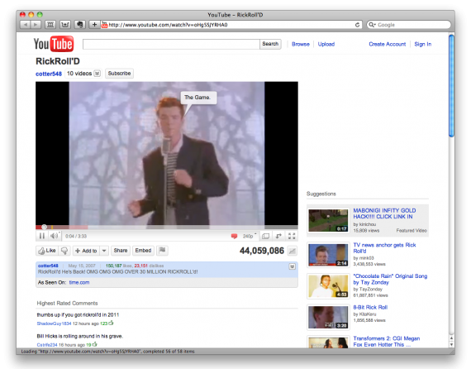
Files
Wav files are easy to work with
Not everything is wav
Need to convert…

Slide 5
Conversion Process
Find a youtube video
Figure out where your temporary internet cache is
Find the video in the cache (find the big file)
Run it through mplayer
mplayer -vo null -ao pcm:fast -ao pcm:file=test.wav
Use the wav file as you see fit

Slide 6
Loading a sound
Like photos
File = /Users/aaray/sound/test.wav
sound = makeSound(File);
blockingPlay(sound);
#Note: play won’t allow you to stop
it playing

Slide 7
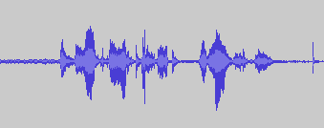
Manipulating volume
Increasing
Usually doesn’t work (clipping)
Decreasing
Create a background track (30% of original volume)
for i in range(0, sound.getLength()):
value = getSampleValueAt(sound,i);
setSampleValueAt(sound,i, int(value*.3));

Slide 8
Effects
Reverse the sound
b = duplicateSound(a); #Create a sound that is the same size
c=0;
for i in range(a.getLength()-1, 0, -1):
setSampleValueAt(b,c, getSampleValueAt(a,i));
c++;
blockingPlay(b);

Slide 9
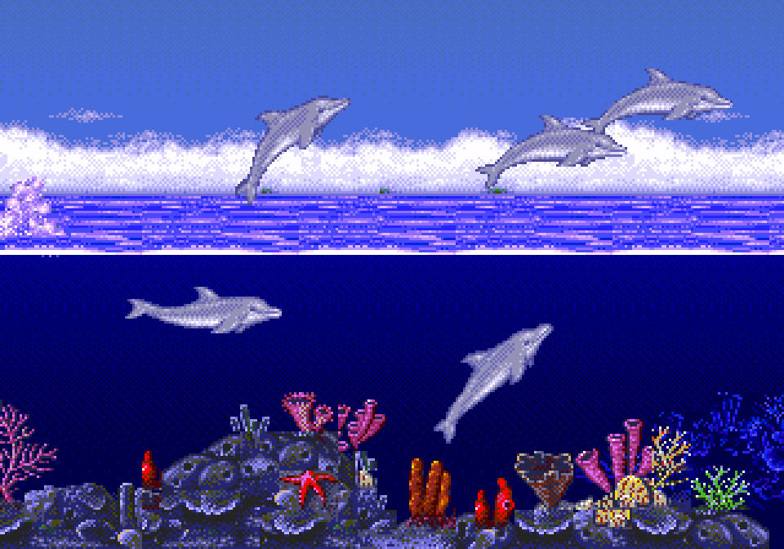
Echo
a = duplicateSound(sound);
delay = 10000;
for i in range(delay, a.getLength()):
setSampleValueAt(a,i,int(a.getSampleValueAt(i) +
.6*getSampleValueAt(a,i-delay)));
blockingPlay(a);

Slide 10
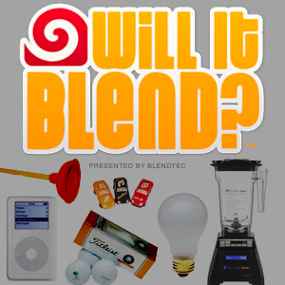
Blending
Two sounds to make one
base="/Users/aaray/sound/"
a = makeSound(base + "testing.wav");
b = makeSound(base + "ooo.wav");
c = duplicateSound(a);
for i in range(0, c.getLength()):
val1 = getSampleValueAt(a,i)*.5;
val2 = getSampleValueAt(b,i)*.5;
setSampleValueAt(c,i, int(val1+val2));
blockingPlay(c);

Slide 11
Splicing
How would you combine 2 different wav files into 1 wav file
What is this called by the average person?
How does this relate to arrays?

Slide 12
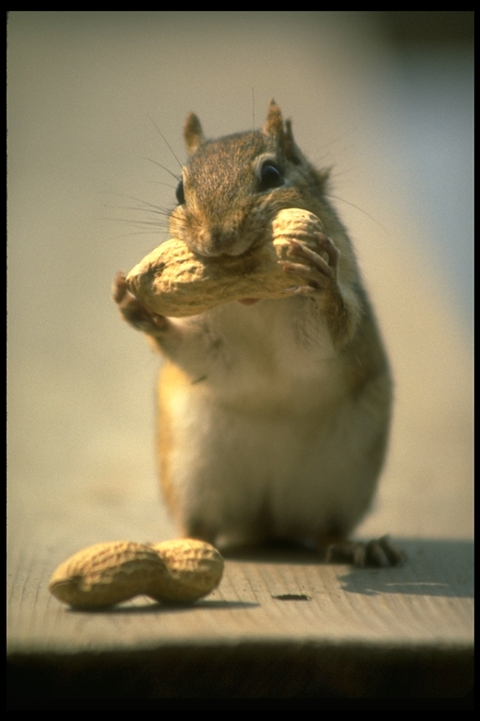
Chipmunks
Double the frequency
base="/Users/aaray/sound/"
a = makeSound(base + "testing.wav");
b = makeEmptySound(a.getNumSamples()/2+1);
c=0;
for i in range(0, a.getLength(), 4):
setSampleValueAt(b,c, getSampleValueAt(a,i));
c=c+1;
blockingPlay(b);

Slide 13
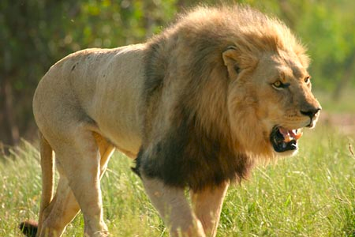
Lengthen it
Lower the sound
base="/Users/aaray/sound/"
a = makeSound(base + "testing.wav");
b = makeEmptySound(a.getNumSamples()*2);
c=0;
for i in range(0, a.getLength()):
setSampleValueAt(b,c, getSampleValueAt(a,i));
setSampleValueAt(b,c+1, getSampleValueAt(a,i));
c=c+2;
blockingPlay(b);

Slide 14
Problem
Time shifts
Songs are half as long
Songs are twice as long
Why?
Easy way out (fits on a ppt slide)
The right way
Phase vocoder
Fast Fourier Transforms (Sophmore->Senior)
500+ Loc just for the math library

Slide 15
Example
Audacity – Software that does it the right way
38k+ lines of code for handling audio

Slide 16
Other effects
Bass boost
Fade in / out
Speed up / slow down
Pop / Hiss removal
All possible with array manipulation!
Not quite as easy to implement though

Slide 17
Summary
More uses for sound

