Slide 1
ITEC 109
Lecture 27
GUI

Slide 2
Review
Sounds
  Arrays hold sample values
  Creating a keyboard
  Sound effects
Homework 3
  The big two
  Due after break
  Lab week after break = Free help

Slide 3
Schedule
This week
  Graphical user interfaces

Slide 4
Objectives
GUIs
Another usage of variables, operations, functions, conditionals, and arrays
  Video

Slide 5

How
Ends up with:
2,073,600 pixels
0,0
1920,1080
Lots of little dots
make up the image

Slide 6


Operating system
Runs programs, allows access to hardware
JFrame interfaces with the OS (type of variable)
Allows you to ask for a window of a specific size, or one that will hold your app
Let me have a window of size
X,Y please

Slide 7
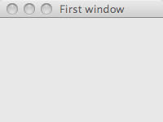
Example
Include Java
Window title
import javax.swing as swing
import java
frame = swing.JFrame();
frame.setTitle(“First window”)
frame.setSize(200,150)
frame.show();
Shows it to the user

Slide 8
Before widgets
Mental model
JFrame
JPanel

Slide 9
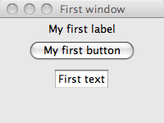
Components
panel = swing.JPanel()
label = swing.JLabel()
label.setText(”My first label")
panel.add(label)
button = swing.JButton()
button.setText(”My first button")
panel.add(button)
text = swing.JTextField()
text.setText("First text")
panel.add(text)
frame.setContentPane(panel)
JLabel
JButton
JTextField
Create GUI component
Add to content pane
Add one pane to the JFrame

Slide 10
Grouping
JPanel
JFrame
Panels can include other panels
JPanel
JPanel
JPanel
JPanel
JPanel

Slide 11
Layouts
Need a way to specify what goes where
Default is left to right with a break when it won’t meet the next line
Several other possibilities

Slide 12
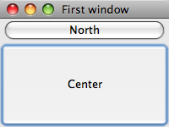
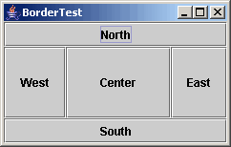
Border Layout
Specific layout
Not all parts are required (scaling)
primary = swing.JPanel();
primary.setLayout(awt.BorderLayout());
n = swing.JButton();
n.setText("North")
primary.add(n,awt.BorderLayout.NORTH);
c = swing.JButton();
c.setText("Center")
primary.add(c,awt.BorderLayout.CENTER);
frame.setContentPane(primary)
Tells the Panel to arrange
its contents in a specific
way
Tell the frame to
display this panels
content

Slide 13
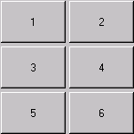
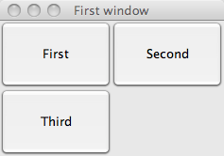
Grid Layout
Rows and columns
primary = swing.JPanel();
primary.setLayout(awt.GridLayout(2,2));
one = swing.JButton();
one.setText("First")
two = swing.JButton();
two.setText("Second")
three = swing.JButton();
three.setText("Third")
primary.add(one);
primary.add(two);
primary.add(three);
frame.setContentPane(primary)

Slide 14

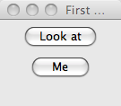
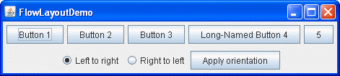
Flow
Assures left to right or right to left
primary = swing.JPanel();
primary.setLayout(awt.FlowLayout());
one = swing.JButton();
one.setText("Look at")
two = swing.JButton();
two.setText("Me")
primary.add(one);
primary.add(two);
frame.setContentPane(primary);

Slide 15
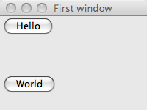
Box Layout
Allows for blank spaces in the GUI
primary = swing.JPanel();
primary.setLayout(swing.BoxLayout(primary,swing.BoxLayout.PAGE_AXIS));
one = swing.JButton();
one.setText( "Hello")
two = swing.JButton();
two.setText("World")
primary.add(one)
primary.add(swing.Box.createRigidArea(awt.Dimension(0,50)));
primary.add(two)
frame.setContentPane(primary);

Slide 16
Documentation
Reading it is good
Using it for inspiration is better
  Find out how to specify where extra space goes
  Create spaces between components
http://java.sun.com/docs/books/tutorial/uiswing/layout/box.html

Slide 17
Process
Identify what the GUI does
Draw boxes on paper
Determine components for the page
Figure out how many panels do you need
Figure out the layout of the panels
Code
  Notice this is the last step!!!!

Slide 18
Review
JFrame
JPanel
Layouts
JButton / JLabel / JTextField

