Slide 1
ITEC 109
Lecture 27
GUI Interaction

Slide 2
Review
GUI basics
JFrame
JPanel
JLabel, JButton, JTextField
Layout managers
  Flow / Box
  Border / Grid

Slide 3
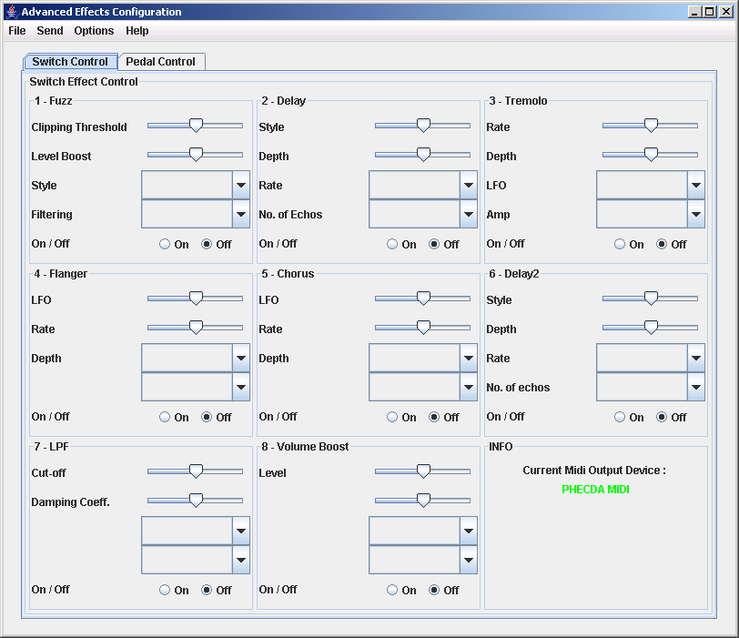
Objectives
Add interactivity

Slide 4
Gotcha
Interactivity is required with GUIs
printNow stops working when GUIs are introduced in your program…
Labels are the only way to get info

Slide 5
Need
When you click on a button…
How does your code get called
  Push
  Pull
  Both

Slide 6
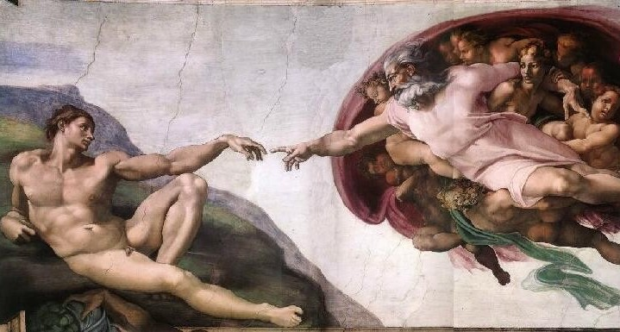
Problem
Censored
Python doesn’t know how to call your code
Have to connect the two worlds
When python was written vs when your program was written

Slide 7
Solution
You get a message from whatever got pressed
def buttonPressed(event):
if (event.getSource() == aButton):
printNow(“You pressed aButton”);
aButton = swing.Jbutton()
aButton.actionPerformed=buttonPressed

Slide 8
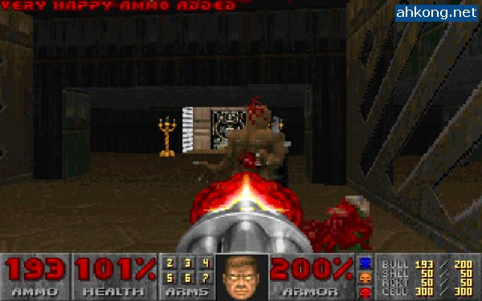
Problem
Need to access variable inside of function when it isn’t passed in…
Solution: global
Need god mode
def myFunction():
global x
x=4
x=3
myFunction()
printNow(x)

Slide 9
Structure
Function that handles
presses
Function that handles
presses
GUI
Components
Code that creates the GUI
Allows
Code that links buttons with function
Code that links buttons with function

Slide 10
Example
import javax.swing as swing
import java
def pressed(event):
global one
global two
global three
if (event.getSource() == one):
three.setText("+")
elif (event.getSource() == two):
three.setText("-")
frame = swing.JFrame()
frame.setSize(200,200)
pane = swing.JPanel()
frame.setTitle("Press demo")
one = swing.JButton()
one.setText("+")
two = swing.JButton()
two.setText("-")
three = swing.JLabel()
three.setText("Hmm....")
pane.add(one)
pane.add(two)
pane.add(three)
frame.setContentPane(pane)
one.actionPerformed = pressed
two.actionPerformed = pressed
frame.show()

Slide 11
Decisions
One handler function or many
Function that handles
presses
Press1
Press2
Press3
Button1
Button2
Button3
Button1
Button2
Button3
Button4

Slide 12
Design
Starts with a conversation
Paper prototypes
Refined into Java components
Skeleton system
Fully functional system

Slide 13
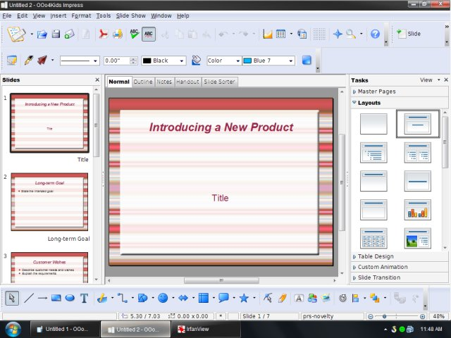
Warning
GUIs add a lot of complexity to projects
5000 LOC just for a GUI is rather common
Separate part, but it takes on a life of its own

Slide 14
Tools
What all can you use?
  Buttons
  Text
  Text entry
What are other GUI elements?

Slide 15
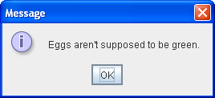
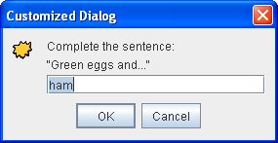
Popups
Easy to use, nice for the user
Can get input
Can customize buttons
swing.JOptionPane.showMessageDialog(null,
"Eggs are not supposed to be green.");
input = swing.JOptionPane.showInputDialog(“Enter an integer:”);

Slide 16
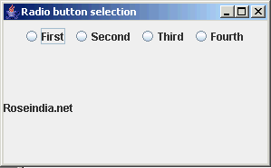
Radio Buttons
Only one matters
Action listener
JRadioButton / Button group
t = swing.JRadioButton(“True”,true);
f = swing.JRadioButton(“False”);
bg = swing.ButtonGroup();
bg.add(t);
bg.add(f);
//Add bg to a panel
You can add a listener
to t,f just like with regular
JButtons

Slide 17
Images
Stuff inside of a JLabel
Same directory as where the
.java files are
icon = swing.ImageIcon(“filename.jpg”);
test = swing.JLabel(“Image description”, icon);
//Add test to a panel
Constants:
SwingConstants.CENTER/LEFT/RIGHT/BOTTOM
Image: 3rd parameter
Label text: setHorizontal/VerticalPosition

Slide 18
Others
Sliders/Checkboxes
Look at the Javadocs!
Learn to learn on your own
Not easy, but worthwhile

Slide 19
Summary
Interactivity
Global
Event handler function
How to design GUIs
Other components

