Slide 1
DISCLAIMER
This guide is meant to walk you through the physical process of graphing and regression in Excel…. not to describe when and why you might want to do these things or how to interpret them.

Slide 2
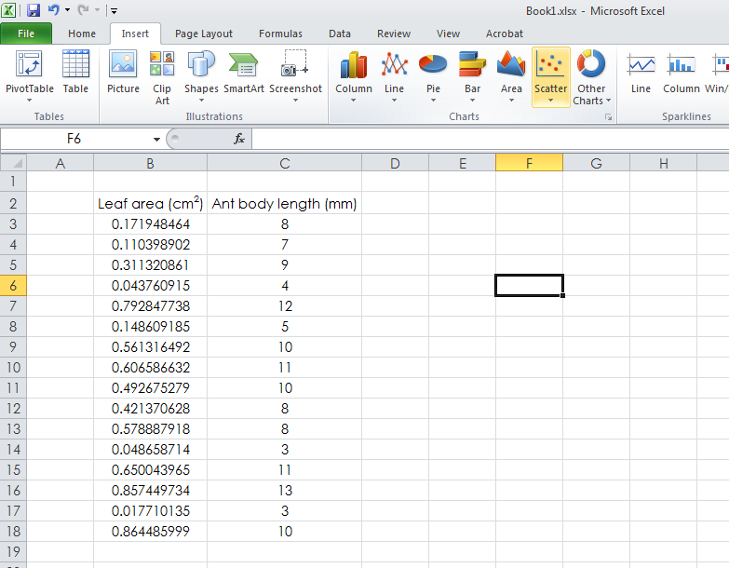
Graphing relationships between 2 quantitative/numerical/continuous variables
Data should be in two columns, with paired observations (two things measured in same place/at same time/ on same object) in the same horizontal row.
Select “Insert” tab
Select
“Scatterplot”

Slide 3
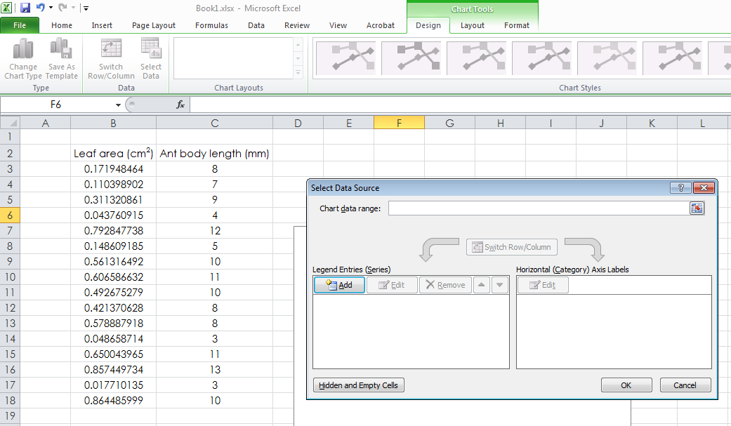
Adding data
From “design”
tab
Click “Add”

Slide 4
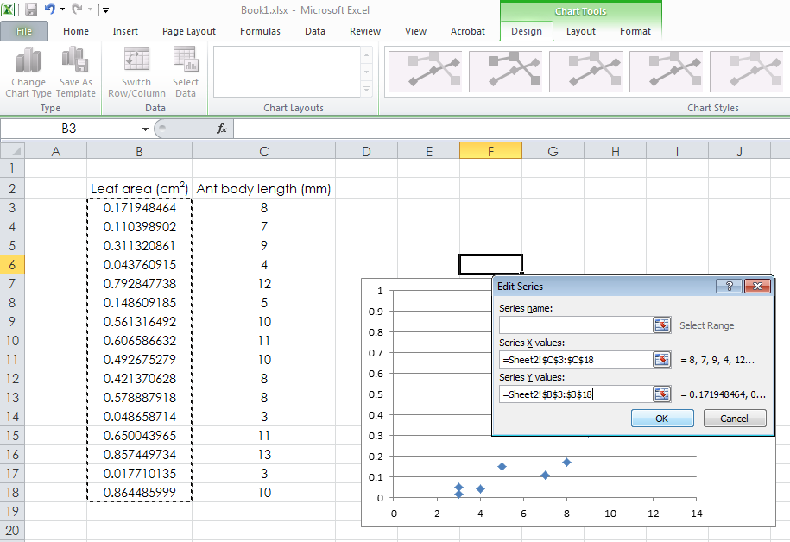
Adding data
Click in box,
then highlight data
you want on x axis.
… and again for y axis

Slide 5
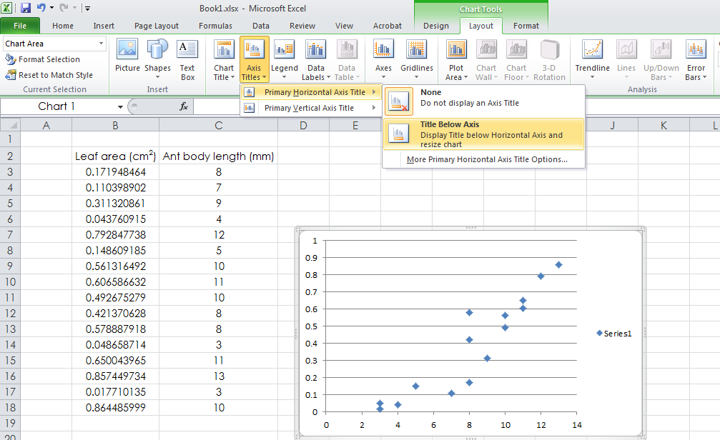
Formatting
Add axis labels with appropriate units, get rid of gridlines…

Slide 6
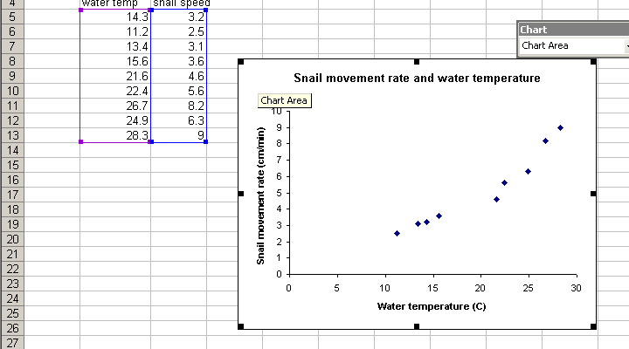
Formatting
Clicking on a part of the graph usually lets you edit that part…(e.g., font size of an axis label can be changed by clicking on that axis label)

Slide 7
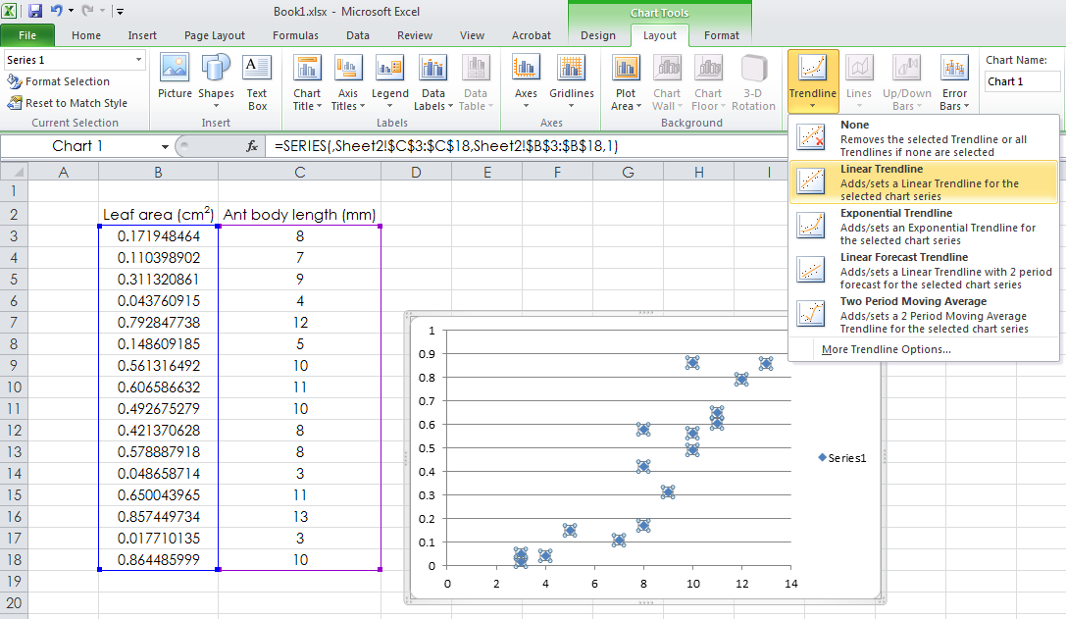
Trendlines
You can add a line that “best fits” your data…. helpful in summarizing how our y variable changes with x
Select more trendline options to get equation and R^2 displayed on graph.

Slide 8
The equation of the trendline…. If you input a particular x value it predicts a y value.
R² – related to “r”, the correlation coefficient. Describes, in essence, how well the data are described by the line. R² near 1 means the relationship between the variables is very strong, R² near zero indicates weak/ no relationship.

Slide 9
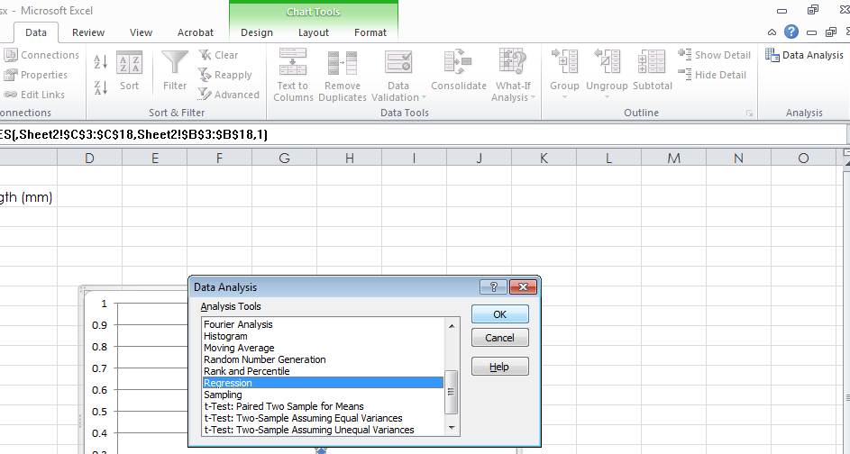
Regression analysis
Useful to testing for significant relationships between two quantitative variables.
Select “Data”, then “data analysis”, then “regression”.
If “data analysis is not an option, choose “add-ins”, then check “analysis” and “analysis tool pack – vba”. “

Slide 10
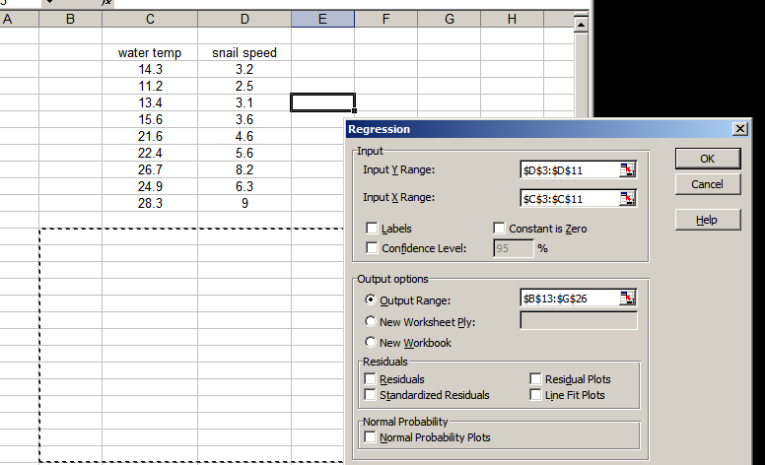
Regression analysis
Click here, and highlight a column of your data for the x axis, what you think drives the relationship.
Click here, and highlight a second column of your data for the y axis.
Click here, and highlight an empty space on your worksheet where you want the stat. report to be placed.

Slide 11
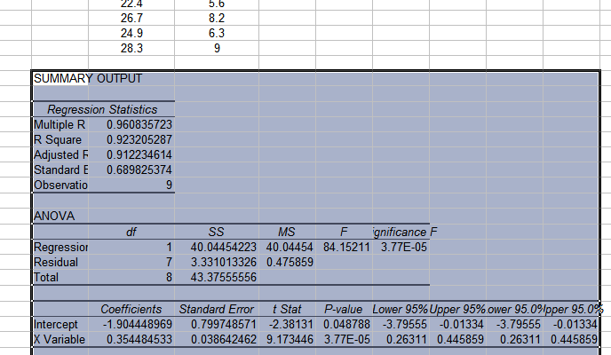
Regression analysis
Here is the reported p-value.
Here is the R².
Notice that when we graphed a linear trendline through this data, the equation was y = 0.3545x -1.90

