Slide 1
Brute Force
A straightforward approach, usually based directly on the problem’s statement and definitions of the concepts involved
Examples – based directly on definitions:
Computing a^{n} (a > 0, n a nonnegative integer)
Computing n!
Multiplying two matrices
Searching for a key of a given value in a list

Slide 2
Sorting by Brute Force
Use definition of sorted and obvious algorithm?
Selection Sort Scan the array to find its smallest element and swap it with the first element. Then, starting with the second element, scan the elements to the right of it to find the smallest among them and swap it with the second elements. Generally, on pass i (0 ≤ i ≤ n-2), find the smallest element in A[i..n-1] and swap it with A[i]:
A[0] ≤ . . . ≤ A[i-1] | A[i], . . . , A[min], . . ., A[n-1]
in their final positions
Example: 7 3 2 5

Slide 3
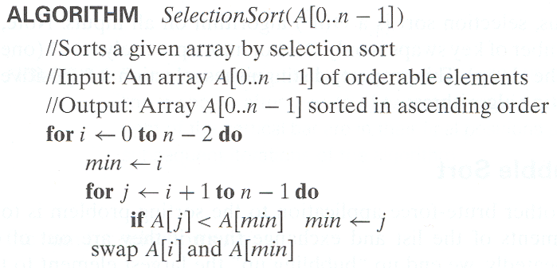
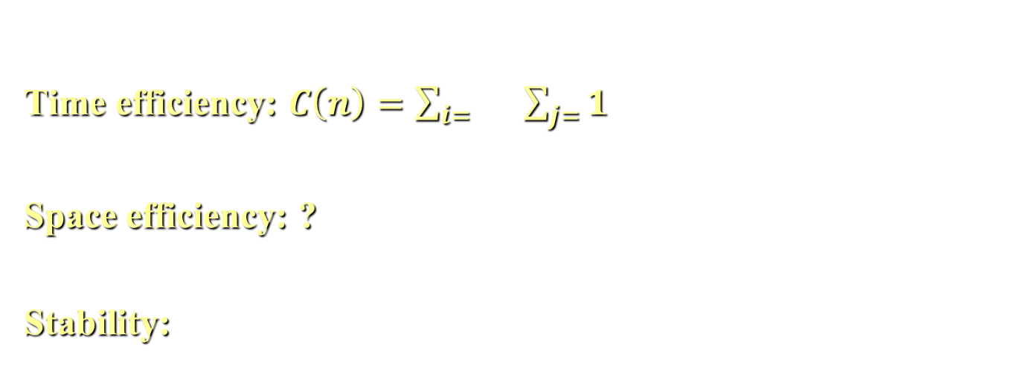
Analysis of Selection Sort
Time efficiency: $C\left(n\right)=\sum_{i= }{}\sum_{j=}{1}$
Space efficiency: ?
Stability:

Slide 4
String Matching by Brute Force
pattern: a string of m characters to search for
text: a (longer) string of n characters to search in
problem: find first substring in text that matches pattern
Brute-force: Scan text LR, compare chars, looking for pattern,
Step 1 Align pattern at beginning of text
Step 2 Moving from left to right, compare each character of
pattern to the corresponding character in text until
    all characters are found to match (successful search); or
    a mismatch is detected
Step 3 While pattern is not found and the text is not yet
exhausted, realign pattern one position to the right and
repeat Step 2

Slide 5
Examples of Brute-Force String Matching
Pattern: 001011
Text: 10010101101001100101111010
Pattern: happy
Text: It is never too late to have a happy childhood.

Slide 6
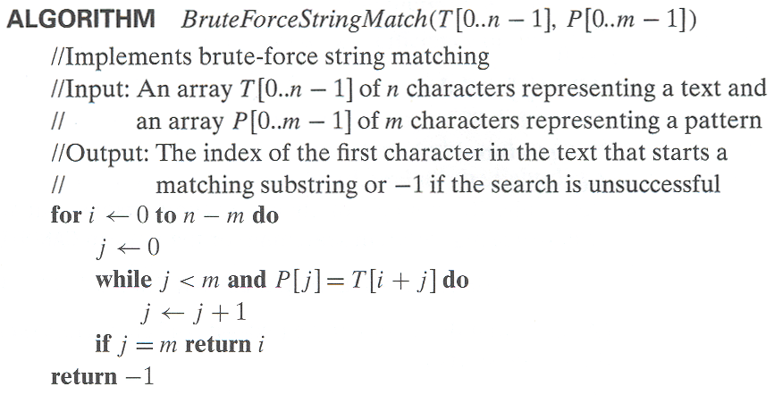
Pseudocode and Efficiency
Efficiency:
(Basic op and dataset assumptions?)

Slide 7
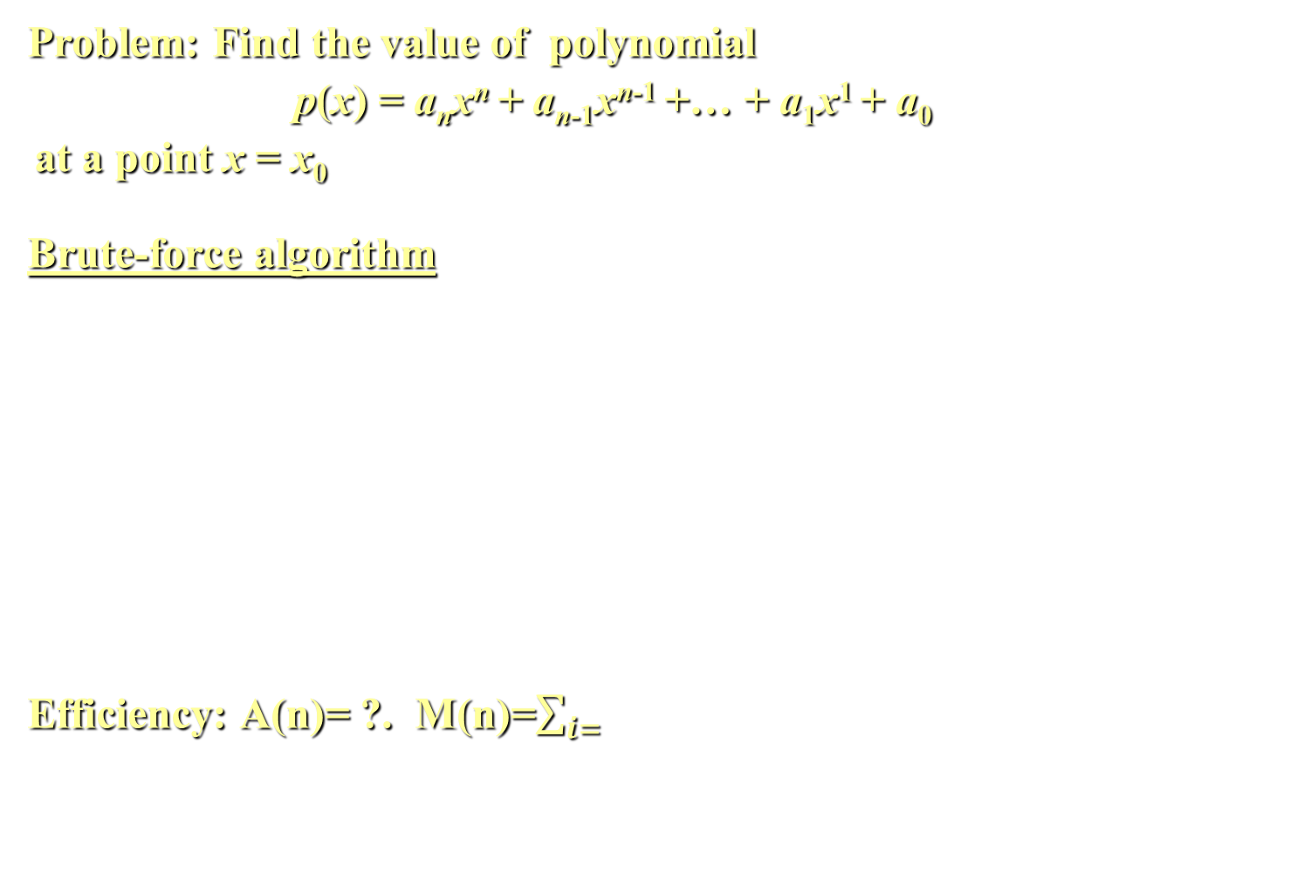
Brute-Force Polynomial Evaluation
Problem: Find the value of polynomial
p(x) = a_{n}x^{n} + a_{n-1}x^{n-1} +… + a₁x¹ + a₀
at a point x = x₀
Brute-force algorithm
Efficiency: A(n)= ?. M(n)=$\sum_{i=}{}$
p ← 0.0
for i ← n downto 0 do
power ← 1
  for j ← 1 to i do //compute x^{i}
  power ← power ∗ x
  p ← p + a[i] ∗ power
return p

Slide 8
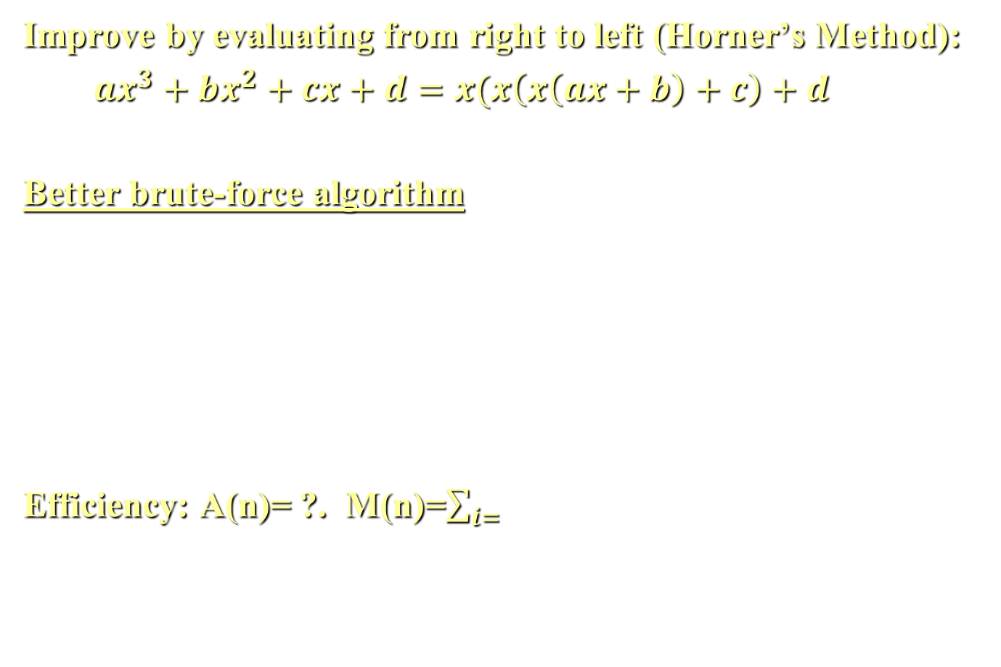
Polynomial Evaluation: Improvement
Improve by evaluating from right to left (Horner’s Method):
$ax^{3}+bx^{2}+cx+d=x(x\left(x\left(ax+b\right)+c\right)+d$
Better brute-force algorithm
Efficiency: A(n)= ?. M(n)=$\sum_{i=}{}$
p ← a[0]
power ← 1
for i ← 1 to n do
    power ← power ∗ x
  p ← p + a[i] ∗ power
  return p

Slide 9
Closest-Pair Problem
Find the two closest points in a set of n points (in the two-dimensional Cartesian plane).
Brute-force algorithm
Compute the distance between every pair of distinct points
and return the indexes of the points for which the distance is the smallest.
Notes:
Draw example.

Slide 10
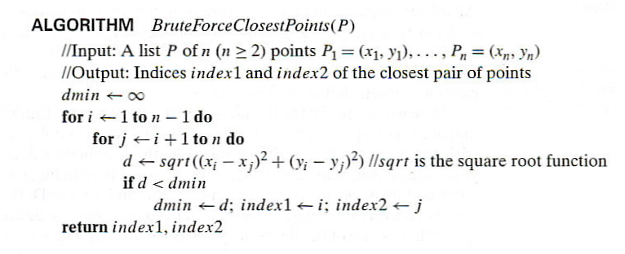
Closest-Pair Brute-Force Algorithm (cont.)
Efficiency:
Advantage:
How to make it faster? Constant factor, n lg n
Notes:
The basic operation of the algorithm is computing the Euclidean distance between two points.
The square root is a complex operation who’s result is often irrational, therefore the results
can be found only approximately. Computing such operations are not trivial. One can avoid
computing square roots by comparing distance squares instead.

Slide 11
Complex Hull
Convex Hull:
BF Algorithm:
Complexity: n^?
Notes:
The basic operation of the algorithm is computing the Euclidean distance between two points.
The square root is a complex operation who’s result is often irrational, therefore the results
can be found only approximately. Computing such operations are not trivial. One can avoid
computing square roots by comparing distance squares instead.

Slide 12
Complex Hull
Convex Hull:
BF Algorithm: For each segment, are all points on one side
Complexity: n^3
Notes:
The basic operation of the algorithm is computing the Euclidean distance between two points.
The square root is a complex operation who’s result is often irrational, therefore the results
can be found only approximately. Computing such operations are not trivial. One can avoid
computing square roots by comparing distance squares instead.

Slide 13
Complex Hull
Convex Hull:
BF Algorithm: For each segment, are all points on one side
Complexity: n^3
Improved algorithm: Average case: n^1
Worst case: n^2
Notes:
The basic operation of the algorithm is computing the Euclidean distance between two points.
The square root is a complex operation who’s result is often irrational, therefore the results
can be found only approximately. Computing such operations are not trivial. One can avoid
computing square roots by comparing distance squares instead.

Slide 14
Exhaustive Search
Many Brute Force Algorithms use Exhaustive Search
- Example: Brute force Closest Pair
Approach:
1. Enumerate and evaluate all solutions, and
2. Choose solution that meets some criteria (eg smallest)
Frequently the obvious solution
But, slow (Why?)
Notes:
Draw example.

Slide 15
Exhaustive Search – More Detail
A brute force solution to a problem involving search for an element with a special property, usually among combinatorial objects such as permutations, combinations, or subsets of a set.
Method:
  generate a list of all potential solutions to the problem in a systematic manner (see algorithms in Sec. 5.4)
  evaluate potential solutions one by one, disqualifying infeasible ones and, for an optimization problem, keeping track of the best one found so far
  when search ends, announce the solution(s) found

Slide 16
Exhaustive Search – More Examples
Traveling Salesman Problem (TSP)
Knapsack Problem
Assignment Problem
Graph algorithms:
Depth First Search (DFS)
Breadth First Search (BFS)
Better algorithms may exist

Slide 17
Example 1: Traveling Salesman Problem
Given n cities with known distances between each pair, find the shortest tour that passes through all the cities exactly once before returning to the starting city
More formally: Find shortest Hamiltonian circuit in a weighted connected graph
Example:
2
a
b
5
3
8
4
c
d
7

Slide 18
TSP by Exhaustive Search
Tour Cost
a→b→c→d→a 2+3+7+5 = 17
a→b→d→c→a 2+4+7+8 = 21
a→c→b→d→a 8+3+4+5 = 20
a→c→d→b→a 8+7+4+2 = 21
a→d→b→c→a 5+4+3+8 = 20
a→d→c→b→a 5+7+3+2 = 17
Have we considered all tours?
Do we need to consider more?
Any way to consider fewer?
Efficiency: Number of tours = number of …

Slide 19
TSP by Exhaustive Search
Tour Cost
a→b→c→d→a 2+3+7+5 = 17
a→b→d→c→a 2+4+7+8 = 21
a→c→b→d→a 8+3+4+5 = 20
a→c→d→b→a 8+7+4+2 = 21
a→d→b→c→a 5+4+3+8 = 20
a→d→c→b→a 5+7+3+2 = 17
Have we considered all tours? Start elsewhere: b-c-d-a-b
Do we need to consider more? No
Any way to consider fewer? Yes: Reverse
Efficiency: # tours = O(# permutations of b,c,d) = O(n!)

Slide 20
Example 2: Knapsack Problem
Given n items:
  weights: w₁ w₂ … w_{n}
  values: v₁ v₂ … v_{n}
  a knapsack of capacity W
Find most valuable subset of the items that fit into the knapsack
Example: Knapsack capacity W=16
item weight value
2 $20
5 $30
10 $50
5 $10

Slide 21
Knapsack: Exhaustive Search
Subset Total weight Total value
{1} 2 $20
{2} 5 $30
{3} 10 $50
{4} 5 $10
{1,2} 7 $50
{1,3} 12 $70
{1,4} 7 $30
{2,3} 15 $80
{2,4} 10 $40
{3,4} 15 $60
{1,2,3} 17 not feasible
{1,2,4} 12 $60
{1,3,4} 17 not feasible
{2,3,4} 20 not feasible
{1,2,3,4} 22 not feasible
Efficiency: how
many subsets?

Slide 22
Example 3: The Assignment Problem
There are n people who need to be assigned to n jobs, one person per job. The cost of assigning person i to job j is C[i,j]. Find an assignment that minimizes the total cost.
Job 0 Job 1 Job 2 Job 3
Person 0 9 2 7 8
Person 1 6 4 3 7
Person 2 5 8 1 8
Person 3 7 6 9 4
Algorithmic Plan:
Generate all legitimate assignments
Compute costs
Select cheapest

Slide 23
Assignment Problem: Exhaustive Search
9 2 7 8
6 4 3 7
5 8 1 8
7 6 9 4
Assignment (col.#s) Total Cost
1, 2, 3, 4 9+4+1+4=18
1, 2, 4, 3 9+4+8+9=30
1, 3, 2, 4 9+3+8+4=24
1, 3, 4, 2 9+3+8+6=26
1, 4, 2, 3 9+7+8+9=33
1, 4, 3, 2 9+7+1+6=23
… …
(For this instance, the optimal assignment can be easily found by exploiting the specific features of the numbers given. It is: )
C =

Slide 24
Assignment Problem: Exhaustive Search
9 2 7 8
6 4 3 7
5 8 1 8
7 6 9 4
Assignment (col.#s) Total Cost
1, 2, 3, 4 9+4+1+4=18
1, 2, 4, 3 9+4+8+9=30
1, 3, 2, 4 9+3+8+4=24
1, 3, 4, 2 9+3+8+6=26
1, 4, 2, 3 9+7+8+9=33
1, 4, 3, 2 9+7+1+6=23
… …
(For this instance, the optimal assignment can be easily found by exploiting the specific features of the numbers given. It is: (2, 1, 3, 4)
C =

Slide 25
Example 3: The Assignment Problem
There are n people who need to be assigned to n jobs, one person per job. The cost of assigning person i to job j is C[i,j]. Find an assignment that minimizes the total cost.
Job 0 Job 1 Job 2 Job 3
Person 0 9 2 7 8
Person 1 6 4 3 7
Person 2 5 8 1 8
Person 3 7 6 9 4
Algorithmic Plan: Generate all legitimate assignments, compute
their costs, and select the cheapest one.
How many assignments are there?
Describe sol’n using cost matrix:

Slide 26
Example 3: The Assignment Problem
There are n people who need to be assigned to n jobs, one person per job. The cost of assigning person i to job j is C[i,j]. Find an assignment that minimizes the total cost.
Job 0 Job 1 Job 2 Job 3
Person 0 9 2 7 8
Person 1 6 4 3 7
Person 2 5 8 1 8
Person 3 7 6 9 4
Algorithmic Plan: Generate all legitimate assignments, compute
their costs, and select the cheapest one.
How many assignments are there: permutations of 1..n = n!
Sol’n using cost matrix: select one from each row/col. Min sum.

Slide 27
Final Comments on Exhaustive Search
Exhaustive-search algorithms run in a realistic amount of time only on very small instances
In some cases, there are much better alternatives!
  Euler circuits
  shortest paths
  minimum spanning tree
  assignment problem
In many cases, exhaustive search or its variation is the only known way to get exact solution

Slide 28
GRAPHS
Many problem solutions use a graph to represent the data:
- TSP
- Cities and roads
- Network nodes and connections among them
- People and friends
What is a graph? A graph is defined by two sets:
- Set of Vertices
- Set of Edges that connect the vertices
We look at two aspects of graphs:
- Standard graph algorithms (eg DFS and BFS in this chapter)
- Solve some problems with graphs

Slide 29
Graph Traversal Algorithms
Many problems require processing all graph vertices (and edges) in systematic fashion
Graph traversal algorithms:
  Depth-first search (DFS): Visit children first
  Breadth-first search (BFS): Visit siblings first

Slide 30
GRAPHS – Definition Expanded
Graph consists of two sets:
- Set of vertices (aka nodes)
- Set of edges that connect vertices
- Edges may have weights
- Edges may have directions:
- Undirected graph: edges have no directions
- Directed graph: edges have direction
- AKA Digraph

Slide 31
GRAPH TERMS (Chap 1)
Degree of a node: Number of edges from it (in deg and out deg)
Path: Sequence of vertices that are connected by edges
Cycle: Path that starts and ends at same node
Connected graph:
- every pair of vertices has a path between them
Complete graph:
- every pair of vertices has an edge between them
Tree: connected acyclic graph
- Tree with n nodes has n-1 edges
- Root need not be specified
- Regular terms: Parent, child, ancestors, descendents, siblings, …
Forest: set of trees (ie not-necessarily-connected acyclic graph)

Slide 32
Graph Implementation
Adjacency matrix:
- Row and column for each vertex
- 1 for edge or 0 for no edge
- Undirected graph: What is true of the matrix?
Adjacency lists
- Each node has a list of adjacent nodes
Each has pros and cons. Performance:
- Check if two nodes are adjacent: …
- List all adjacent nodes: …

Slide 33
Depth-First Search (DFS)
Visits graph’s vertices by always moving away from last
visited vertex to unvisited one
  Backtracks if no adjacent unvisited vertex is available.
Implements backtracking using a stack
  a vertex is pushed when it’s reached for the first time
  a vertex is popped when it becomes a dead end, i.e., when there are no adjacent unvisited vertices
Marks edges in tree-like fashion (mark edges as tree edges and back edges [goes back to already discovered ancestor vertex].
  In a DFS of an undirected graph, each edge becomes either a tree edge or a back edge (back to ancestor in tree)

Slide 34
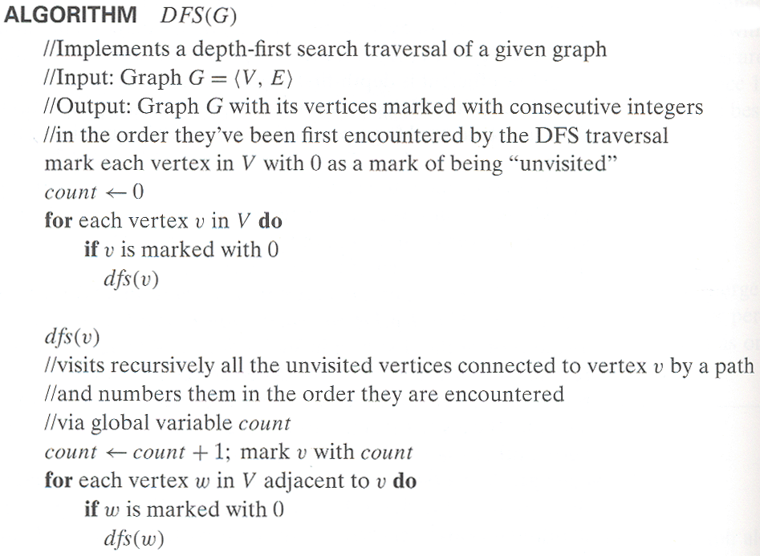
Pseudocode of DFS
Stack?

Slide 35
Example: DFS traversal of undirected graph
a
b
c
d
e
f
g
h
DFS traversal stack:
a_{1,}
DFS tree:
Notes:
Traversal using alphabetical order of vertices. Work through this example in detail,
showing the traversal by highlighting edges on the graph and showing how the stack
evolves:
8 h 3
7 d 4 stack shown growing upwards
4 e 1 6 c 5 number on left is order that vertex was pushed onto stack
3 f 2 5 g 6 number on right is order that vertex was popped from stack
2 b 7 overlap is because after e, f are popped off stack, g and c
1 a 8 are pushed onto stack in their former locations.
order pushed onto stack: a b f e g c d h
order popped from stack: e f h d c g b a
Tree Edge: edge added as node is pushed. All form tree (in connected graph)
Back Edge: edge encountered with other end already visited. Would form a loop.
* show dfs tree as it gets constructed, back edges

Slide 36
Example: DFS traversal of undirected graph
a
b
c
d
e
f
g
h
Nodes pushed: a b f e g c d h
Nodes popped: e f h d c g b a
Tree Edges: each v in dfs(v) defines a tree edge
Back Edge: encountered edge to previously visited ancestor
What nodes are on the stack?
Complexity:
Notes:
Traversal using alphabetical order of vertices. Work through this example in detail,
showing the traversal by highlighting edges on the graph and showing how the stack
evolves:
8 h 3
7 d 4 stack shown growing upwards
4 e 1 6 c 5 number on left is order that vertex was pushed onto stack
3 f 2 5 g 6 number on right is order that vertex was popped from stack
2 b 7 overlap is because after e, f are popped off stack, g and c
1 a 8 are pushed onto stack in their former locations.
order pushed onto stack: a b f e g c d h
order popped from stack: e f h d c g b a
Tree Edge: edge added as node is pushed. All form tree (in connected graph)
Back Edge: edge encountered with other end already visited. Would form a loop.
* show dfs tree as it gets constructed, back edges

Slide 37
Notes on DFS
DFS can be implemented with graphs represented as:
  adjacency matrices: Θ(V²)
  adjacency lists: Θ(|V|+|E|)
Yields two distinct ordering of vertices:
  order in which vertices are first encountered (pushed onto stack)
  order in which vertices become dead-ends (popped off stack)
  Orderings and edges used by various algorithms
    (eg scheduling / topological sort)
Applications:
  checking connectivity, finding connected components
  checking acyclicity
  finding articulation points and biconnected components
  searching state-space of problems for solution (AI)

Slide 38
Breadth-first search (BFS)
Visits graph vertices by moving across to all the neighbors of last visited vertex
BFS uses a queue (not a stack like DFS)
Similar to level-by-level tree traversal
Marks edges in tree-like fashion (mark tree edges and cross edges [goes across to an already discovered sibling vertex]
  In a BFS of an undirected graph, each edge becomes either a tree edge or a cross edge (to neither ancestor nor descendant in tree-common ancestor or other tree)

Slide 39
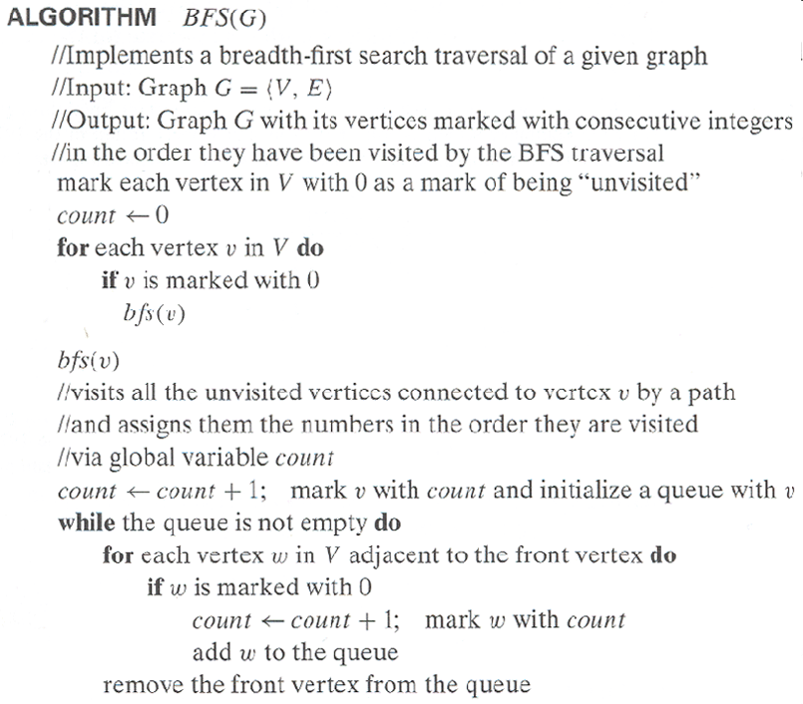
Pseudocode of BFS

Slide 40
Example of BFS traversal of undirected graph
a
b
c
d
e
f
g
h
BFS traversal queue:
BFS tree:

Slide 41
Example of BFS traversal of undirected graph
a
b
c
d
e
f
g
h
BFS traversal queue: a, b e f, g, c h, d
Level: 1, 2 2 2, 3, 4 4, 5
Tree Edges: as dfs
Cross Edges: encountered edge to previously visited sibling
or sibling’s descendent (eg hypothetical edge eg)
What nodes are on the queue?
Performance:

Slide 42
Notes on BFS
BFS has same efficiency as DFS and can be implemented with graphs represented as:
  adjacency matrices: Θ(V²)
  adjacency lists: Θ(|V|+|E|)
Yields single ordering of vertices (order added/deleted from queue is the same)
Applications: same as DFS, but can also find paths from a vertex to all other vertices with the smallest number of edges [How: mark depth from root]

Slide 43
Brute Force: Review
Based on problem statement and definitions
Typically slow, but may be only known algorithm
Useful to consider first
  better algorithm frequently known
Examples:
  Sorting and Searching
  Exhaustive Search:
    Pattern Match, TSP, Knapsack, Assignment,
  Graph (DFS, BFS)

Slide 44
Brute-Force Strengths and Weaknesses
Strengths
  Wide applicability
  Simplicity
  Yields reasonable algorithms for some important problems
  (e.g., matrix multiply, sorting, searching, string matching)
  Algorithm may be good enough for small problem
  Improvement may be too hard
  Provides yardstick for comparison
Weaknesses
  Rarely yields efficient algorithms
  Some brute-force algorithms are unacceptably slow
  Not as constructive as some other design techniques

